Slide 1
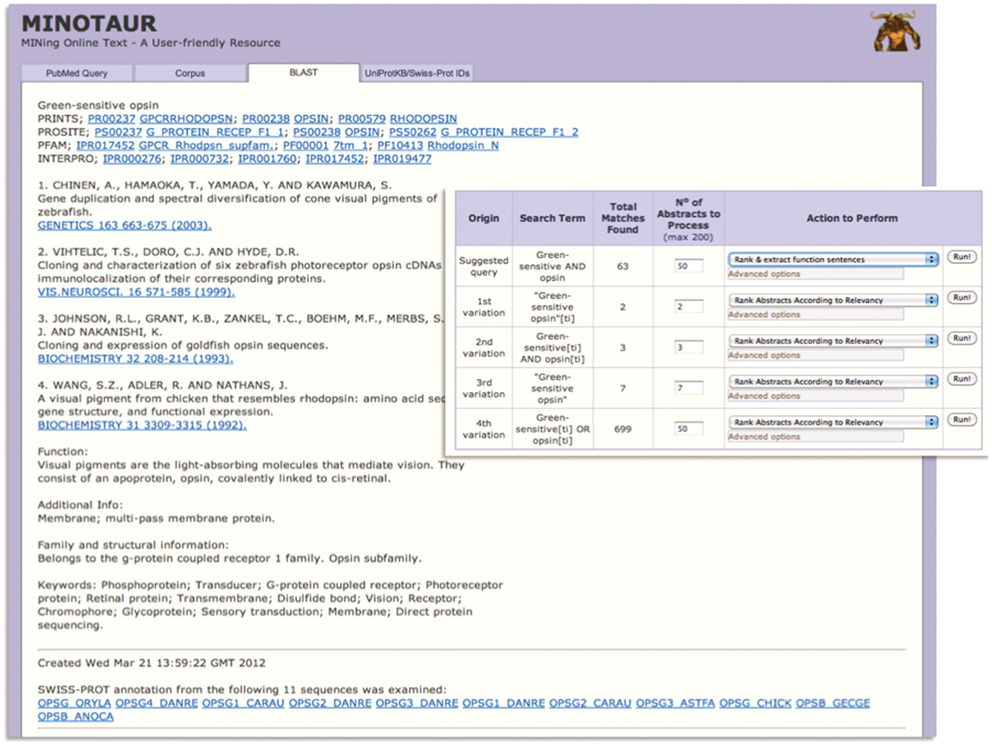
Figure 3. Using MINOTAUR to generate a PRECIS report for query sequence, Q30HW6_9CICH. The report, culled from the top ...
Notes:
Figure 3. Using MINOTAUR to generate a PRECIS report for query sequence, Q30HW6_9CICH. The report, culled from the top 11 BLAST hits, suggests the sequence is a green-sensitive opsin—accordingly, the annotation extracted from UniProtKB/Swiss-Prot relates to the function of opsins. However, the hierarchical PRINTS diagnosis suggests that the sequence is a rhodopsin. To shed light on the discrepancy, the sequence can be used to generate possible PubMed queries—the inset shows that the recommended query is ‘Green-sensitive AND opsin’, and the SVM-based ‘rank and extract function sentences’ qualifier has been selected to extract sentences from the 63 retrieved abstracts.
Unless provided in the caption above, the following copyright applies to the content of this slide: © The Author(s) 2012. Published by Oxford University Press.This is an Open Access article distributed under the terms of the Creative Commons Attribution Non-Commercial License (http://creativecommons.org/licenses/by-nc/3.0), which permits unrestricted non-commercial use, distribution, and reproduction in any medium, provided the original work is properly cited.

