Slide 1
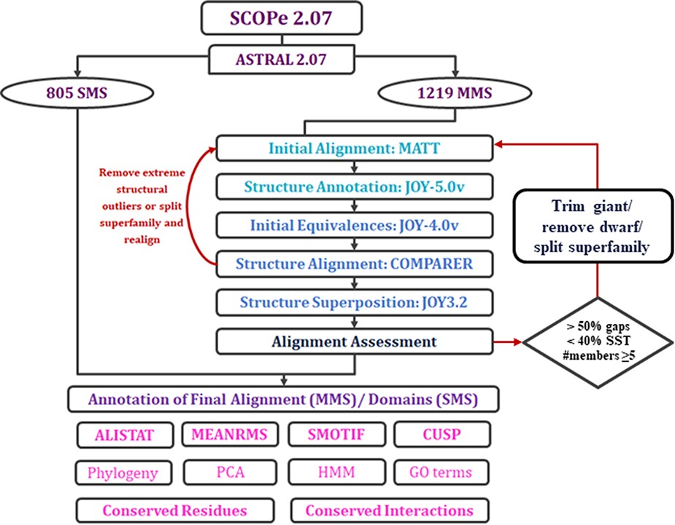
Figure 2. Workflow of PASS2.7 alignment and/or annotation of superfamily member(s). The newly added alignment ...
Notes:
Figure 2. Workflow of PASS2.7 alignment and/or annotation of superfamily member(s). The newly added alignment improvement step involves the identification of MMS with at least five members whose alignments possess >50% gap positions and <40% conservation of secondary structural elements. Clusters are identified for such cases based on a machine learning algorithm, on basis of which the alignment is improved. The additional feature available for MMS in this update is the conserved interactions.
Unless provided in the caption above, the following copyright applies to the content of this slide: © The Author(s) 2022. Published by Oxford University Press.This is an Open Access article distributed under the terms of the Creative Commons Attribution License (https://creativecommons.org/licenses/by/4.0/), which permits unrestricted reuse, distribution, and reproduction in any medium, provided the original work is properly cited.

