Slide 1
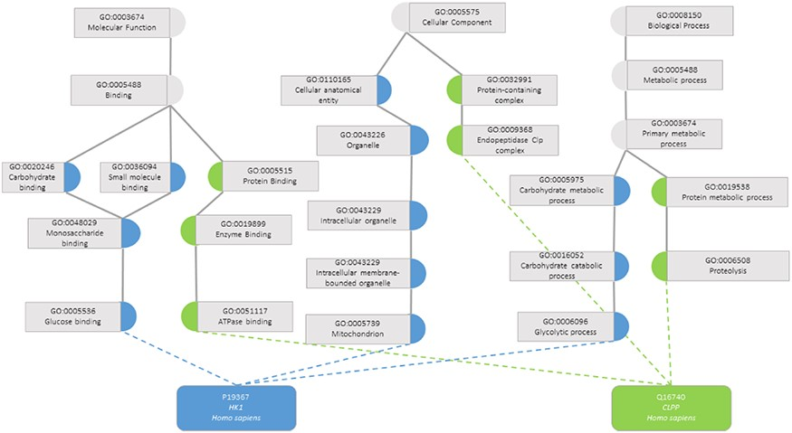
Figure 1. Semantic similarity in the Gene Ontology between proteins P19367 and Q16740. Blue circles are classes that ...
Notes:
Figure 1. Semantic similarity in the Gene Ontology between proteins P19367 and Q16740. Blue circles are classes that only annotate protein P19367, the green circles are classes that only annotate protein Q16740 and grey circles are classes that annotate both proteins.
Unless provided in the caption above, the following copyright applies to the content of this slide: © The Author(s) 2020. Published by Oxford University Press.This is an Open Access article distributed under the terms of the Creative Commons Attribution License (http://creativecommons.org/licenses/by/4.0/), which permits unrestricted reuse, distribution, and reproduction in any medium, provided the original work is properly cited.

