Slide 1
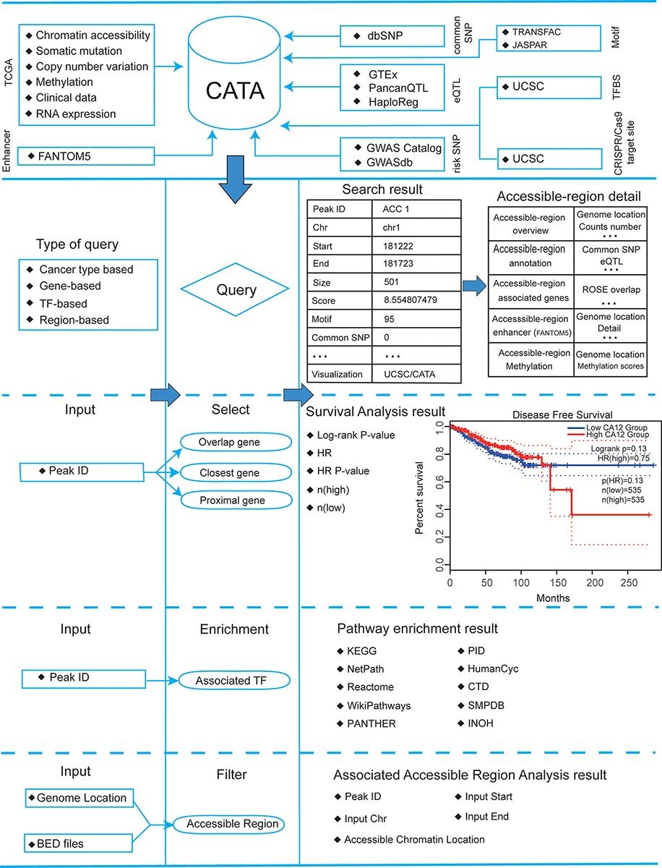
Figure 2. Database content and construction. CATA provides chromatin-accessible regions of cancer-based on TCGA ...
Notes:
Figure 2. Database content and construction. CATA provides chromatin-accessible regions of cancer-based on TCGA ATAC-seq data. Genetic and epigenetic annotations of accessible regions were collected or calculated including common SNPs, eQTLs, risk SNPs, LD SNPs, TFBS, CNV, SNV, methylation sites and enhancer location. CATA also provides ATAC-seq samples associated with clinical data. CATA integrates multiple functions including storage, search, download, statistics, visualization, browse and analysis.
Unless provided in the caption above, the following copyright applies to the content of this slide: © The Author(s) 2022. Published by Oxford University Press.This is an Open Access article distributed under the terms of the Creative Commons Attribution License (https://creativecommons.org/licenses/by/4.0/), which permits unrestricted reuse, distribution, and reproduction in any medium, provided the original work is properly cited.

Slide 2
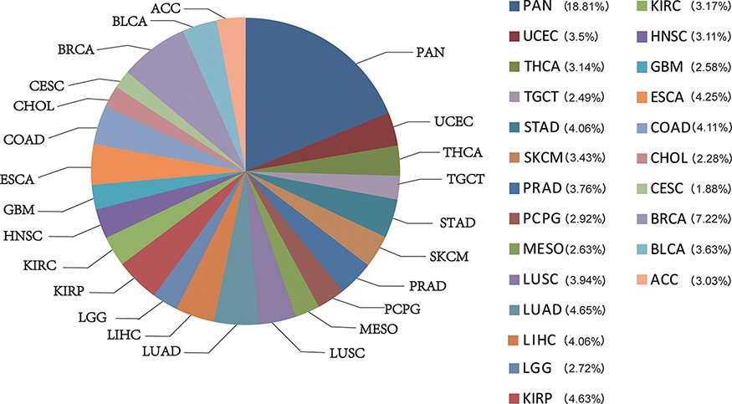
Figure 1. The percentage of chromatin-accessible region for per cancer type.
Notes:
Figure 1. The percentage of chromatin-accessible region for per cancer type.
Unless provided in the caption above, the following copyright applies to the content of this slide: © The Author(s) 2022. Published by Oxford University Press.This is an Open Access article distributed under the terms of the Creative Commons Attribution License (https://creativecommons.org/licenses/by/4.0/), which permits unrestricted reuse, distribution, and reproduction in any medium, provided the original work is properly cited.

Slide 3
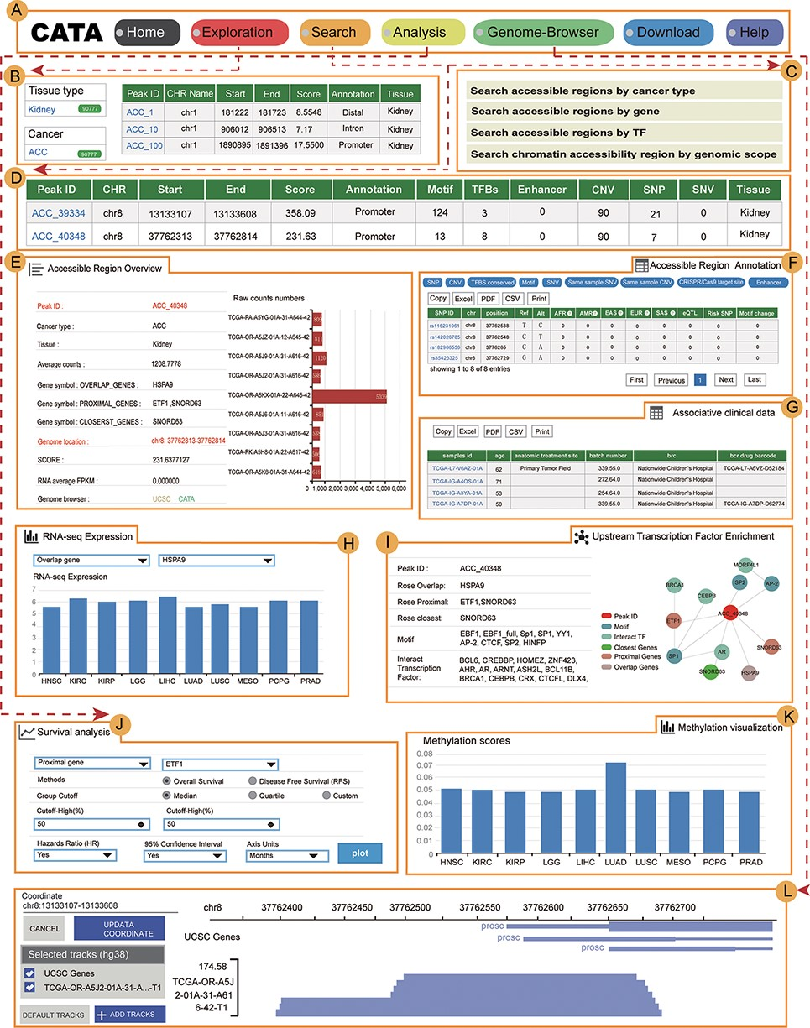
Figure 3. The main function and usage of CATA. (A) The navigation bar of CATA. (B) CATA provides user’s friendly ...
Notes:
Figure 3. The main function and usage of CATA. (A) The navigation bar of CATA. (B) CATA provides user’s friendly explorations. (C) Users can query using five methods: ‘Search by Cancer type’, ‘Search by gene’, ‘Search by TF’ and ‘Advanced search by genome location’. (D) The display of search results. (E) Overview of chromatin-accessible regions. The y-axis is the patient ID provided by TCGA. The x-axis is the count number that is the raw read count of ATAC-seq in the Peak ID. (F) Interactive table of chromatin-accessible region, related annotation information. (G) The table of clinical data. (H) The visualization of RNA-expression. (I) Upstream TF enrichment graph. (J) The overall survival and disease-free survival analysis of the interest gene can be presented in the ‘Survival’ region. Meanwhile, genes with the most significant association with patient survival can be identified. (K) The visualization of the methylation level. (L) Personalized genome browser-GIVE.
Unless provided in the caption above, the following copyright applies to the content of this slide: © The Author(s) 2022. Published by Oxford University Press.This is an Open Access article distributed under the terms of the Creative Commons Attribution License (https://creativecommons.org/licenses/by/4.0/), which permits unrestricted reuse, distribution, and reproduction in any medium, provided the original work is properly cited.

Slide 4
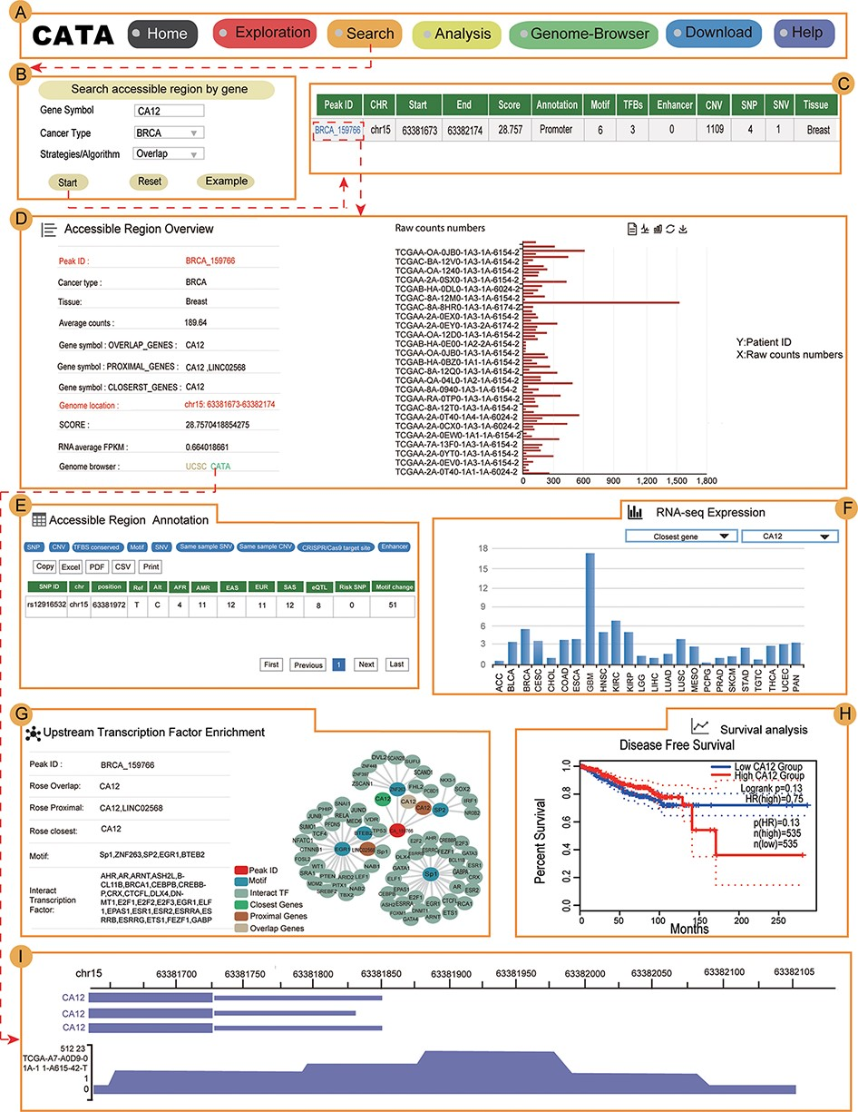
Figure 4. Validation results associated with CA12 in breast cancer. (A) The navigation bar of CATA. (B) Input and ...
Notes:
Figure 4. Validation results associated with CA12 in breast cancer. (A) The navigation bar of CATA. (B) Input and parameters of ‘Search accessible regions by gene’. (C) The brief annotation information about the detailed genetic information in chromatin-accessible regions of CA12, including SNP, motif, CNV, SNV, TFBS, etc. The score is a score of chromatin accessibility provided by TCGA. The higher the score, the more open the chromatin. (D) In accessible region overview, annotation CAR information of CA12 CAR regions including raw count numbers, presented by bar plots and some summary information (overlap genes, proximal genes, closest genes, genome location, score of chromatin-accessible regions, RNA average FPKM) about the accessible region of interest gene. The y-axis is the patient ID provided by TCGA. The x-axis is the count number that is the raw read count of ATAC-seq in the Peak ID. (E) In accessible region annotation, annotation CAR information of CAR regions are provided in tabular form, including SNP, motif, CNV, SNV, TFBS, etc. (F) The visualization of RNA expression of CA12. (G) Upstream TF enrichment of the CA12 graph. (H) The disease-free survival analysis of CA12. (I) Visualization of the CA12 chromatin-accessible region.
Unless provided in the caption above, the following copyright applies to the content of this slide: © The Author(s) 2022. Published by Oxford University Press.This is an Open Access article distributed under the terms of the Creative Commons Attribution License (https://creativecommons.org/licenses/by/4.0/), which permits unrestricted reuse, distribution, and reproduction in any medium, provided the original work is properly cited.

