Slide 1
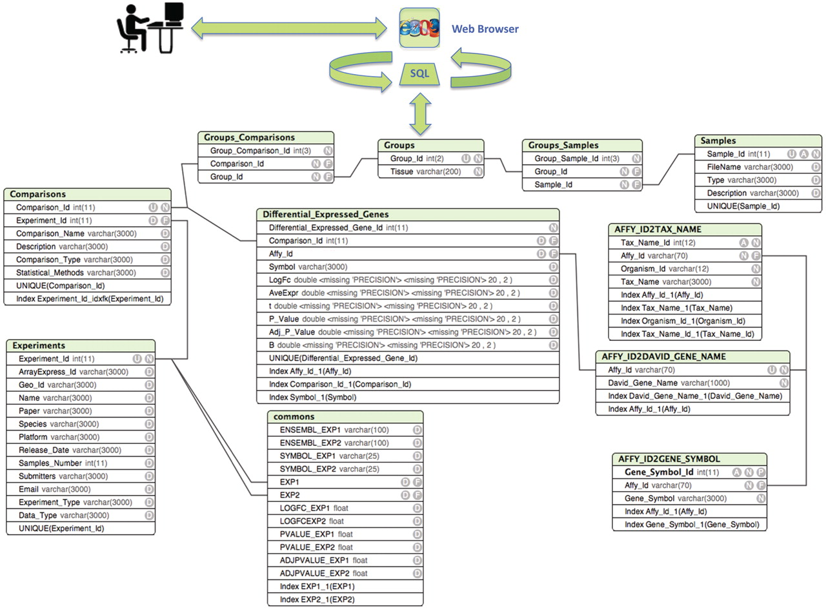
Figure 1. Entity relationship diagram of ParkDB. The scheme illustrates the tables created for data storage with the ...
Notes:
Figure 1. Entity relationship diagram of ParkDB. The scheme illustrates the tables created for data storage with the respective attributes and relations. The simple relations between the tables facilitate the possible expansion of the database to other genes involved in PD neurodegeneration and dopaminergic differentiation.
Unless provided in the caption above, the following copyright applies to the content of this slide: © The Author(s) 2011. Published by Oxford University Press.This is Open Access article distributed under the terms of the Creative Commons Attribution Non-Commercial License (http://creativecommons.org/licenses/by-nc/2.5), which permits unrestricted non-commercial use, distribution, and reproduction in any medium, provided the original work is properly cited.

Slide 2
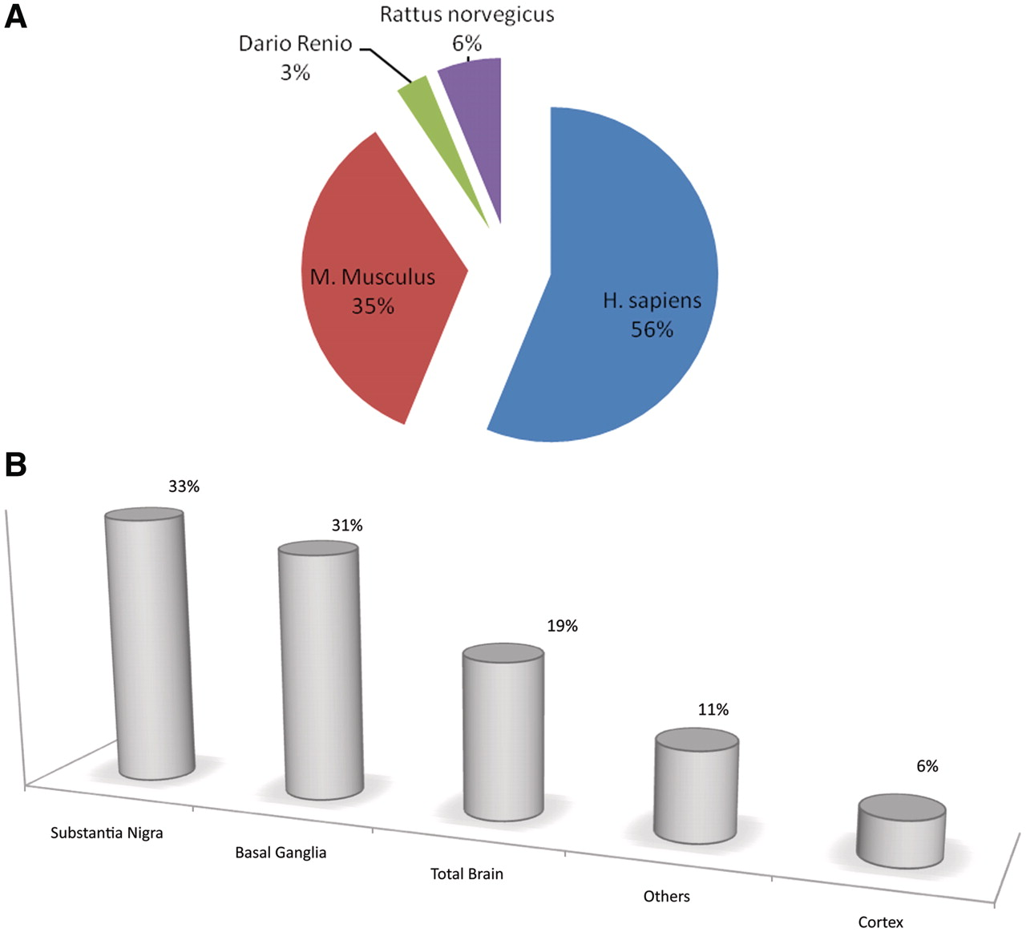
Figure 2. Pie charts and bar plot representing the curated information for each biological tissue, organism and ...
Notes:
Figure 2. Pie charts and bar plot representing the curated information for each biological tissue, organism and comparison. Fifty-six percent of resources are retrieved from human experiments, 35% from mouse, 6% from rat and the remaining 3% from zebrafish. (A). Thirty-three percent of the tissues included in ParkDB were obtained from substantia nigra, 31% from basal ganglia, 19% from the whole brain, 6% from different regions of cortex and 11% from different tissues such as Blood, B Lymphocytes, etc. (B).
Unless provided in the caption above, the following copyright applies to the content of this slide: © The Author(s) 2011. Published by Oxford University Press.This is Open Access article distributed under the terms of the Creative Commons Attribution Non-Commercial License (http://creativecommons.org/licenses/by-nc/2.5), which permits unrestricted non-commercial use, distribution, and reproduction in any medium, provided the original work is properly cited.

Slide 3
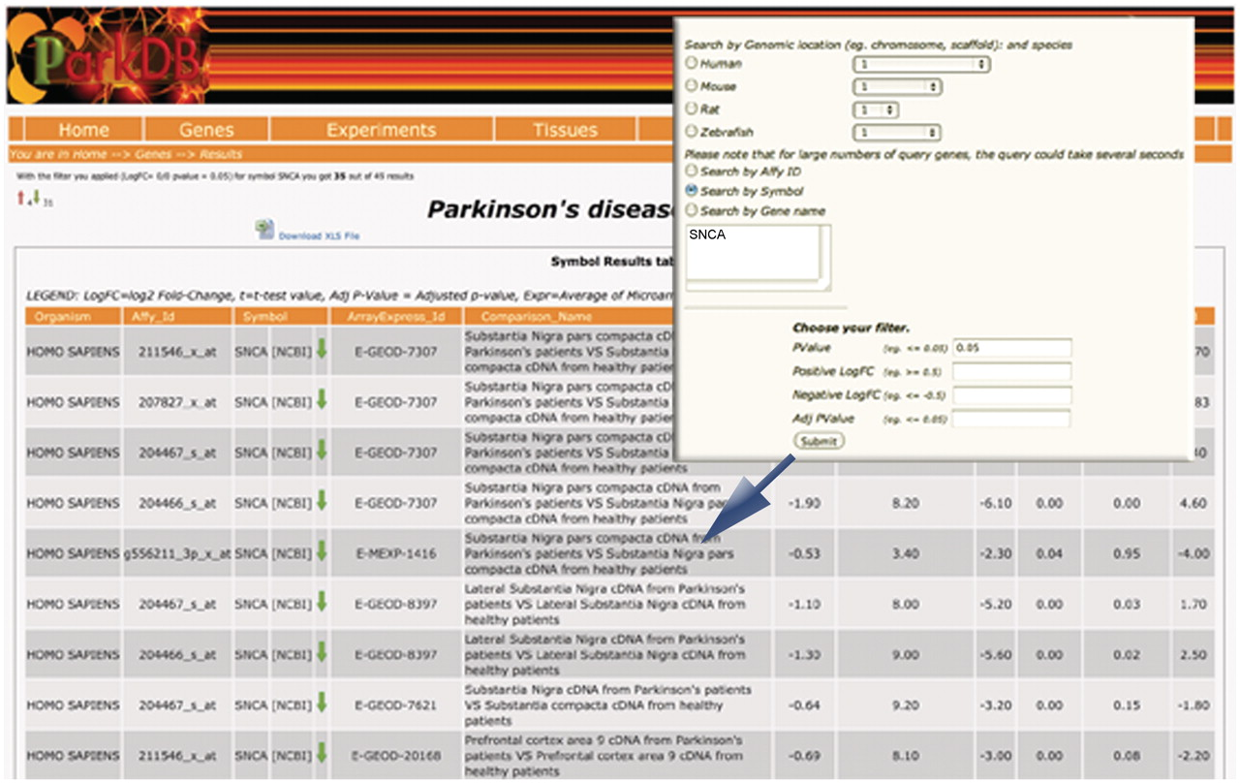
Figure 3. Gene query. The table shows the differential expressed genes obtained searching for SNCA. Red and green ...
Notes:
Figure 3. Gene query. The table shows the differential expressed genes obtained searching for SNCA. Red and green arrows indicate, respectively, up- and down-regulation.
Unless provided in the caption above, the following copyright applies to the content of this slide: © The Author(s) 2011. Published by Oxford University Press.This is Open Access article distributed under the terms of the Creative Commons Attribution Non-Commercial License (http://creativecommons.org/licenses/by-nc/2.5), which permits unrestricted non-commercial use, distribution, and reproduction in any medium, provided the original work is properly cited.

Slide 4
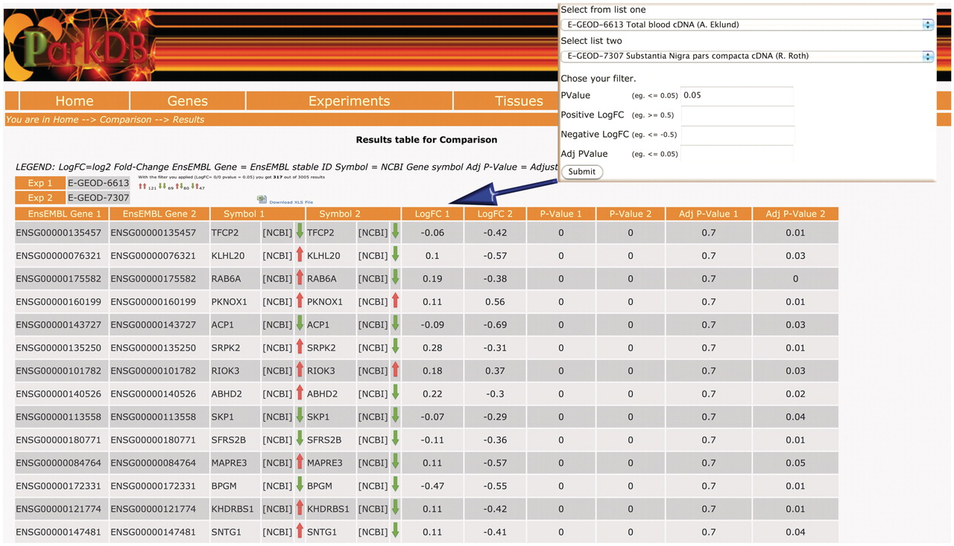
Figure 4. Comparison query. The table shows the common genes obtained comparing substantia nigra from PD patients and a ...
Notes:
Figure 4. Comparison query. The table shows the common genes obtained comparing substantia nigra from PD patients and a transgenic mice that over-expresses HSP70/SNCA. The resulting view also highlights whether the genes were found to be up-regulated/down-regulated or anti-correlated, in two different comparisons.
Unless provided in the caption above, the following copyright applies to the content of this slide: © The Author(s) 2011. Published by Oxford University Press.This is Open Access article distributed under the terms of the Creative Commons Attribution Non-Commercial License (http://creativecommons.org/licenses/by-nc/2.5), which permits unrestricted non-commercial use, distribution, and reproduction in any medium, provided the original work is properly cited.

