Slide 1
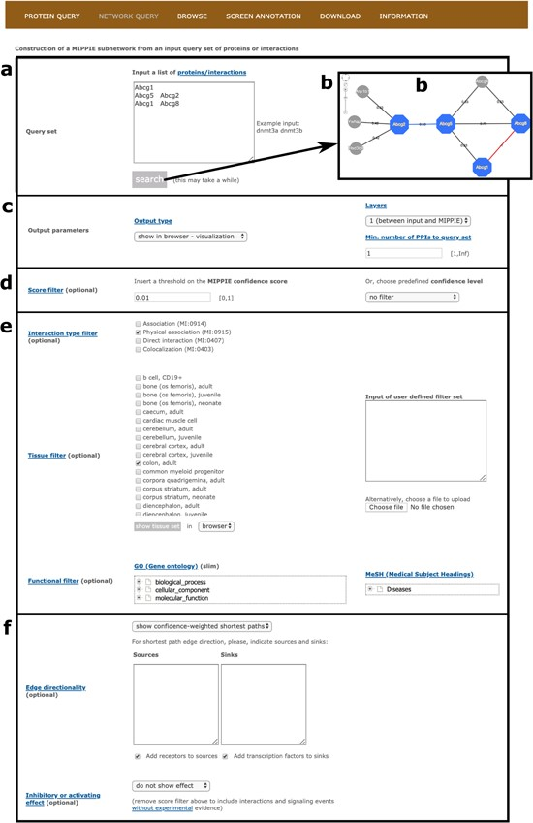
Figure 4 MIPPIE’s NETWORK QUERY tab offers the most advanced search and filtering options. (a, b) Users can type in or ...
Notes:
Figure 4 MIPPIE’s NETWORK QUERY tab offers the most advanced search and filtering options. (a, b) Users can type in or upload a list of proteins or protein pairs to quickly generate a visual representation of the network they form. (c) The results can be explored in a variety of output formats and constrained to 0-, 1-level neighbors or to a minimum number of interactions to the query set. (d) In addition, the quality of the output network can be fine-tuned with confidence score filters. (e, f) This tab also allows for the construction of tissue-, function- or disease-specific networks and for the prediction of interaction directionalities and/or effects.
Unless provided in the caption above, the following copyright applies to the content of this slide: © The Author(s) 2020. Published by Oxford University Press.This is an Open Access article distributed under the terms of the Creative Commons Attribution License (http://creativecommons.org/licenses/by/4.0/), which permits unrestricted reuse, distribution, and reproduction in any medium, provided the original work is properly cited.

