Slide 1
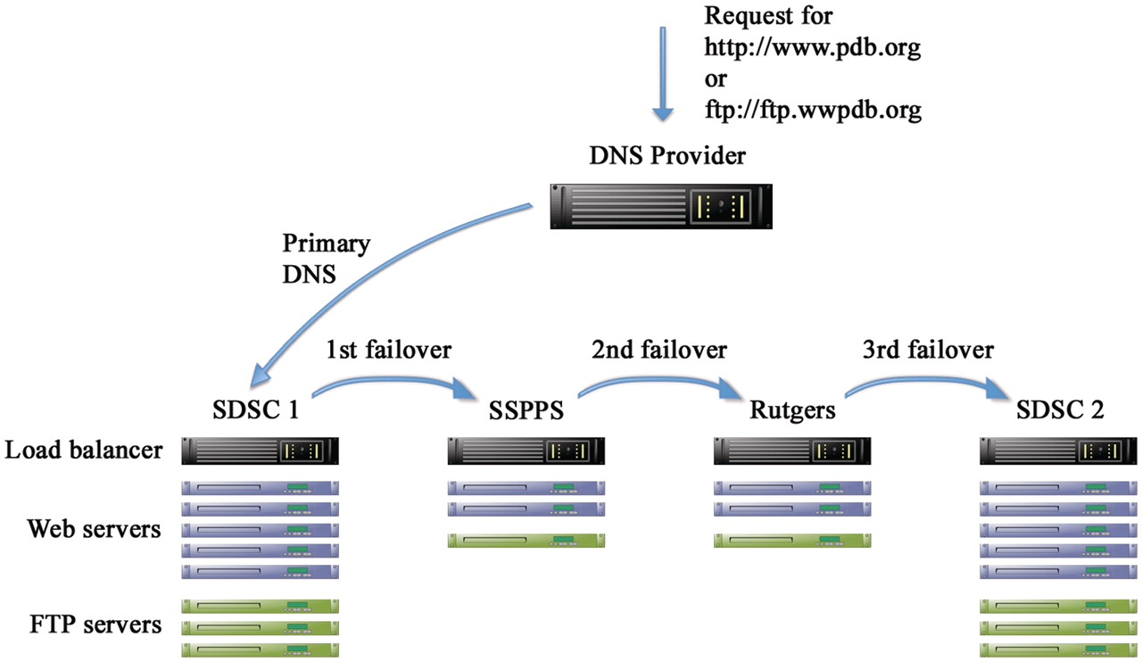
Figure 1. Schematic representation of hardware redundancy and DNS failover. There are four clusters in three separate ...
Notes:
Figure 1. Schematic representation of hardware redundancy and DNS failover. There are four clusters in three separate geographical locations: San Diego Supercomputer Center (SDSC) and Skaggs School of Pharmacy and Pharmaceutical Sciences (SSPPS), both at the University of California, San Diego (UCSD), and Rutgers, the State University of New Jersey. Each cluster contains multiple load balanced Web and FTP servers. A third party DNS provider is used to manage the DNS entries for the website (www.pdb.org) and the FTP site (ftp.wwpdb.org) including failover in case the primary cluster fails.
Unless provided in the caption above, the following copyright applies to the content of this slide: © The Author(s) 2011. Published by Oxford University Press.This is Open Access article distributed under the terms of the Creative Commons Attribution Non-Commercial License (http://creativecommons.org/licenses/by-nc/2.5), which permits unrestricted non-commercial use, distribution, and reproduction in any medium, provided the original work is properly cited.

