Slide 1
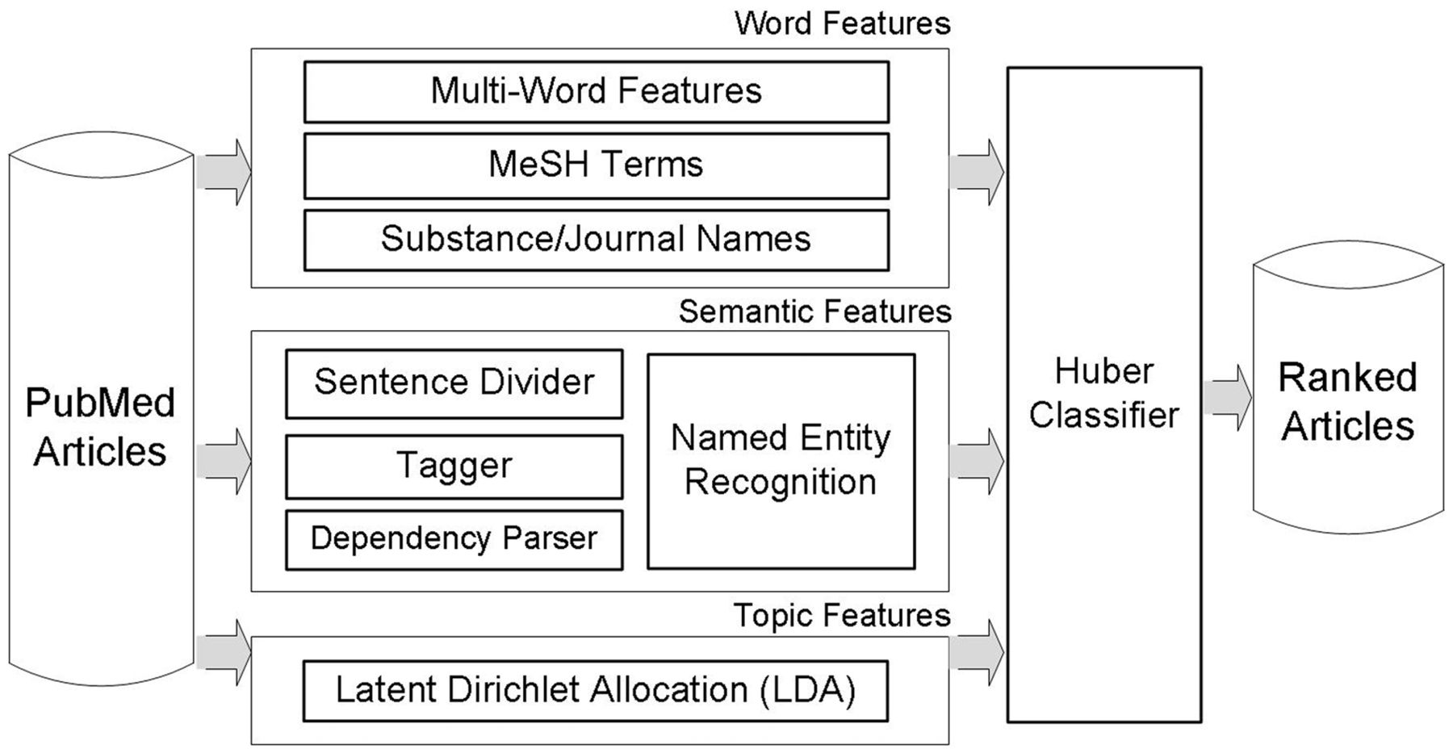
Figure 1 Our article prioritization method for the BioCreative 2012 Triage task. For input articles, features are ...
Notes:
Figure 1 Our article prioritization method for the BioCreative 2012 Triage task. For input articles, features are generated in three different ways: word features including multiwords, MeSH terms and substance/journal names; semantic features utilizing dependency relations and a Semantic Model; topic features are extracted by LDA topic modeling.
Unless provided in the caption above, the following copyright applies to the content of this slide: Published by Oxford University Press.This is an Open Access article distributed under the terms of the Creative Commons Attribution License (http://creativecommons.org/licenses/by-nc/3.0/), which permits non-commercial reuse, distribution, and reproduction in any medium, provided the original work is properly cited. For commercial re-use, please contact journals.permissions@oup.com.

