Slide 1
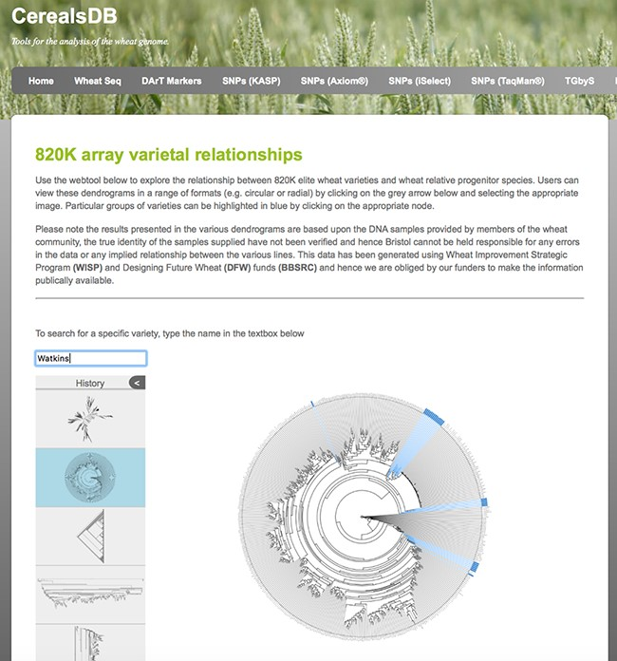
Figure 3. A circular dendrogram rendered using phylocanvas shows Watkins lines highlighted in blue. Users can view ...
Notes:
Figure 3. A circular dendrogram rendered using phylocanvas shows Watkins lines highlighted in blue. Users can view relationships between wheat varieties genotyped on both the 820K and 35K arrays and display the data in a number of different styles of dendrogram.
Unless provided in the caption above, the following copyright applies to the content of this slide: © The Author(s) 2020. Published by Oxford University Press.This is an Open Access article distributed under the terms of the Creative Commons Attribution License (http://creativecommons.org/licenses/by/4.0/), which permits unrestricted reuse, distribution, and reproduction in any medium, provided the original work is properly cited.

