Slide 1
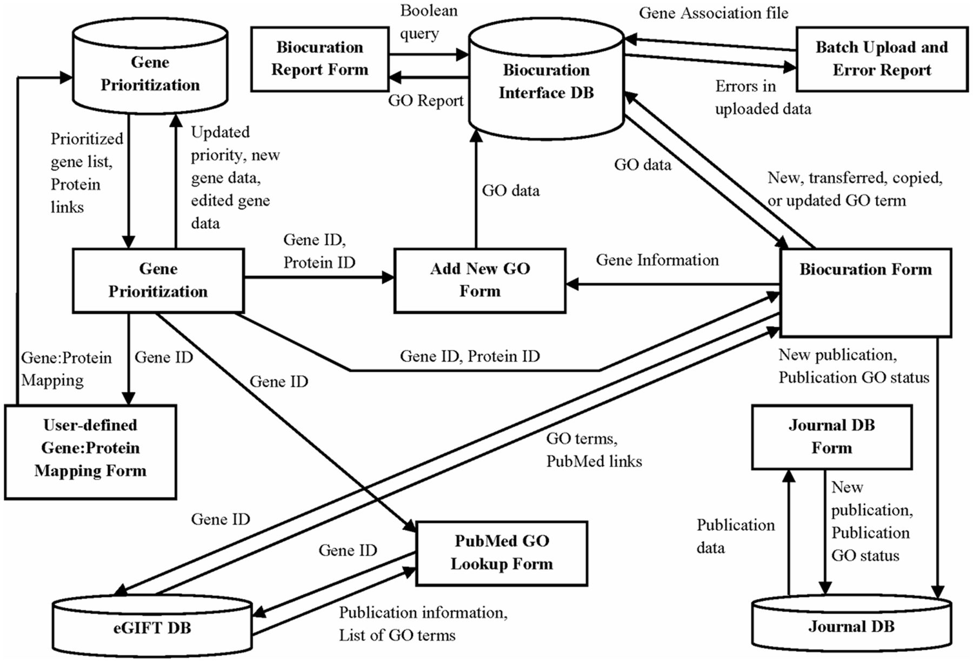
Figure 5 The AgBase annotation workflow is supported by three underlying databases. This schema shows the GP, BI and ...
Notes:
Figure 5 The AgBase annotation workflow is supported by three underlying databases. This schema shows the GP, BI and JDB (cylinders), the information they contribute to interface forms (squares) and the data from each database used to create these interfaces (arrows).
Unless provided in the caption above, the following copyright applies to the content of this slide: © The Author(s) 2012. Published by Oxford University Press.This is an Open Access article distributed under the terms of the Creative Commons Attribution License (http://creativecommons.org/licenses/by-nc/3.0/), which permits non-commercial reuse, distribution, and reproduction in any medium, provided the original work is properly cited. For commercial re-use, please contact journals.permissions@oup.com.

