Slide 1
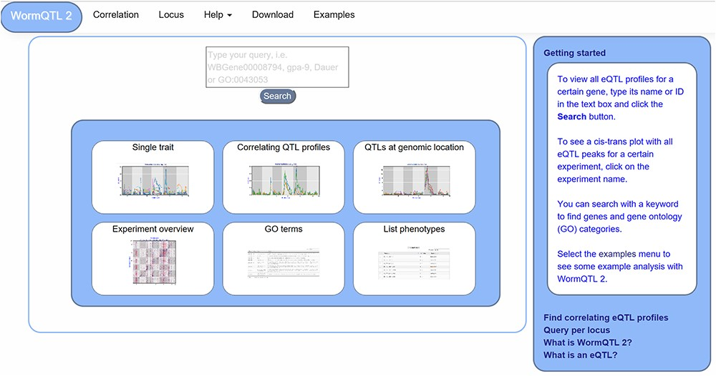
Figure 1 WormQTL2 Homepage. On the top of the page, the navigation bar can be found. This includes the WormQTL2 logo, ...
Notes:
Figure 1 WormQTL2 Homepage. On the top of the page, the navigation bar can be found. This includes the WormQTL2 logo, which functions as a home button. It also includes a fast link to the Correlation and Locus overviews as well as links for help, data download and visual examples. The search box is located in the center, in which genes, phenotypes and GO terms can be entered. Shown in the blue middle square are the buttons for the investigations of single traits, correlating QTL profiles, QTLs at a specific locus, all eQTLs of an experiment, eQTLs per GO term and a list of all phenotypes for which QTLs can be shown. On the right side, a bar with information about WormQTL2 and QTLs in general can be found.
Unless provided in the caption above, the following copyright applies to the content of this slide: © The Author(s) 2020. Published by Oxford University Press.This is an Open Access article distributed under the terms of the Creative Commons Attribution License (http://creativecommons.org/licenses/by/4.0/), which permits unrestricted reuse, distribution, and reproduction in any medium, provided the original work is properly cited.

