Slide 1
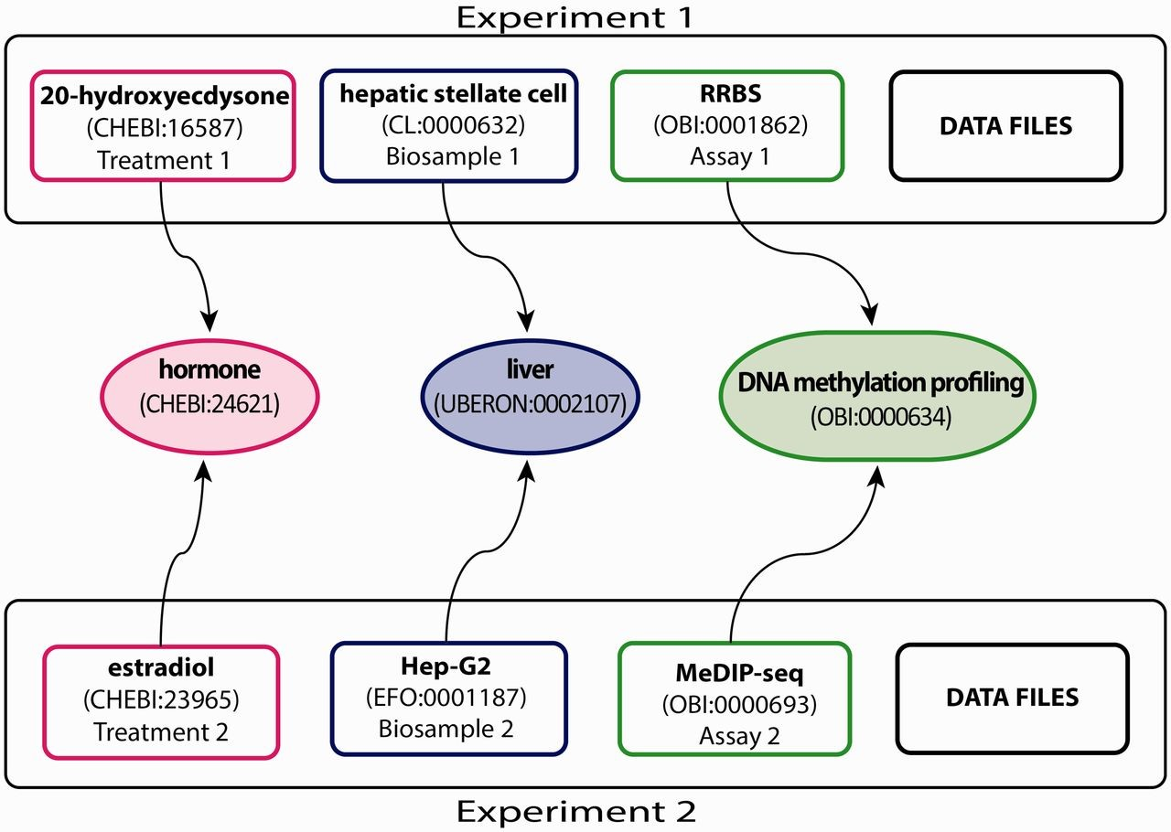
Figure 1. Experimental metadata annotated with appropriate ontology terms. This example, showing a subset of the full ...
Notes:
Figure 1. Experimental metadata annotated with appropriate ontology terms. This example, showing a subset of the full breadth of metadata annotated for an ENCODE experiment, emphasizes the annotation of three experimental metadata categories (treatment, biosample and assay) in two experiments. Treatments have been annotated to ChEBI (e.g. 20-hydroxyecdysone—CHEBI:16587 and estradiol—CHEBI:23965). Biosamples have been annotated to one of three ontologies: Uberon, CL and EFO (e.g. hepatic stellate cell—CL:0000632 and Hep-G2—EFO:0001187). Assays have been annotated to OBI (e.g. RRBS—OBI:0001862 and MeDIP-seq—OBI:000693). The terms in the middle are parent terms found in the ontology that provide a more general context and can be used to find these experiments (i.e. biological role for treatments, organ for biosamples, assay category for experimental assays). Each annotated term in the experiment maps, through relationships in the ontology, to the middle terms.
Unless provided in the caption above, the following copyright applies to the content of this slide: © The Author(s) 2015. Published by Oxford University Press.This is an Open Access article distributed under the terms of the Creative Commons Attribution License (http://creativecommons.org/licenses/by/4.0/), which permits unrestricted reuse, distribution, and reproduction in any medium, provided the original work is properly cited.

