Slide 1
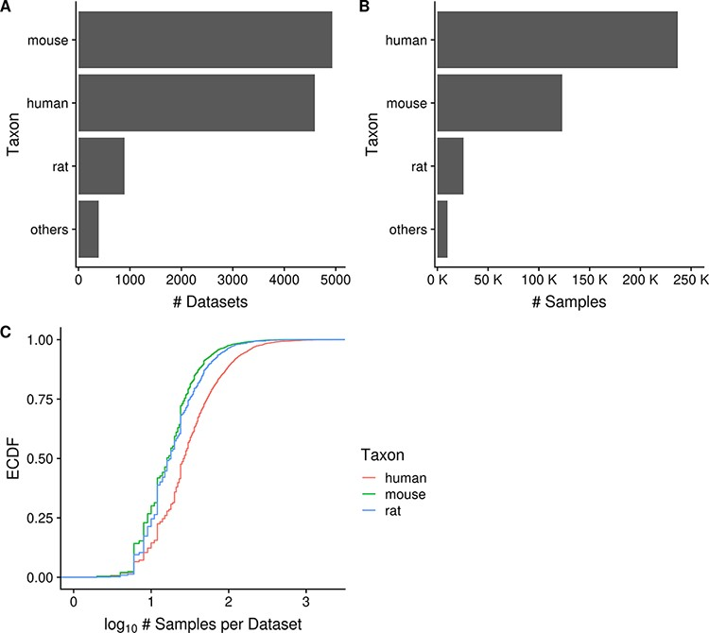
Figure 2. Horizontal bar charts displaying the number of datasets (A) and samples (B) grouped by taxon; empirical ...
Notes:
Figure 2. Horizontal bar charts displaying the number of datasets (A) and samples (B) grouped by taxon; empirical cumulative distribution function representation of the number of datasets against the number of samples per dataset grouped by taxon (C). ‘Others’ taxon group consists of D. rerio, D. melanogaster, C. elegans and S. cerevisiae. (Ndataset = 10 420 in C).
Unless provided in the caption above, the following copyright applies to the content of this slide: © The Author(s) 2021. Published by Oxford University Press.This is an Open Access article distributed under the terms of the Creative Commons Attribution License (http://creativecommons.org/licenses/by/4.0/), which permits unrestricted reuse, distribution, and reproduction in any medium, provided the original work is properly cited.

