Slide 1
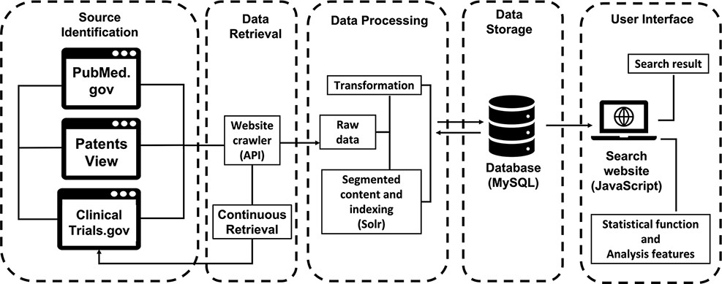
Figure 1. The workflow of ProbioQuest. The database works with continuous data retrieval from 3 public sources via API ...
Notes:
Figure 1. The workflow of ProbioQuest. The database works with continuous data retrieval from 3 public sources via API function. Our in-house Perl script transforms the raw data into the desired structure and then inputs it to MySQL. Subsequently, Solr creates segments of the content and indexes according to the title and abstract or summary of the processed data. The user interface was built by using JavaScript for searching, with its statistical function and analysis feature.
Unless provided in the caption above, the following copyright applies to the content of this slide: © The Author(s) 2022. Published by Oxford University Press.This is an Open Access article distributed under the terms of the Creative Commons Attribution-NonCommercial License (https://creativecommons.org/licenses/by-nc/4.0/), which permits non-commercial re-use, distribution, and reproduction in any medium, provided the original work is properly cited. For commercial re-use, please contact journals.permissions@oup.com

Slide 2
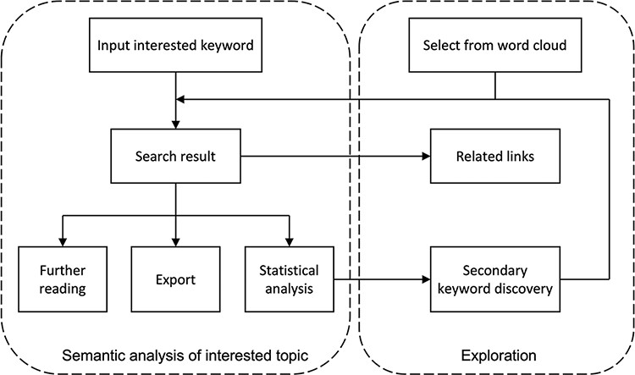
Figure 2. Flow chart of semantic analysis and exploration on the user interface of ProBioQuest. Users can simply input ...
Notes:
Figure 2. Flow chart of semantic analysis and exploration on the user interface of ProBioQuest. Users can simply input the keyword of interest, and ProBioQuest will show related search results. Users can then click the results for further reading or export the selected result. To explore deep searching, ProBioQuest provides a statistical analysis of the search result and Keywords Bank allows further searching by adding a secondary keyword.
Unless provided in the caption above, the following copyright applies to the content of this slide: © The Author(s) 2022. Published by Oxford University Press.This is an Open Access article distributed under the terms of the Creative Commons Attribution-NonCommercial License (https://creativecommons.org/licenses/by-nc/4.0/), which permits non-commercial re-use, distribution, and reproduction in any medium, provided the original work is properly cited. For commercial re-use, please contact journals.permissions@oup.com

Slide 3
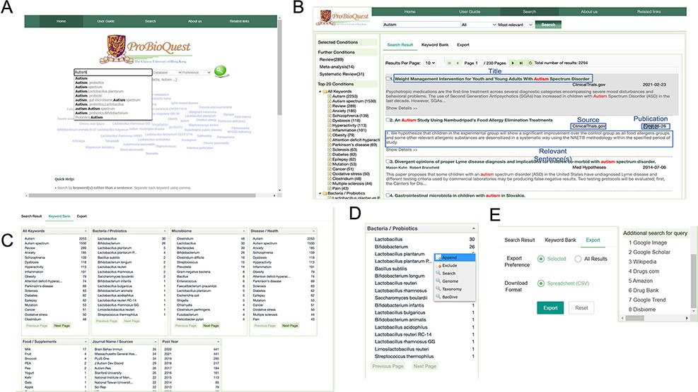
Figure 3. An overview of the user interface of ProBioQuest. (A) Home page includes a keyword cloud of the most frequent ...
Notes:
Figure 3. An overview of the user interface of ProBioQuest. (A) Home page includes a keyword cloud of the most frequent keywords from all seed articles, a search bar which offers suggestions while the user is typing and a help box for users unfamiliar with the system’s details. (B) Autism as an example of input and the search result. Each article is linked out to ClinicalTrials.gov, PubMed.gov or PatentsView with a simple click. (C) Novel feature in Keyword Bank tab. This tab shows relevant keywords in descending order of the number of articles they co-existed, which aids secondary key concept discovery of the interested topic. All keywords are divided into categories. (D) The secondary keyword can be appended into the search bar or linked out. (E) Search result can be exported as CSV format or linked out to search for additional information.
Unless provided in the caption above, the following copyright applies to the content of this slide: © The Author(s) 2022. Published by Oxford University Press.This is an Open Access article distributed under the terms of the Creative Commons Attribution-NonCommercial License (https://creativecommons.org/licenses/by-nc/4.0/), which permits non-commercial re-use, distribution, and reproduction in any medium, provided the original work is properly cited. For commercial re-use, please contact journals.permissions@oup.com

Slide 4
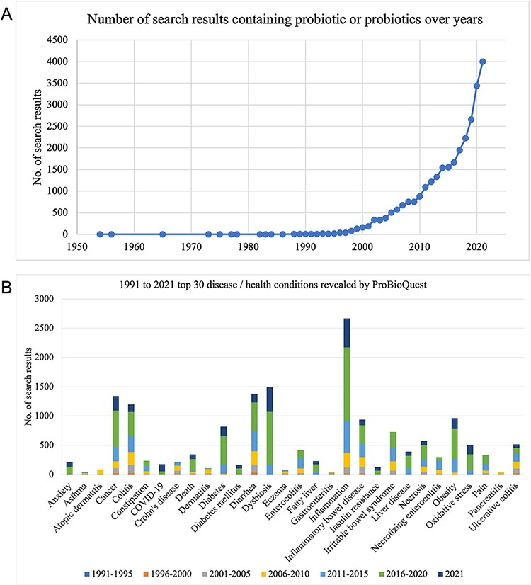
Figure 4. The number of articles containing ‘probiotic/probiotics’ from 1950 to 2021 and articles of top 30 ...
Notes:
Figure 4. The number of articles containing ‘probiotic/probiotics’ from 1950 to 2021 and articles of top 30 Disease/Health in 5-years groups. (A) The number of articles on probiotics has been growing rapidly during the past two decades. (B) Popular topics such as inflammation, diarrhea and cancer maintained a high rate of occurrence in the articles from 1991 to 2021.
Unless provided in the caption above, the following copyright applies to the content of this slide: © The Author(s) 2022. Published by Oxford University Press.This is an Open Access article distributed under the terms of the Creative Commons Attribution-NonCommercial License (https://creativecommons.org/licenses/by-nc/4.0/), which permits non-commercial re-use, distribution, and reproduction in any medium, provided the original work is properly cited. For commercial re-use, please contact journals.permissions@oup.com

Slide 5
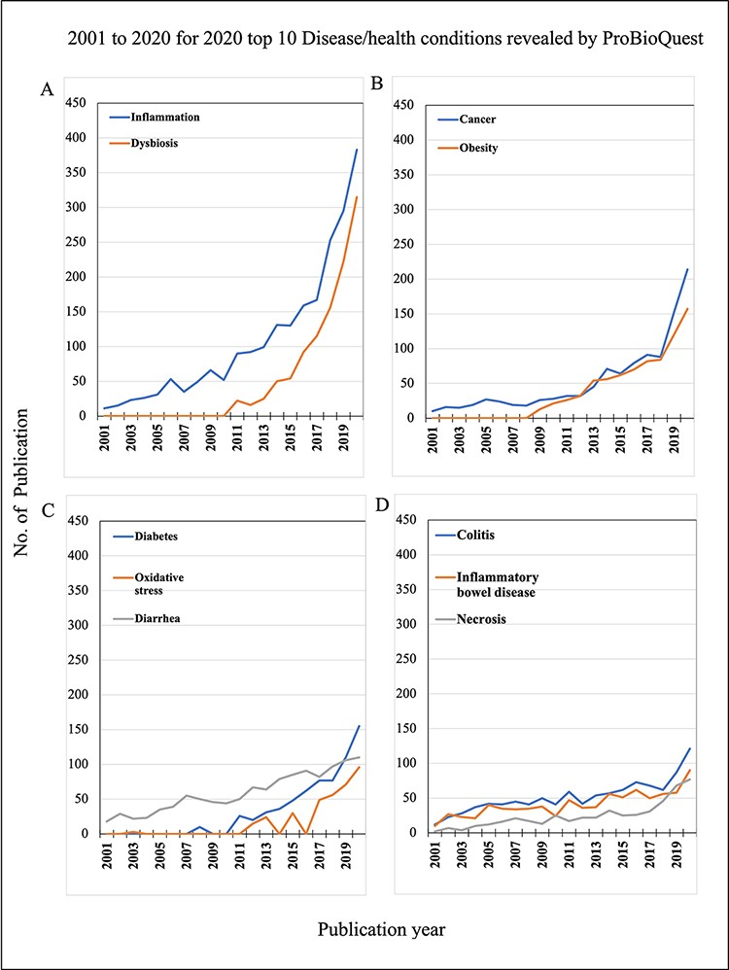
Figure 5. 2001 to 2020 for 2020 top 10 Disease/Health conditions revealed by ProBioQuest. The top 10 most popular ...
Notes:
Figure 5. 2001 to 2020 for 2020 top 10 Disease/Health conditions revealed by ProBioQuest. The top 10 most popular Disease/Health keywords in 2020 were selected for further analysis of their trends during the two decades from 2001 to 2020. (A) Inflammation and dysbiosis have clear trends of marked growth in numbers. (C–D) Specific diseases of awareness on metabolic disorders like obesity, diabetes and oxidative stress and diseases of abnormal cell growth like cancer and necrosis also increased in the past 10 years, although to a lesser extent.
Unless provided in the caption above, the following copyright applies to the content of this slide: © The Author(s) 2022. Published by Oxford University Press.This is an Open Access article distributed under the terms of the Creative Commons Attribution-NonCommercial License (https://creativecommons.org/licenses/by-nc/4.0/), which permits non-commercial re-use, distribution, and reproduction in any medium, provided the original work is properly cited. For commercial re-use, please contact journals.permissions@oup.com

Slide 6
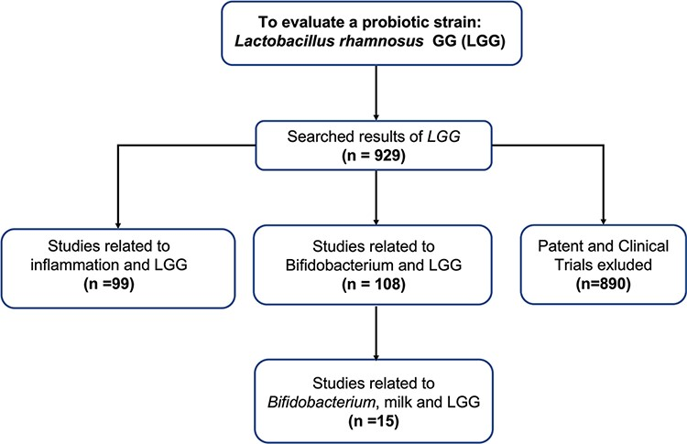
Figure 6. Flowchart of using ProBioQuest to evaluate a probiotic strain-Lactobacillus rhamnosus GG. Searching ...
Notes:
Figure 6. Flowchart of using ProBioQuest to evaluate a probiotic strain-Lactobacillus rhamnosus GG. Searching Lactobacillus rhamnosus GG in ProbioQuest returned 929 results. There were 890 articles from Pudmed.gov. To narrow down the number of results to those of more specific interest, a second keyword (‘Bifidobacterium’ or ‘inflammation’) was added. This reduced the number of results to 108 and 99, respectively. The addition of more keywords would further reduce the number of results and narrow the field of enquiry.
Unless provided in the caption above, the following copyright applies to the content of this slide: © The Author(s) 2022. Published by Oxford University Press.This is an Open Access article distributed under the terms of the Creative Commons Attribution-NonCommercial License (https://creativecommons.org/licenses/by-nc/4.0/), which permits non-commercial re-use, distribution, and reproduction in any medium, provided the original work is properly cited. For commercial re-use, please contact journals.permissions@oup.com

