Slide 1
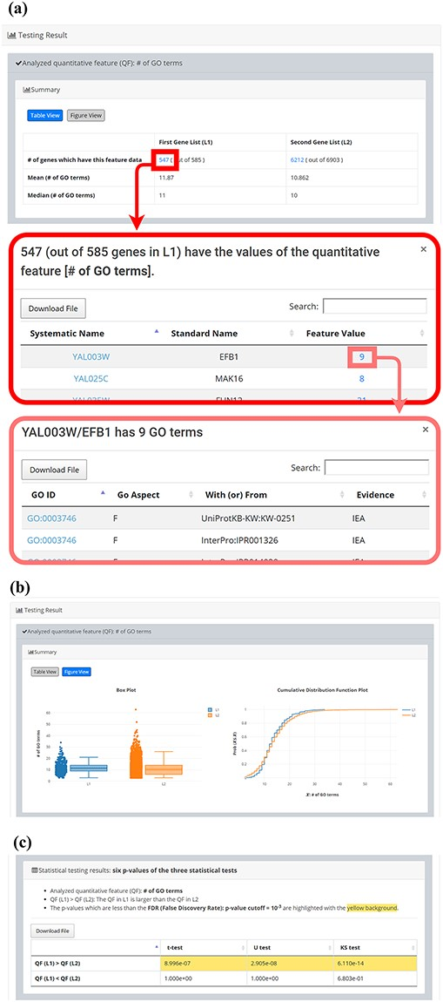
Figure 4. The result page (the second part). The second part contains the result of each selected quantitative feature ...
Notes:
Figure 4. The result page (the second part). The second part contains the result of each selected quantitative feature shown as two sections: (i) Summary and (ii) Statistical testing results. In the “Summary” section, users can choose “Table View” or “Figure View”. (a) “Table View” provides a table containing two kinds of information. First, the numbers of genes (in L1 and L2, respectively) which have the feature values are given. If users click on the number, they will see the names and the feature values of these genes. By clicking on a feature value, users will see the original sources of the feature value. Second, the mean and median feature values of the genes (having feature values) in L1 and L2, respectively, are given. (b) “Figure View” provides two kinds of plots for visualization. Box plots are used to display variation in the feature values in L1 and L2, respectively. Cumulative distribution function (CDF) plots are used to show the probability that the feature value X is less than or equal to a specific value x (i.e. Prob(X$\leq$x)). (c) In the “Statistical testing results” section, users can see a table with six p-values. Three p-values (calculated by t-test, U test, and KS test) represent the statistical significance of claiming the quantitative feature of L1 is larger than that of L2 (denoted as QF(L1)>QF(L2)). The other three p-values (calculated by t-test, U test, and KS test) represent the statistical significance of claiming the quantitative feature of L1 is smaller than that of L2 (denoted as QF(L1)<QF(L2)). To draw the users’ attention, the p-values which are less than the p-value threshold are highlighted with the yellow background.
Unless provided in the caption above, the following copyright applies to the content of this slide: © The Author(s) 2020. Published by Oxford University Press.This is an Open Access article distributed under the terms of the Creative Commons Attribution License (http://creativecommons.org/licenses/by/4.0/), which permits unrestricted reuse, distribution, and reproduction in any medium, provided the original work is properly cited.

