Slide 1
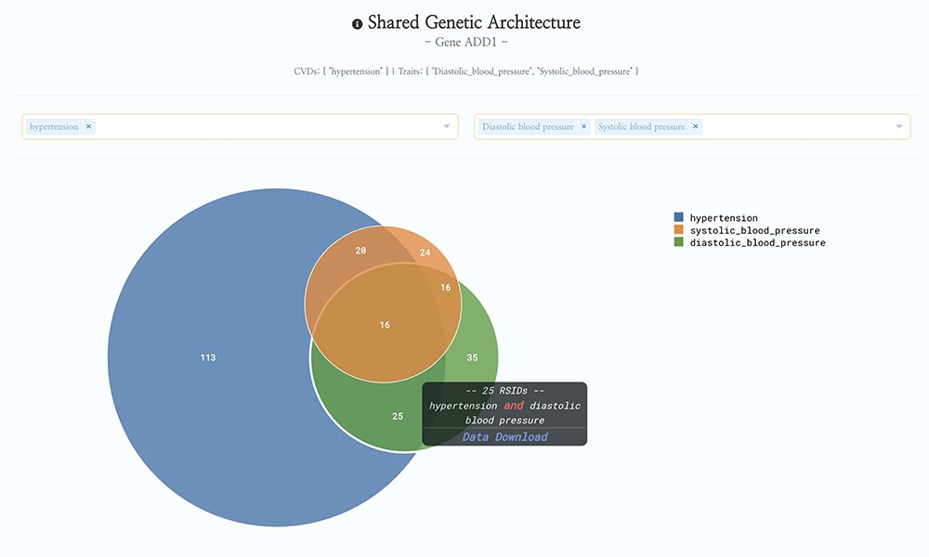
Figure 1. HeartBioPortal2.0’s shared genetic architecture feature. The gene ADD1 is known to be associated with ...
Notes:
Figure 1. HeartBioPortal2.0’s shared genetic architecture feature. The gene ADD1 is known to be associated with salt-sensitive essential hypertension—here we see the shared genetic architecture of that gene’s variants (represented as unique reference SNP ID number (rsID) accession identifiers) across the continuous cardiometabolic spectrum from health (systolic and diastolic blood pressure) to disease (hypertension), facilitating the understanding of CVD trait genetics underlying health-to-disease transitions and endophenotypes. HeartBioPortal’s frontend design philosophy has always been to keep the user interface clean and minimalistic to ensure viewer comprehension and avoid potential confusion; therefore, additional details can be acquired from the hyperlinked data download, which is presented in a tidy .csv format amenable to follow-up analyses.
Unless provided in the caption above, the following copyright applies to the content of this slide: © The Author(s) 2020. Published by Oxford University Press.This is an Open Access article distributed under the terms of the Creative Commons Attribution License (http://creativecommons.org/licenses/by/4.0/), which permits unrestricted reuse, distribution, and reproduction in any medium, provided the original work is properly cited.

