Slide 1
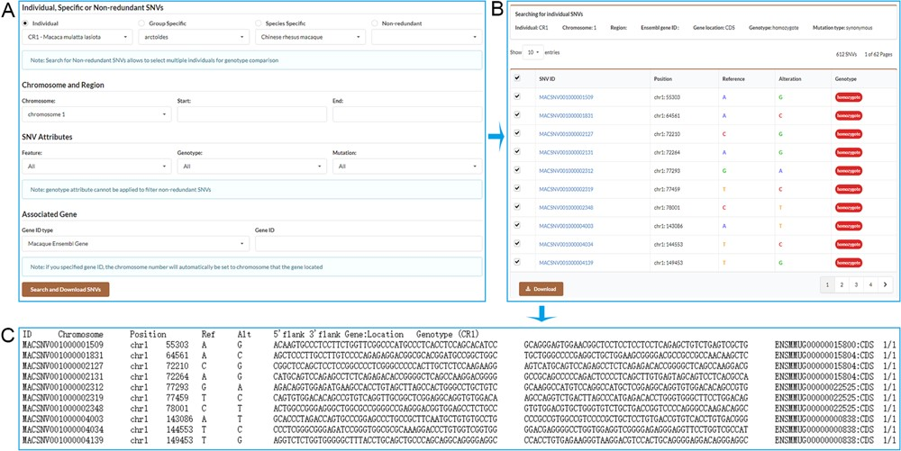
Figure 3 Screenshots of the search result pages. A. Search for individual SNVs, specific SNVs or non-redundant SNVs by ...
Notes:
Figure 3 Screenshots of the search result pages. A. Search for individual SNVs, specific SNVs or non-redundant SNVs by specifying chromosome and position range or associated gene. B. Search result table allows users to select desired SNVs to download. C. SNV list with detailed information obtained by downloading.
Unless provided in the caption above, the following copyright applies to the content of this slide: © The Author(s) 2020. Published by Oxford University Press.This is an Open Access article distributed under the terms of the Creative Commons Attribution License (http://creativecommons.org/licenses/by/4.0/), which permits unrestricted reuse, distribution, and reproduction in any medium, provided the original work is properly cited.

