Slide 1
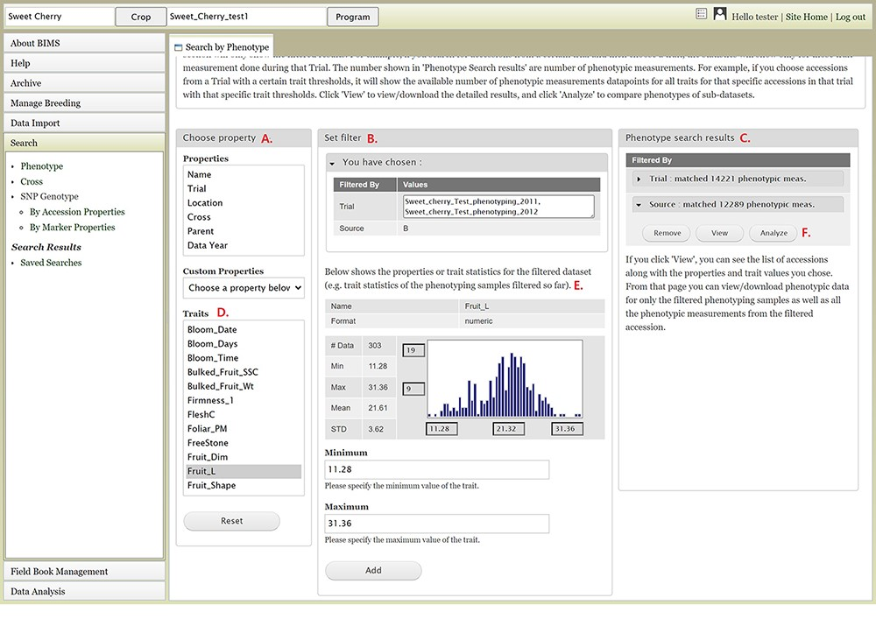
Figure 9. BIMS interface to search phenotype data. A. Choose a property section where users can filter the dataset by ...
Notes:
Figure 9. BIMS interface to search phenotype data. A. Choose a property section where users can filter the dataset by choosing various properties or traits. B. Set filter section that is populated with options for the data type when users choose a property or a trait. C. Phenotype search results section that shows the selected filter. D. Trait list in the Choose property section. E. Diagram of the trait value distribution for the previously filtered dataset. F. Remove, View, and Analyze buttons in the Phenotype search results section.
Unless provided in the caption above, the following copyright applies to the content of this slide: © The Author(s) 2021. Published by Oxford University Press.This is an Open Access article distributed under the terms of the Creative Commons Attribution License (http://creativecommons.org/licenses/by/4.0/), which permits unrestricted reuse, distribution, and reproduction in any medium, provided the original work is properly cited.

