Slide 1
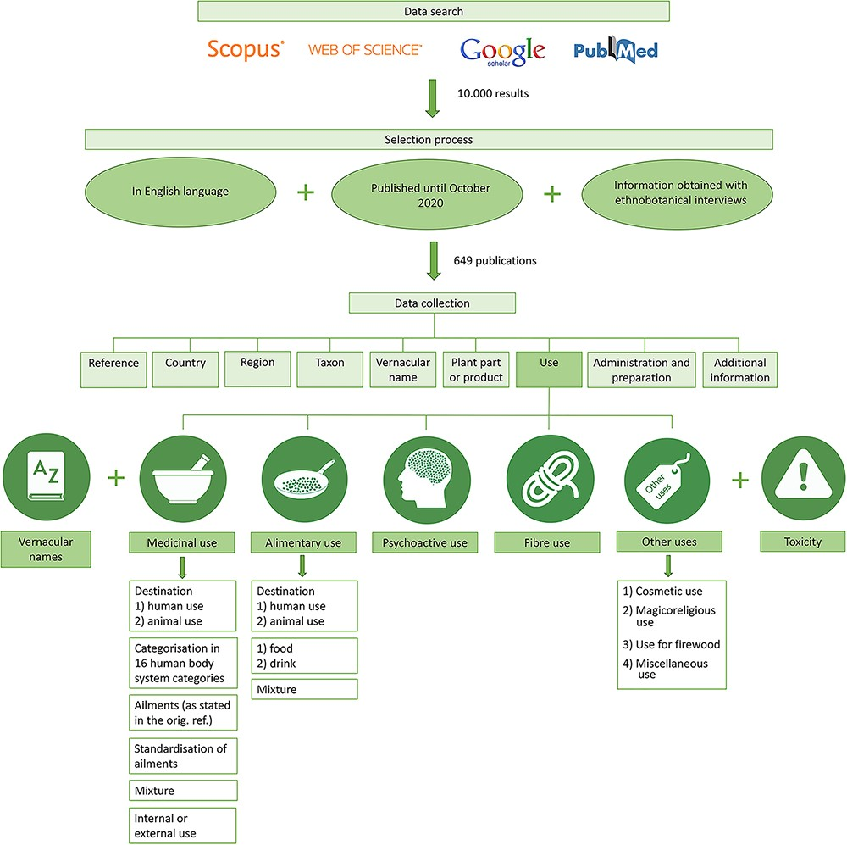
Figure 1. Workflow of the data search, selection process and data collection for the CANNUSE database construction.
Notes:
Figure 1. Workflow of the data search, selection process and data collection for the CANNUSE database construction.
Unless provided in the caption above, the following copyright applies to the content of this slide: © The Author(s) 2021. Published by Oxford University Press.This is an Open Access article distributed under the terms of the Creative Commons Attribution License (http://creativecommons.org/licenses/by/4.0/), which permits unrestricted reuse, distribution, and reproduction in any medium, provided the original work is properly cited.

