Slide 1
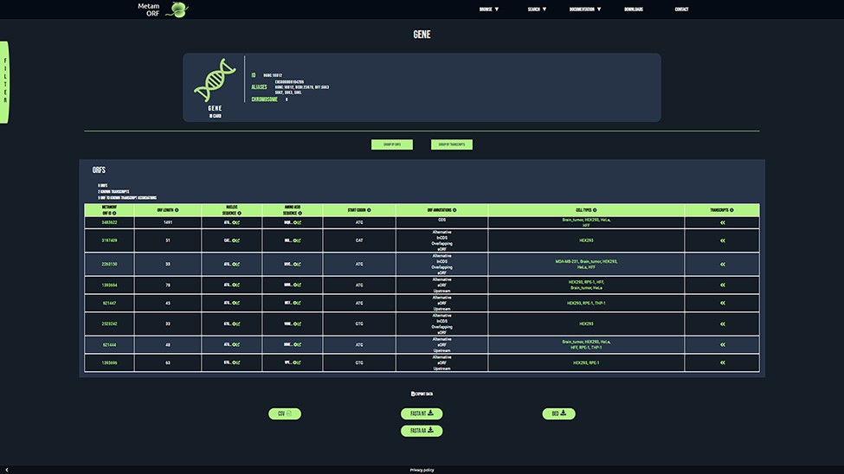
Figure 3. MetamORF gene-centric view. The page displays the transcripts and the ORFs related to SGK3 gene. A filter has ...
Notes:
Figure 3. MetamORF gene-centric view. The page displays the transcripts and the ORFs related to SGK3 gene. A filter has been applied to select exclusively the ORFs detected in HFF, Jurkat, RPE-1, HEK293 or HeLa cells. Other filters may be used and the results can be exported as CSV, FASTA or BED files.
Unless provided in the caption above, the following copyright applies to the content of this slide: © The Author(s) 2021. Published by Oxford University Press.This is an Open Access article distributed under the terms of the Creative Commons Attribution License (http://creativecommons.org/licenses/by/4.0/), which permits unrestricted reuse, distribution, and reproduction in any medium, provided the original work is properly cited.

