Slide 1
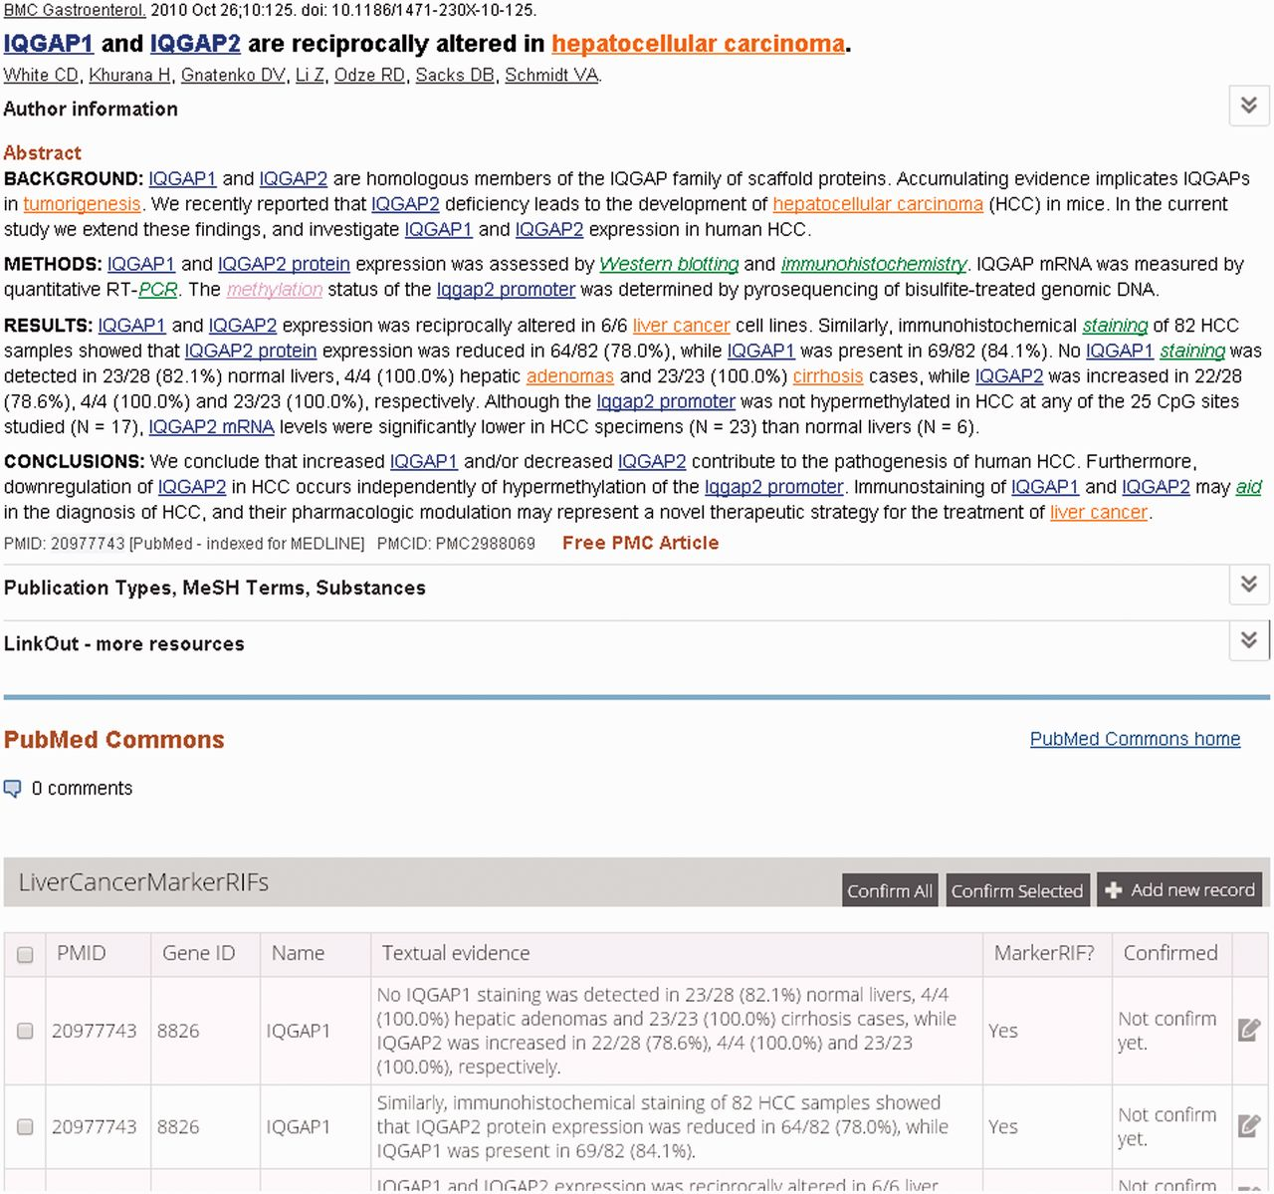
Figure 1. An augmented abstract on PubMed (PMID 20977743). The mentions of gene, disease, PTM and investigation ...
Notes:
Figure 1. An augmented abstract on PubMed (PMID 20977743). The mentions of gene, disease, PTM and investigation techniques are highlighted in blue, brown, purple and green, respectively.
Unless provided in the caption above, the following copyright applies to the content of this slide: © The Author(s) 2014. Published by Oxford University Press.This is an Open Access article distributed under the terms of the Creative Commons Attribution License (http://creativecommons.org/licenses/by/4.0/), which permits unrestricted reuse, distribution, and reproduction in any medium, provided the original work is properly cited.

Slide 2
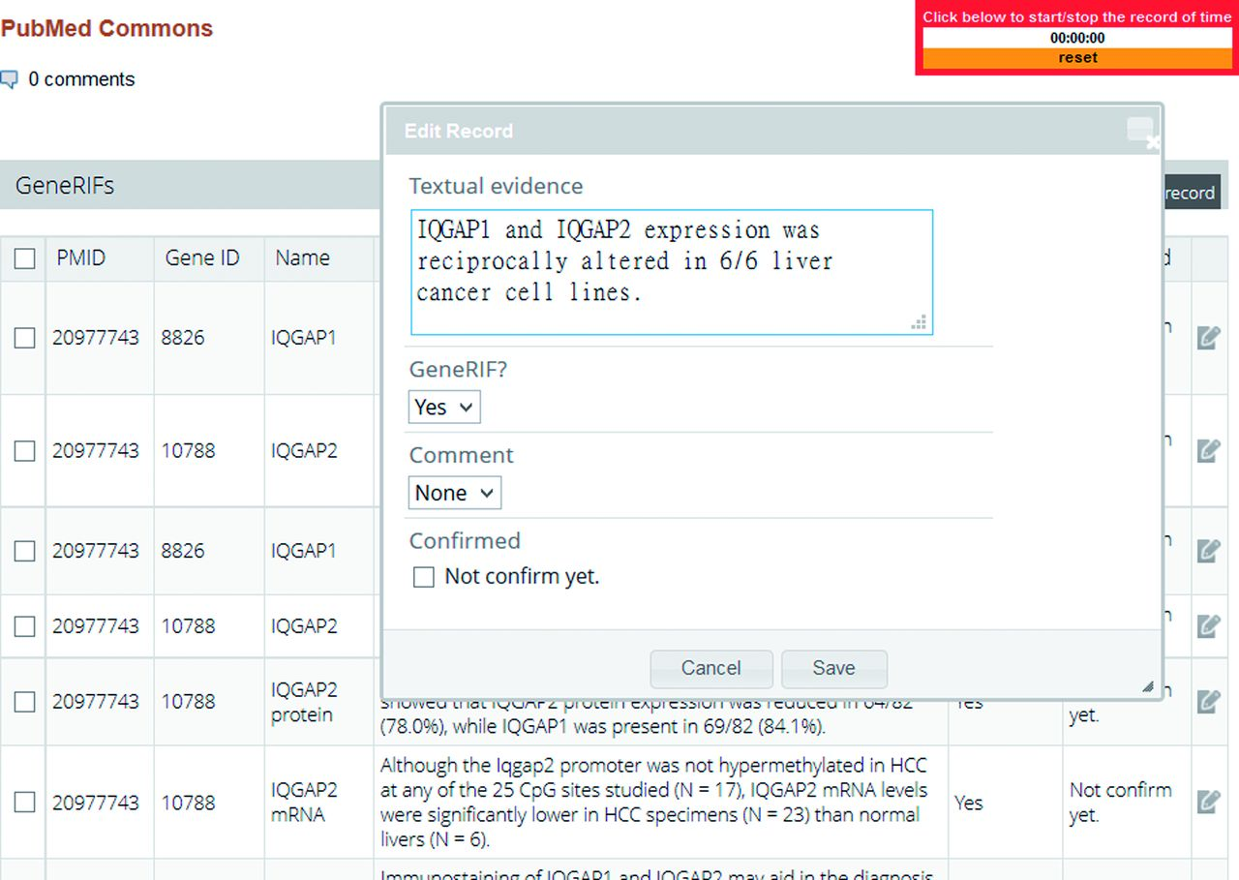
Figure 2. The curation interface of LiverCancerMarkerRIF.
Notes:
Figure 2. The curation interface of LiverCancerMarkerRIF.
Unless provided in the caption above, the following copyright applies to the content of this slide: © The Author(s) 2014. Published by Oxford University Press.This is an Open Access article distributed under the terms of the Creative Commons Attribution License (http://creativecommons.org/licenses/by/4.0/), which permits unrestricted reuse, distribution, and reproduction in any medium, provided the original work is properly cited.

Slide 3
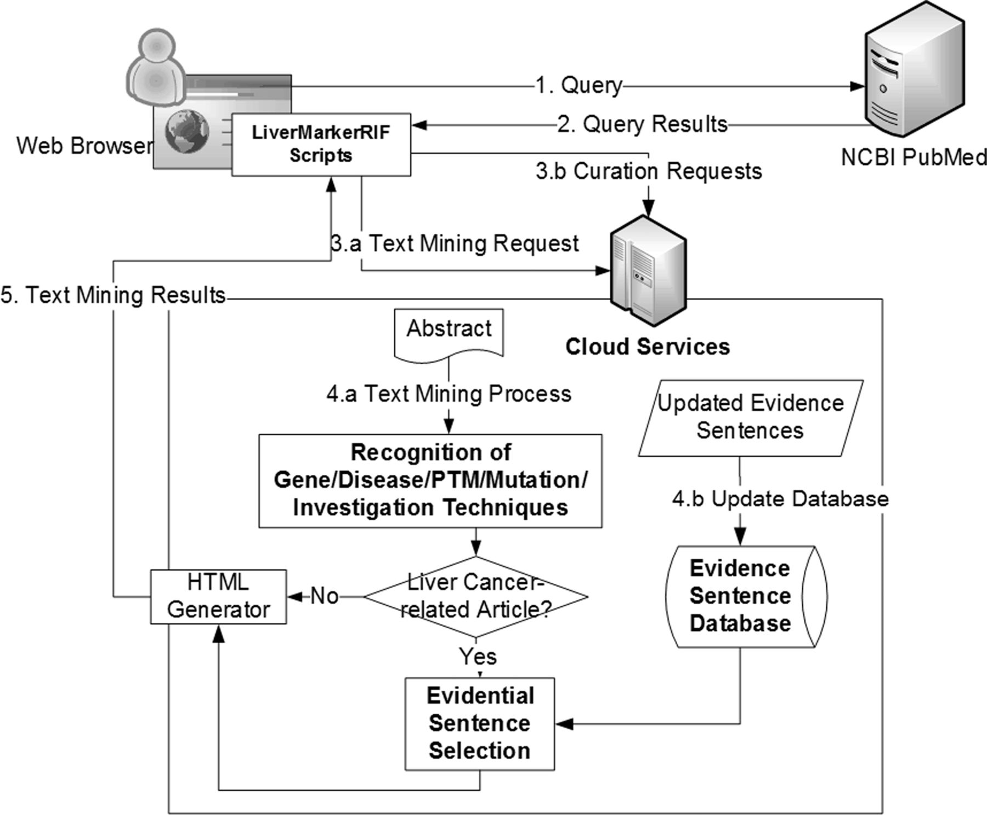
Figure 3. The system workflow of LiverCancerMarkerRIF. After installing LiverCancerMarkerRIF, it monitors the query ...
Notes:
Figure 3. The system workflow of LiverCancerMarkerRIF. After installing LiverCancerMarkerRIF, it monitors the query sent to PubMed (step 1 and 2) and analyzes the returned results to extract the target text, such as the title and abstract. In step 3.a, the extracted text is sent to the cloud server to recognize biomedical entities. In step 4.a, in addition to recognizing entities, the curated evidential sentences for the article are further extracted from our database and combined with the entity recognition results if the text contained liver cancer-related terms. The results are finally sent back to the LiverCancerMarkerRIF in the client side to augment the original content. If some evidential sentences are curated by the curator, LiverCancerMarkerRIF will issue a curation request (step 3.b) and update our server-side database (step 4.b).
Unless provided in the caption above, the following copyright applies to the content of this slide: © The Author(s) 2014. Published by Oxford University Press.This is an Open Access article distributed under the terms of the Creative Commons Attribution License (http://creativecommons.org/licenses/by/4.0/), which permits unrestricted reuse, distribution, and reproduction in any medium, provided the original work is properly cited.

Slide 4
Figure 4. The details of the curation task protocol in BioCreative IV IAT.
Notes:
Figure 4. The details of the curation task protocol in BioCreative IV IAT.
Unless provided in the caption above, the following copyright applies to the content of this slide: © The Author(s) 2014. Published by Oxford University Press.This is an Open Access article distributed under the terms of the Creative Commons Attribution License (http://creativecommons.org/licenses/by/4.0/), which permits unrestricted reuse, distribution, and reproduction in any medium, provided the original work is properly cited.

Slide 5
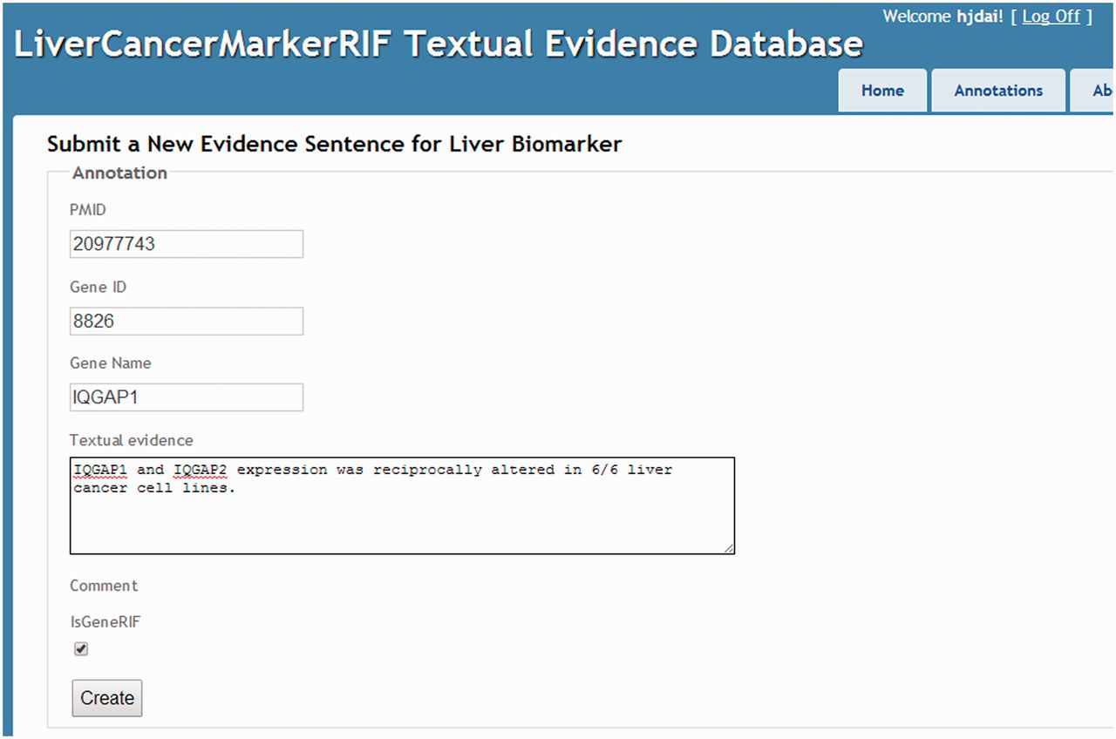
Figure 5. The manual curation interface.
Notes:
Figure 5. The manual curation interface.
Unless provided in the caption above, the following copyright applies to the content of this slide: © The Author(s) 2014. Published by Oxford University Press.This is an Open Access article distributed under the terms of the Creative Commons Attribution License (http://creativecommons.org/licenses/by/4.0/), which permits unrestricted reuse, distribution, and reproduction in any medium, provided the original work is properly cited.

Slide 6
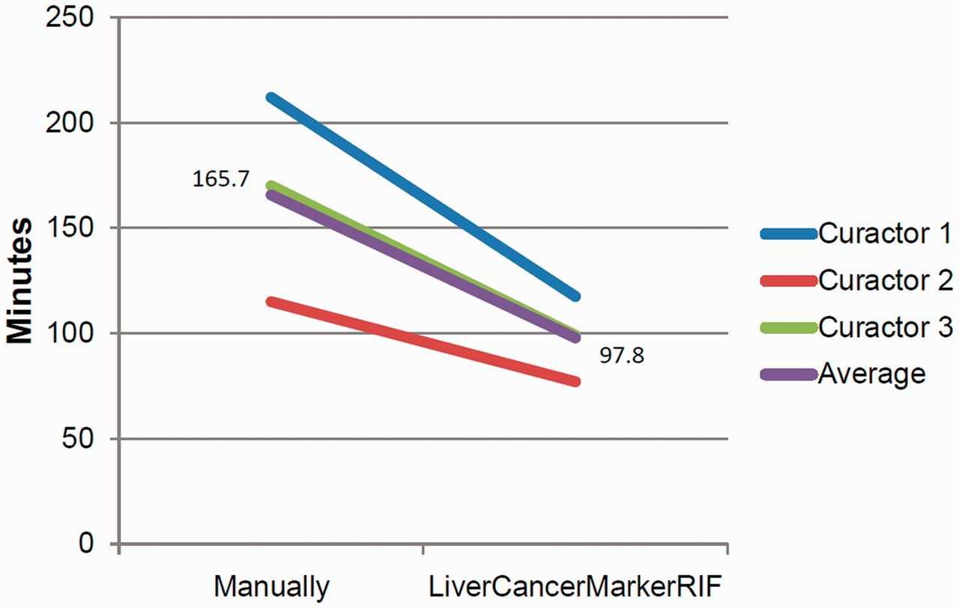
Figure 6. Curation time comparison.
Notes:
Figure 6. Curation time comparison.
Unless provided in the caption above, the following copyright applies to the content of this slide: © The Author(s) 2014. Published by Oxford University Press.This is an Open Access article distributed under the terms of the Creative Commons Attribution License (http://creativecommons.org/licenses/by/4.0/), which permits unrestricted reuse, distribution, and reproduction in any medium, provided the original work is properly cited.

Slide 7
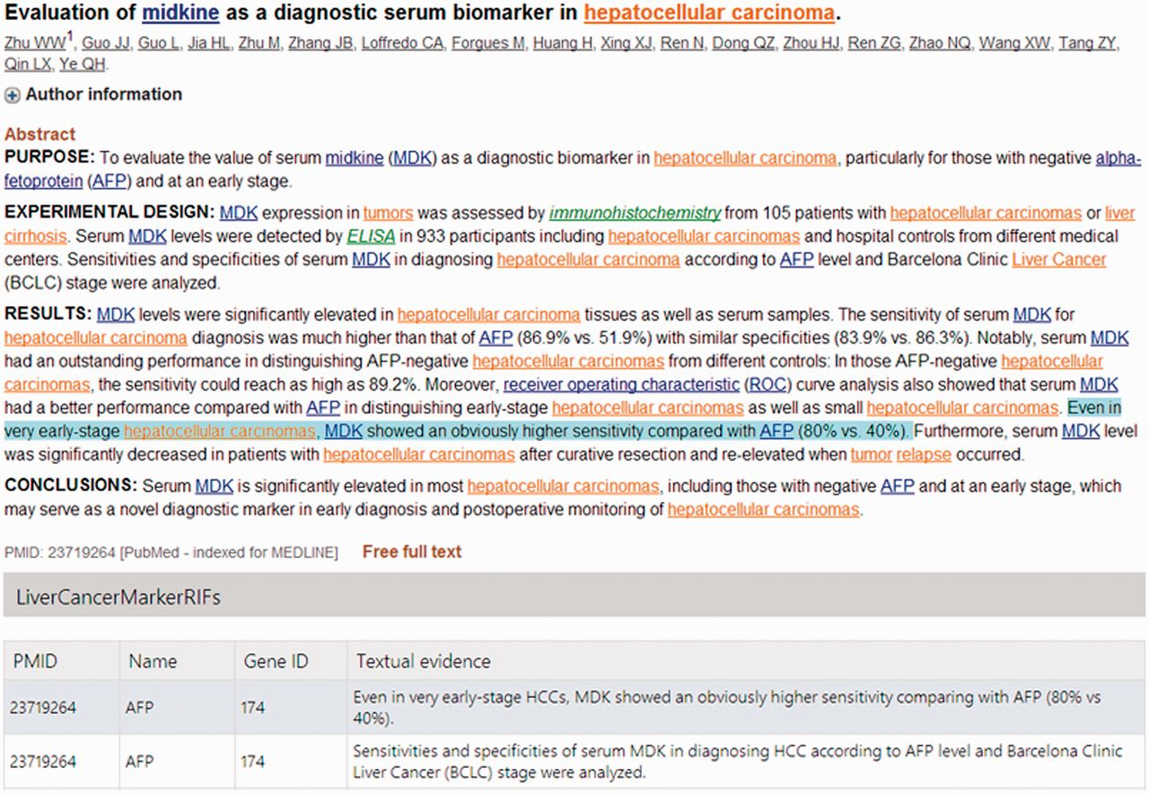
Figure 7. The curated table for non-logon users.
Notes:
Figure 7. The curated table for non-logon users.
Unless provided in the caption above, the following copyright applies to the content of this slide: © The Author(s) 2014. Published by Oxford University Press.This is an Open Access article distributed under the terms of the Creative Commons Attribution License (http://creativecommons.org/licenses/by/4.0/), which permits unrestricted reuse, distribution, and reproduction in any medium, provided the original work is properly cited.

Slide 8
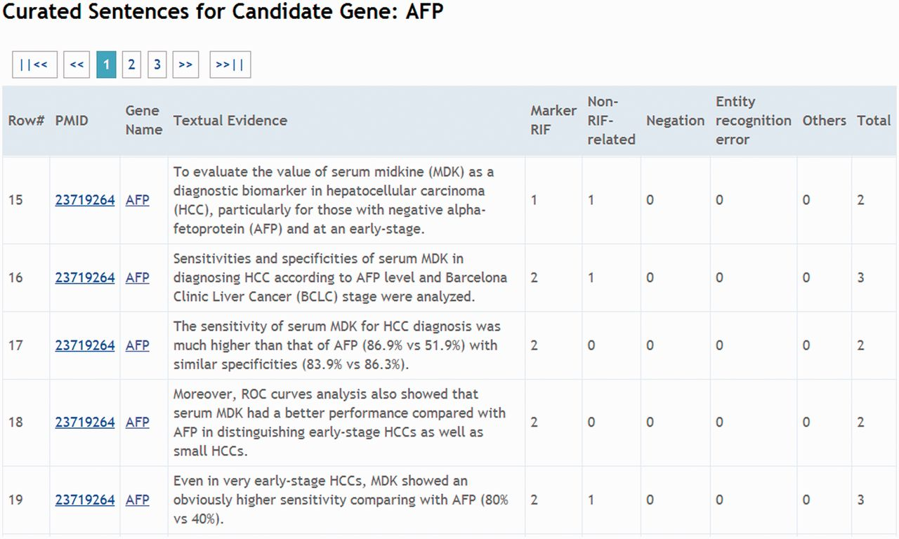
Figure 8. A snapshot of the curated affirmations for AFP from all curators.
Notes:
Figure 8. A snapshot of the curated affirmations for AFP from all curators.
Unless provided in the caption above, the following copyright applies to the content of this slide: © The Author(s) 2014. Published by Oxford University Press.This is an Open Access article distributed under the terms of the Creative Commons Attribution License (http://creativecommons.org/licenses/by/4.0/), which permits unrestricted reuse, distribution, and reproduction in any medium, provided the original work is properly cited.

