Slide 1
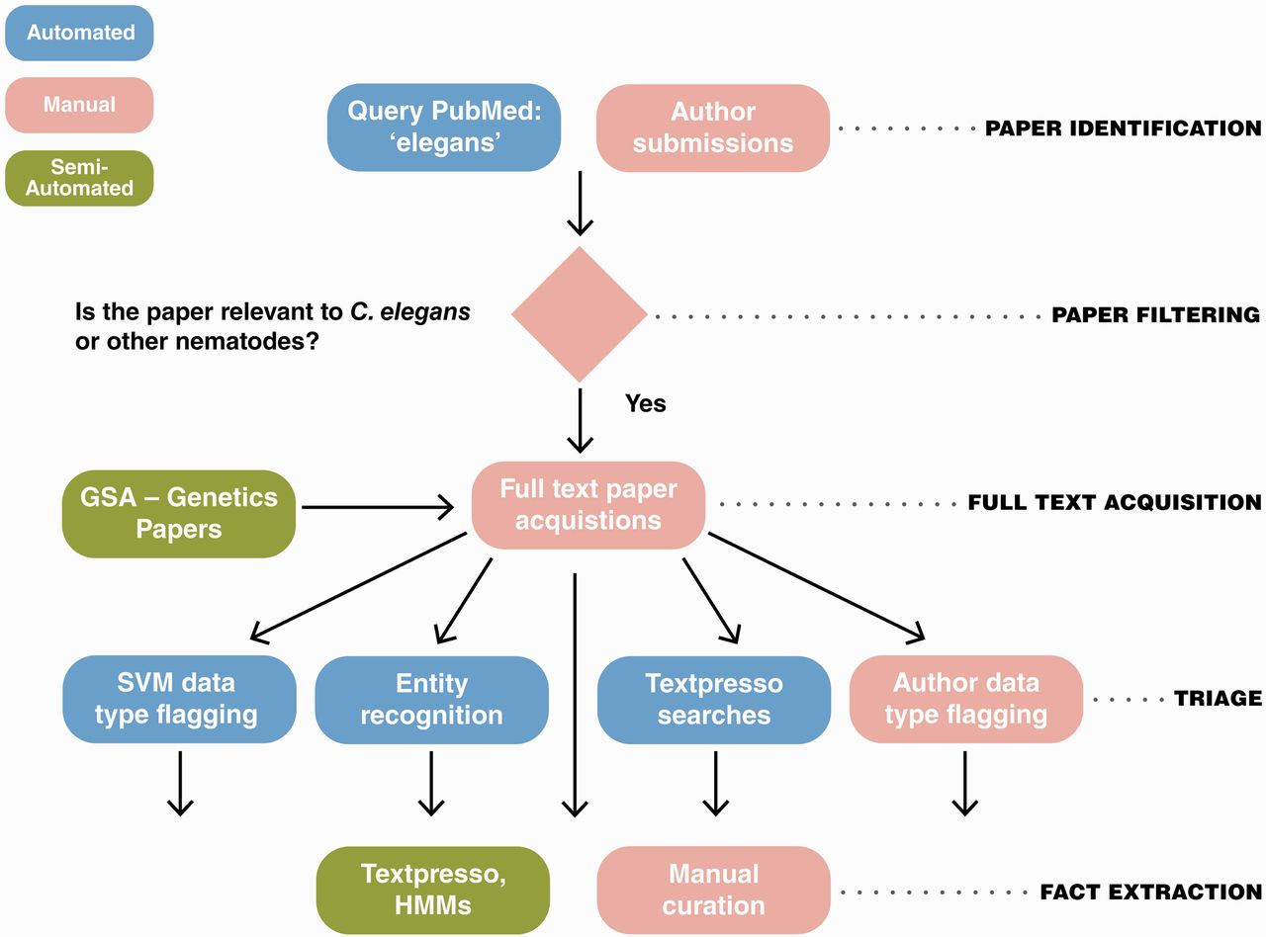
Figure 1 The WormBase literature curation workflow. WormBase literature curation incorporates automated (blue), ...
Notes:
Figure 1 The WormBase literature curation workflow. WormBase literature curation incorporates automated (blue), semi-automated (green) and manual (pink) steps. Potentially curatable papers are initially brought into WormBase primarily via PubMed searches with additional contributions from authors and a collaboration between WormBase and the GSA for Genetics and G3: Genes, Genomes, Genetics papers. Following full-text acquisition, a triage step is used to determine what data types are present in papers. The triage step is largely automated but also includes author contributions. Once papers have been flagged for data types, curators responsbile for curation of that data type use manual and semi-automated methods to extract the information and convert it into machine-readable format.
Unless provided in the caption above, the following copyright applies to the content of this slide: © The Author(s) 2012. Published by Oxford University Press.This is an Open Access article distributed under the terms of the Creative Commons Attribution License (http://creativecommons.org/licenses/by-nc/3.0/), which permits non-commercial reuse, distribution, and reproduction in any medium, provided the original work is properly cited. For commercial re-use, please contact journals.permissions@oup.com.

Slide 2
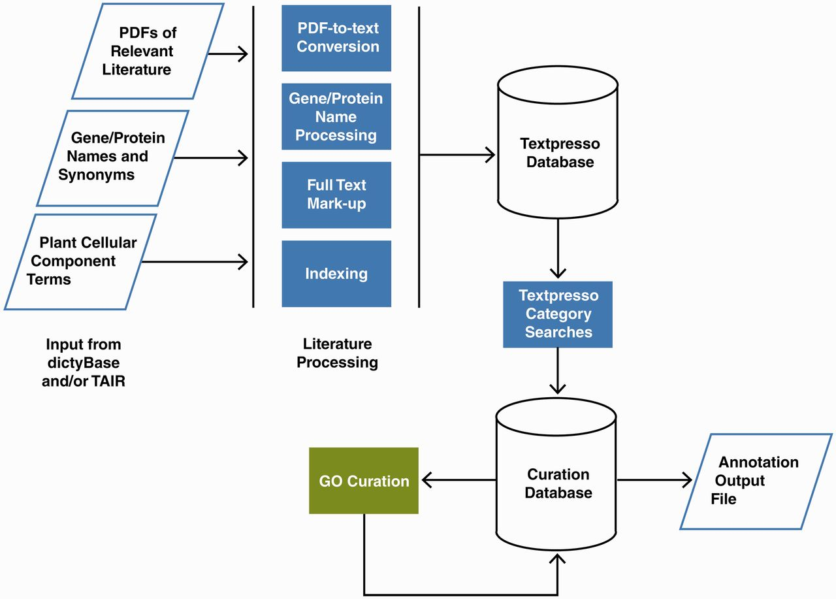
Figure 2 Pipeline for Textpresso for Cellular Component Curation for dictyBase and TAIR. PDFs of publications included ...
Notes:
Figure 2 Pipeline for Textpresso for Cellular Component Curation for dictyBase and TAIR. PDFs of publications included in the dictyBase and TAIR curation corpora and files of Dictyostelium and Arabidopsis gene and protein names and synonyms are uploaded to a Textpresso server at Caltech. PDFs are converted to text; gene and protein names and synonyms are processed to include variants (e.g. upper- and lower-case versions), and organism-specific terms are added to the Textpresso cellular component ontology. Full text is then marked up using the new categories. Four- and five-category searches are performed on the full text and results formatted and stored for use in the curation database. Using a Web-based curation form, curators make annotations that are subsequently stored in the curation database and available for export as annotation files.
Unless provided in the caption above, the following copyright applies to the content of this slide: © The Author(s) 2012. Published by Oxford University Press.This is an Open Access article distributed under the terms of the Creative Commons Attribution License (http://creativecommons.org/licenses/by-nc/3.0/), which permits non-commercial reuse, distribution, and reproduction in any medium, provided the original work is properly cited. For commercial re-use, please contact journals.permissions@oup.com.

Slide 3
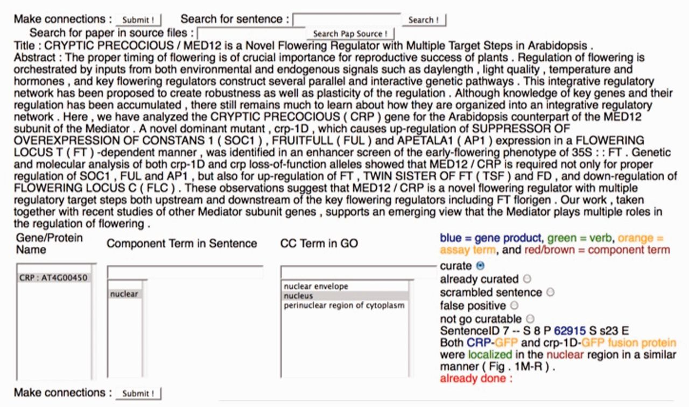
Figure 3 The Textpresso for CCC Curation Form. A screenshot of the curation form used for the Textpresso for CCC ...
Notes:
Figure 3 The Textpresso for CCC Curation Form. A screenshot of the curation form used for the Textpresso for CCC evaluation is shown. Textpresso sentences are displayed on the bottom right corner of the form, with matches to each of the Textpresso categories highlighted and color coded. The title and abstract of the paper are shown at the top. On the bottom left side of the form are three curation boxes containing, from left to right, the identified gene product, the component term from the retrieved sentence and suggested GO terms based on the previous curation. To make a GO annotation, the curator makes a selection from each of the boxes, highlighted in gray, selects the curate radio button above the sentence and presses Submit to commit the annotation to the curation database. Additional radio buttons allow curators to further classify sentences, if needed. These additional actions were not part of the current BioCreative evaluation.
Unless provided in the caption above, the following copyright applies to the content of this slide: © The Author(s) 2012. Published by Oxford University Press.This is an Open Access article distributed under the terms of the Creative Commons Attribution License (http://creativecommons.org/licenses/by-nc/3.0/), which permits non-commercial reuse, distribution, and reproduction in any medium, provided the original work is properly cited. For commercial re-use, please contact journals.permissions@oup.com.

