Slide 1
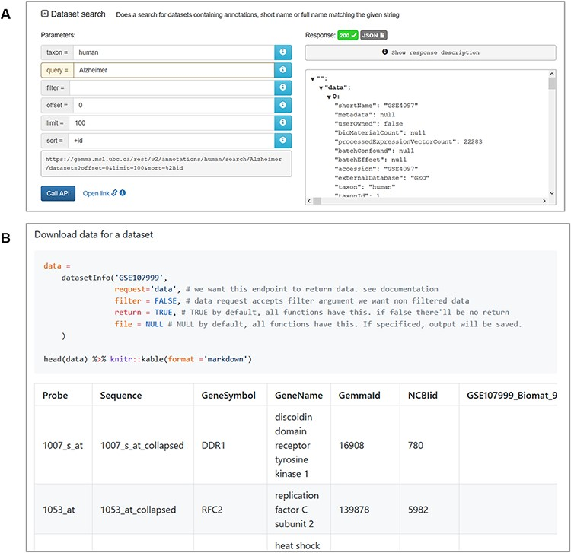
Figure 12. Snapshot of JSON output from searching for ‘Alzheimer’ datasets using the interactive documentation website ...
Notes:
Figure 12. Snapshot of JSON output from searching for ‘Alzheimer’ datasets using the interactive documentation website of the Gemma REST Application Programming Interface (API) (A) and tabulated output of GSE107999’s (63) metadata and expression data using the GemmaAPI.R package (B).
Unless provided in the caption above, the following copyright applies to the content of this slide: © The Author(s) 2021. Published by Oxford University Press.This is an Open Access article distributed under the terms of the Creative Commons Attribution License (http://creativecommons.org/licenses/by/4.0/), which permits unrestricted reuse, distribution, and reproduction in any medium, provided the original work is properly cited.

