Slide 1
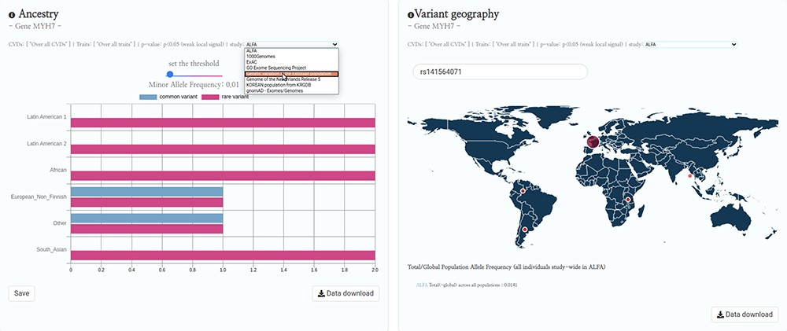
Figure 4. HeartBioPortal2.0’s genetic ancestry and variant geography feature. CVD-relevant exome/genome population ...
Notes:
Figure 4. HeartBioPortal2.0’s genetic ancestry and variant geography feature. CVD-relevant exome/genome population allele frequency data displayed in the Ancestry and Variant Geography maps from dozens of studies/cohorts ranging from gnomAD to ‘Genome of the Netherlands Release 5’ to ‘Korean population from KRGDB’ among many others. In total, 54 diverse subpopulations across 27 new studies/cohorts have been added, relative to gnomAD alone in HeartBioPortal’s initial debut in May 2019. Users can now search individual mutations (rsID accession identifiers) as well as toggle a Minor Allele Frequency (MAF) slider bar that interactively displays the proportion of rare vs. common variants at user-selected MAF thresholds.
Unless provided in the caption above, the following copyright applies to the content of this slide: © The Author(s) 2020. Published by Oxford University Press.This is an Open Access article distributed under the terms of the Creative Commons Attribution License (http://creativecommons.org/licenses/by/4.0/), which permits unrestricted reuse, distribution, and reproduction in any medium, provided the original work is properly cited.

