Slide 1
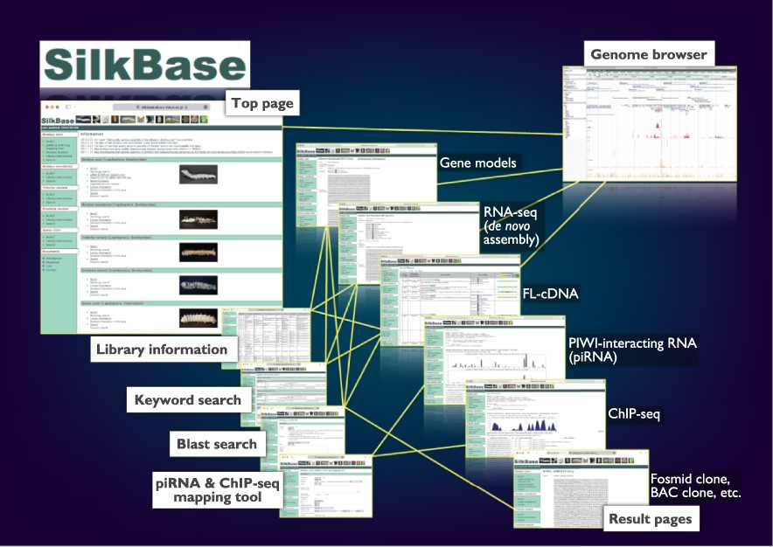
Figure 1. Overview of the Web user interfaces. The path lines show the user pathways between the Web user interfaces.
Notes:
Figure 1. Overview of the Web user interfaces. The path lines show the user pathways between the Web user interfaces.
Unless provided in the caption above, the following copyright applies to the content of this slide: © The Author(s) 2022. Published by Oxford University Press.This is an Open Access article distributed under the terms of the Creative Commons Attribution-NonCommercial License (https://creativecommons.org/licenses/by-nc/4.0/), which permits non-commercial re-use, distribution, and reproduction in any medium, provided the original work is properly cited. For commercial re-use, please contact journals.permissions@oup.com

Slide 2
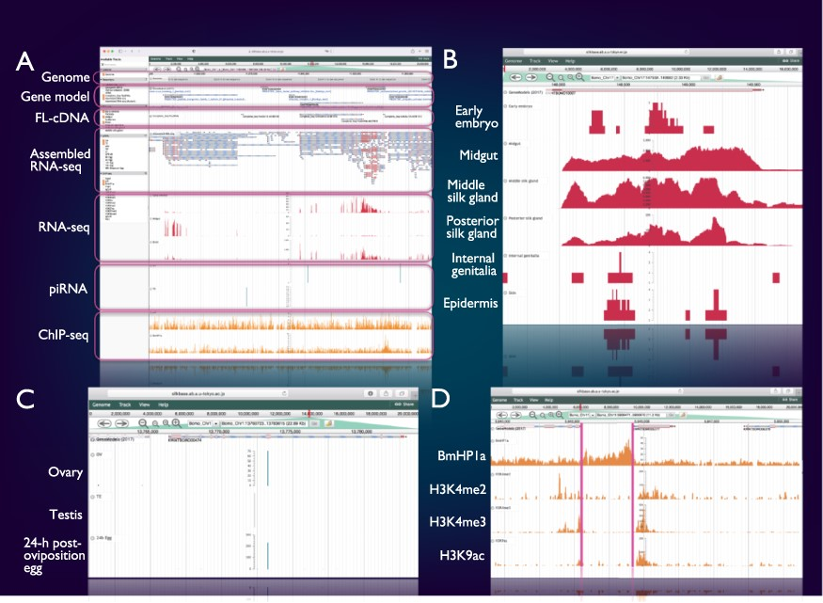
Figure 2. Integrated genome browser. (A) Overview of the genome browser. Genomic, transcriptomic and epigenomic ...
Notes:
Figure 2. Integrated genome browser. (A) Overview of the genome browser. Genomic, transcriptomic and epigenomic information is displayed on a single screen. (B) Transcriptional status of BmSuc1 in different tissues. (C) A piRNA-producing locus in the Masc gene. (D) Histone modifications around the KWMTBOMO06377 gene.
Unless provided in the caption above, the following copyright applies to the content of this slide: © The Author(s) 2022. Published by Oxford University Press.This is an Open Access article distributed under the terms of the Creative Commons Attribution-NonCommercial License (https://creativecommons.org/licenses/by-nc/4.0/), which permits non-commercial re-use, distribution, and reproduction in any medium, provided the original work is properly cited. For commercial re-use, please contact journals.permissions@oup.com

Slide 3
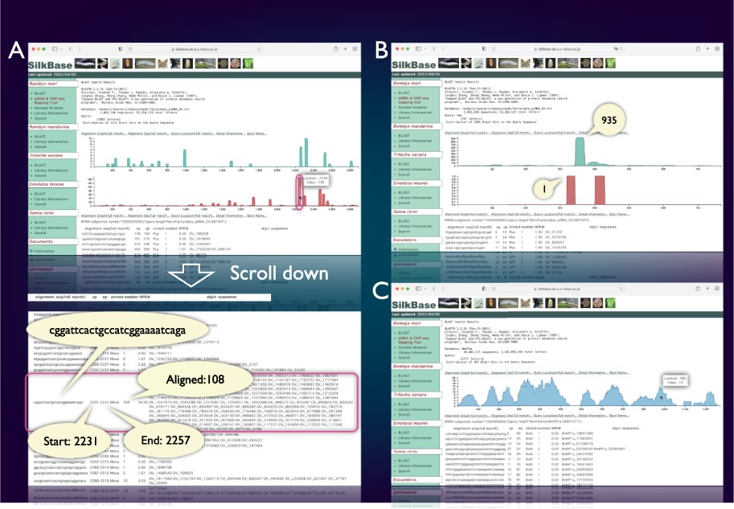
Figure 3. piRNA- and ChIP-seq mapping tool. The vertical axis indicates the nucleotide position of the query sequence, ...
Notes:
Figure 3. piRNA- and ChIP-seq mapping tool. The vertical axis indicates the nucleotide position of the query sequence, and the horizontal axis indicates the depth of coverage. The upper graph shows the mapping results on the sense strand, whereas the lower graph shows those on the antisense strand (piRNA mapping tool only). Information on nucleotide sequence, start point, end point, strand and the depth of coverage is displayed below the graph. (A) piRNA production in ovary from the transposon Kabuki. The detailed information of a certain peak (indicated by oval) is as follows: the piRNA sequence is ‘cggattcactgccatcggaaaatcaga’, and 108 reads are mapped from 2231 to 2257. (B) An example of the piRNA production status in the Fem locus. The depth of coverage is 935 on the sense strand and 1 on the antisense strand. (C) Mapping of the HP1a-binding sites around the KWMTBOMO02692 gene. The depth of ChIP-seq coverage on both strands is merged and displayed on a single graph (ChIP-seq mapping tool).
Unless provided in the caption above, the following copyright applies to the content of this slide: © The Author(s) 2022. Published by Oxford University Press.This is an Open Access article distributed under the terms of the Creative Commons Attribution-NonCommercial License (https://creativecommons.org/licenses/by-nc/4.0/), which permits non-commercial re-use, distribution, and reproduction in any medium, provided the original work is properly cited. For commercial re-use, please contact journals.permissions@oup.com

Slide 4
Figure 4. Comparative genomic analysis of B. mori-related species. (A) The phylogenetic relationship of B. mori and ...
Notes:
Figure 4. Comparative genomic analysis of B. mori-related species. (A) The phylogenetic relationship of B. mori and related species. The host plants are different among the three groups (indicated by rectangles). (B) An example of the identification of B. mori Masc homologs from four species.
Unless provided in the caption above, the following copyright applies to the content of this slide: © The Author(s) 2022. Published by Oxford University Press.This is an Open Access article distributed under the terms of the Creative Commons Attribution-NonCommercial License (https://creativecommons.org/licenses/by-nc/4.0/), which permits non-commercial re-use, distribution, and reproduction in any medium, provided the original work is properly cited. For commercial re-use, please contact journals.permissions@oup.com

