Slide 1
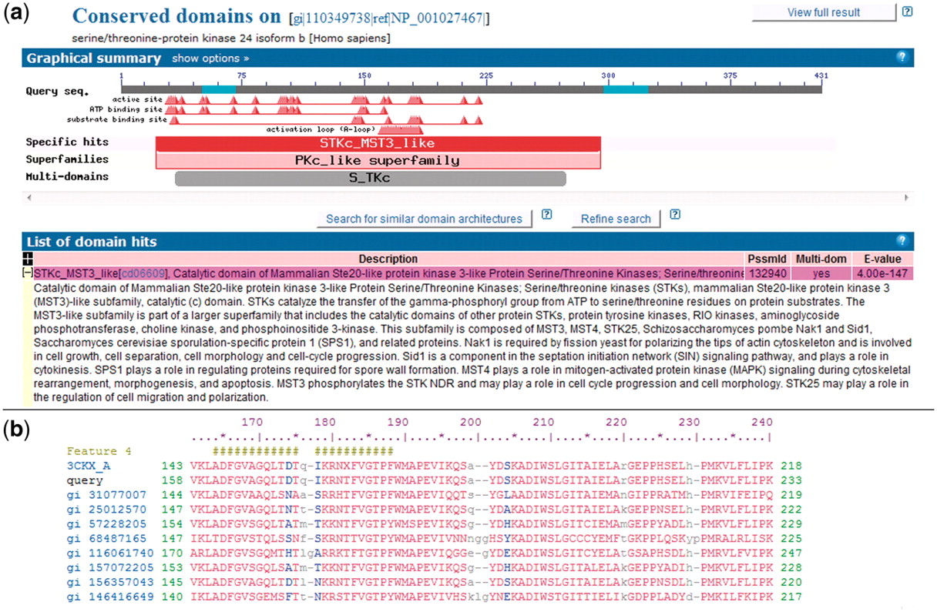
Figure 1. NCBI Conserved Domains annotated on a protein query. (a) RPS-BLAST is used to find domain footprints and ...
Notes:
Figure 1. NCBI Conserved Domains annotated on a protein query. (a) RPS-BLAST is used to find domain footprints and derived functional sites using a serine–threonine protein kinase as a protein query (GI 110349738). Shown in red is a specific hit, i.e. a protein sub-family identified with high confidence. (b) Example of a multiple sequence alignment (MSA) representing a CDD domain. The alignable regions (structured blocks or block alignments) are shown in upper case blocks, while the unaligned regions are shown as lower case and gaps. NCBI CDD also can provide functional site annotation. The hash marks indicate the annotation of an activation loop (A-loop). The row starting with ‘query’ shows the protein query (GI:110349738) with start and stop sites.
Unless provided in the caption above, the following copyright applies to the content of this slide: Published by Oxford University Press 2011.This is Open Access article distributed under the terms of the Creative Commons Attribution Non-Commercial License (http://creativecommons.org/licenses/by-nc/2.5), which permits unrestricted non-commercial use, distribution, and reproduction in any medium, provided the original work is properly cited.

