Slide 1
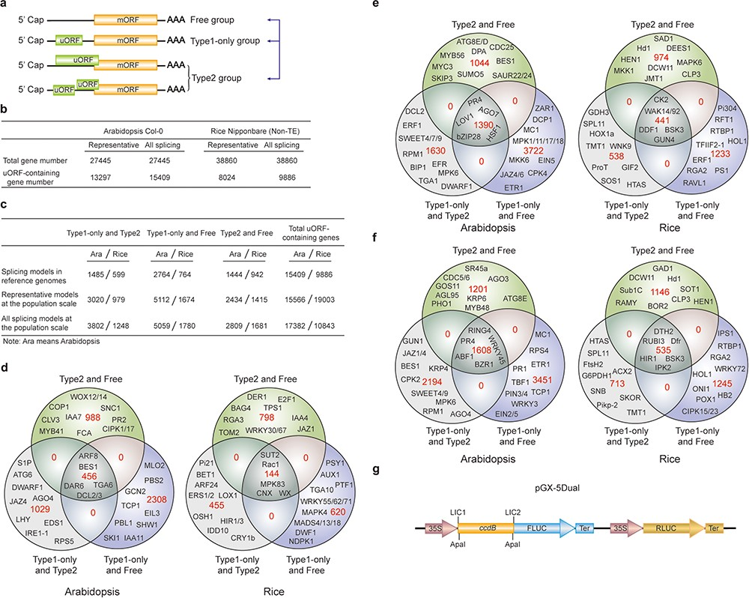
Figure 3 uORF variation. (a) Schematic of altered uORF types analyzed in this study. Three Level1 uORF variants are ...
Notes:
Figure 3 uORF variation. (a) Schematic of altered uORF types analyzed in this study. Three Level1 uORF variants are focused by studying changes between Type1-only and Type2, between Type1-only and uORF-free and between Type2 and uORF-free. Genes with both Type2 and Type1 on the same splicing model are grouped as Type2 in this analysis. (b) Number of uORF-containing genes in Arabidopsis Col-0 and rice Nipponbare. The representative and all splicing gene models are calculated. Non-TE, non-transposon element. (c) Number of three Level1 uORF variants. Analysis is performed among different splicing models of reference genomes (Arabidopsis Col-0 and rice Nipponbare), and among accessions at the population scale using the representative and all splicing gene models. (d) Venn diagram of three Level1 uORF variants within different splicing models of Arabidopsis Col-0 and rice Nipponbare. (e, f) Venn diagram of three Level1 uORF variants of the representative gene models (e) and all splicing gene models (f) at the population level. Example gene names are shown in different regions. (g) Schematic of dual-luciferase vector pGX-5Dual. 5′ leader containing different uORF variants are cloned via LIC method to control the translation of firefly luciferase (FLUC). ApaI is used to linearize the vector. Comparison of the ratio of FLUC activity and mRNA level to the internal control RLUC expressed from the same vector will indicate the effects of uORF variants on mRNA stability and translation efficiency.
Unless provided in the caption above, the following copyright applies to the content of this slide: © The Author(s) 2020. Published by Oxford University Press.This is an Open Access article distributed under the terms of the Creative Commons Attribution License (http://creativecommons.org/licenses/by/4.0/), which permits unrestricted reuse, distribution, and reproduction in any medium, provided the original work is properly cited.

