Slide 1
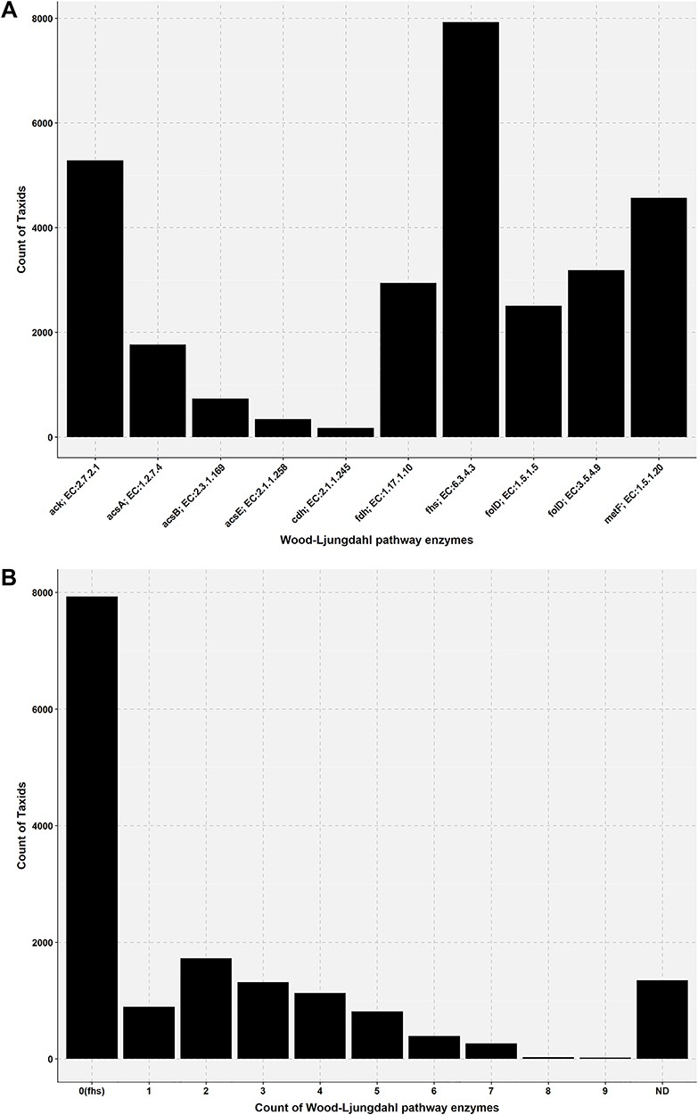
Figure 5 Bar plot showing the presence of Wood–Ljungdahl pathway enzymes in the genome of AcetoBas accessions. (A) ...
Notes:
Figure 5 Bar plot showing the presence of Wood–Ljungdahl pathway enzymes in the genome of AcetoBas accessions. (A) Count of taxids for the Wood–Ljungdahl pathway enzymes in the genome of AcetoBase accessions (ND, not determined). (B) Count of taxids for the presence of particular enzymes in the Wood–Ljungdahl pathway.
Unless provided in the caption above, the following copyright applies to the content of this slide: © The Author(s) 2019. Published by Oxford University Press.This is an Open Access article distributed under the terms of the Creative Commons Attribution Non-Commercial License (http://creativecommons.org/licenses/by-nc/4.0/), which permits non-commercial re-use, distribution, and reproduction in any medium, provided the original work is properly cited. For commercial re-use, please contact journals.permissions@oup.com

