Slide 1
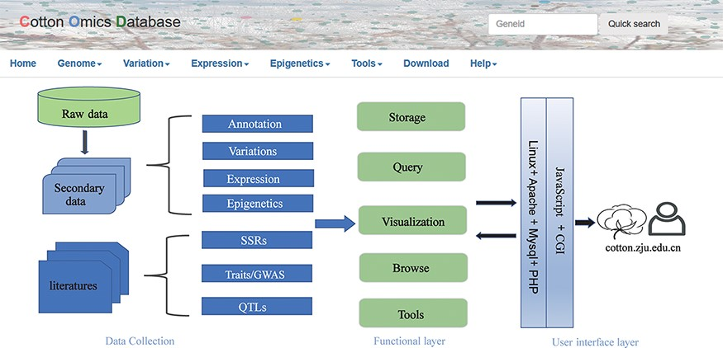
Figure 1. Summary of COTTONOMICS data collection and construction. COTTONOMICS is an easily accessible web database ...
Notes:
Figure 1. Summary of COTTONOMICS data collection and construction. COTTONOMICS is an easily accessible web database that integrates 32.5 TB of omics data including seven assembled genomes, resequencing data from 1180 allotetraploid cotton accessions and multi-omics data; detailed data information is found in Table 1
Unless provided in the caption above, the following copyright applies to the content of this slide: © The Author(s) 2022. Published by Oxford University Press.This is an Open Access article distributed under the terms of the Creative Commons Attribution-NonCommercial License (https://creativecommons.org/licenses/by-nc/4.0/), which permits non-commercial re-use, distribution, and reproduction in any medium, provided the original work is properly cited. For commercial re-use, please contact journals.permissions@oup.com

Slide 2
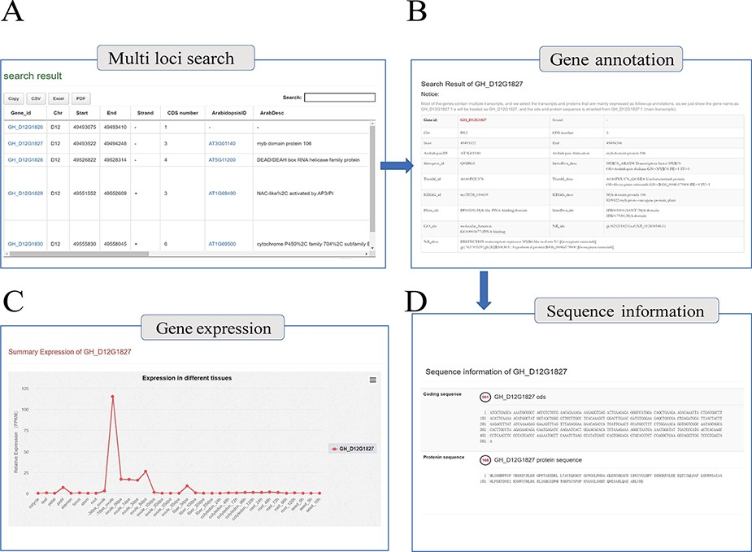
Figure 2. Genome annotation query interface. (A) Multi-loci query interface. (B) COTTONOMICS returns detailed ...
Notes:
Figure 2. Genome annotation query interface. (A) Multi-loci query interface. (B) COTTONOMICS returns detailed information regarding the functional annotation, location, etc. (C) Expression of the query gene; the interface use dot plots to indicate the expression level of the query gene in different tissues. (D) Sequence information of gene locus GH_D12G1827.
Unless provided in the caption above, the following copyright applies to the content of this slide: © The Author(s) 2022. Published by Oxford University Press.This is an Open Access article distributed under the terms of the Creative Commons Attribution-NonCommercial License (https://creativecommons.org/licenses/by-nc/4.0/), which permits non-commercial re-use, distribution, and reproduction in any medium, provided the original work is properly cited. For commercial re-use, please contact journals.permissions@oup.com

Slide 3
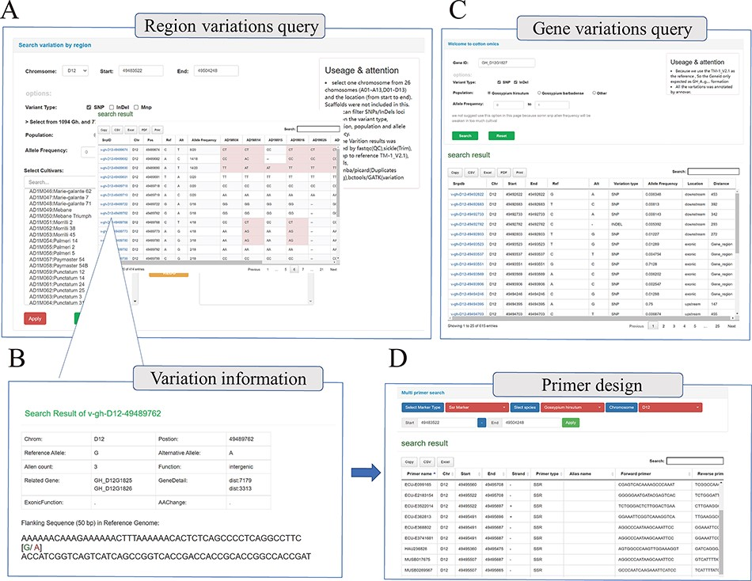
Figure 3. Whole genome-wide variations query interface. (A) Variation information regarding genome region (e.g. ...
Notes:
Figure 3. Whole genome-wide variations query interface. (A) Variation information regarding genome region (e.g. D12:49 483 522–49 504 248) among different cotton samples. (B) Detailed introduction of the mutation site (e.g. v-gh-D12-49 489 762), including location information, related genes, function prediction and flank sequence. (C) Variations query based on gene locus (e.g. GH_D12G1827); this interface will return all the mutation sites related to the gene, including upstream, downstream, UTR, exon, etc. (D) Multi-type primer design interface; users can obtain SSR primers and InDel primers based on locus.
Unless provided in the caption above, the following copyright applies to the content of this slide: © The Author(s) 2022. Published by Oxford University Press.This is an Open Access article distributed under the terms of the Creative Commons Attribution-NonCommercial License (https://creativecommons.org/licenses/by-nc/4.0/), which permits non-commercial re-use, distribution, and reproduction in any medium, provided the original work is properly cited. For commercial re-use, please contact journals.permissions@oup.com

Slide 4
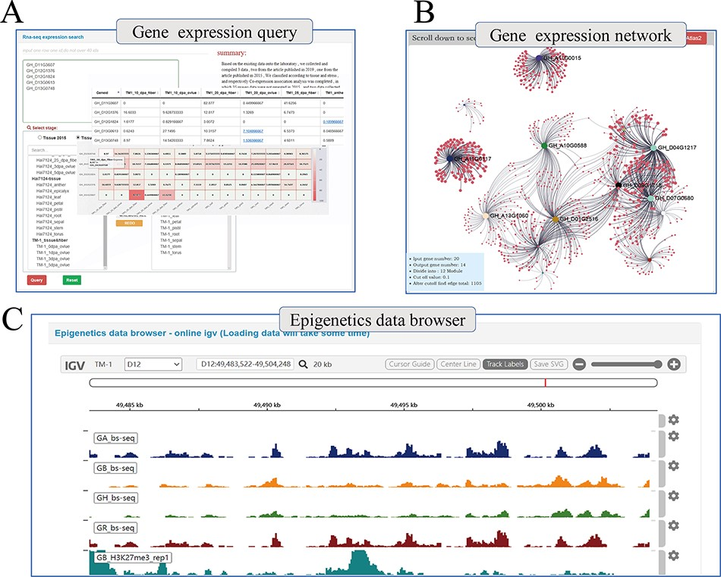
Figure 4. Whole genome-wide transcriptome and epigenome query interface. (A) The interface uses heatmap to show the ...
Notes:
Figure 4. Whole genome-wide transcriptome and epigenome query interface. (A) The interface uses heatmap to show the expression levels of multi-genes in different states. (B) Co-expression relationship visualization of query genes; each dot represents a gene related to the query genes. The size of the gene is proportional to the number of related genes, and the thickness of the line is proportional to the association between the genes. (C) Gene browser for epigenetic data; users can perform operations of coloring, zooming and position jump to the data just like operating the local igv tool.
Unless provided in the caption above, the following copyright applies to the content of this slide: © The Author(s) 2022. Published by Oxford University Press.This is an Open Access article distributed under the terms of the Creative Commons Attribution-NonCommercial License (https://creativecommons.org/licenses/by-nc/4.0/), which permits non-commercial re-use, distribution, and reproduction in any medium, provided the original work is properly cited. For commercial re-use, please contact journals.permissions@oup.com

Slide 5
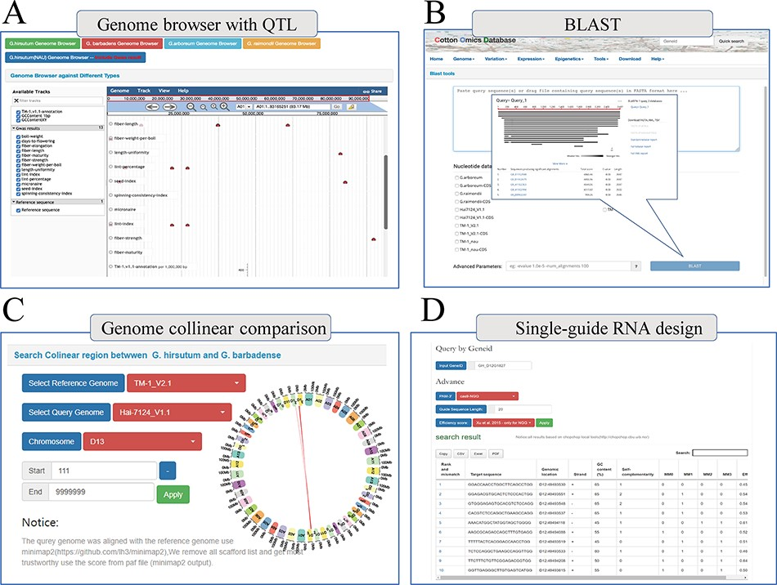
Figure 5. Multi-online bioinformatics tools. Genome browser for multiple cotton species. (B) Online blast tools; users ...
Notes:
Figure 5. Multi-online bioinformatics tools. Genome browser for multiple cotton species. (B) Online blast tools; users can blast against multiple cotton genome databases based on nucleic acid sequence and protein sequence. (C) Genome collinear comparison query interface; the interface provided circle graphs to show the collinearity of the genome, and users can also download the table to view these collinearity segments information. (D) Single-guide RNA design tools; the interface allows users to design single-guide RNA based on gene loci or chromosome location; furthermore, we also provide a variety of scoring strategies for users to evaluate the efficiency.
Unless provided in the caption above, the following copyright applies to the content of this slide: © The Author(s) 2022. Published by Oxford University Press.This is an Open Access article distributed under the terms of the Creative Commons Attribution-NonCommercial License (https://creativecommons.org/licenses/by-nc/4.0/), which permits non-commercial re-use, distribution, and reproduction in any medium, provided the original work is properly cited. For commercial re-use, please contact journals.permissions@oup.com

