Slide 1
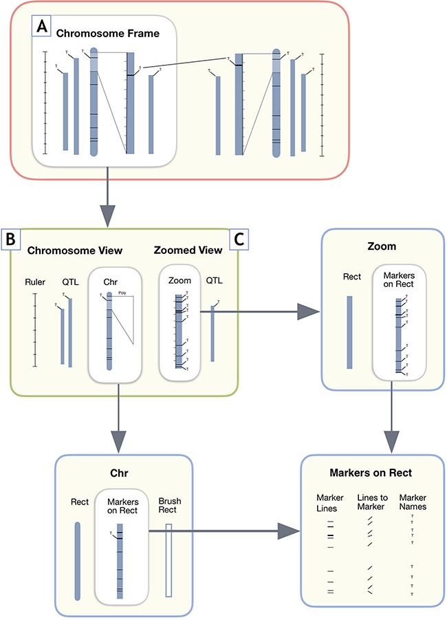
Figure 5 User interface design components for MapViewer linkage group display. A. The Chromosome Frame, which acts as ...
Notes:
Figure 5 User interface design components for MapViewer linkage group display. A. The Chromosome Frame, which acts as a container for the other drawing elements. B. Chromosome View is a child element of the Chromosome Frame parent. C. The Zoomed View child element draws the zoomed in region to the side of the full linkage group.
Unless provided in the caption above, the following copyright applies to the content of this slide: © The Author(s) 2019. Published by Oxford University Press.This work is written by US Government employees and is in the public domain in the US.

