Slide 1
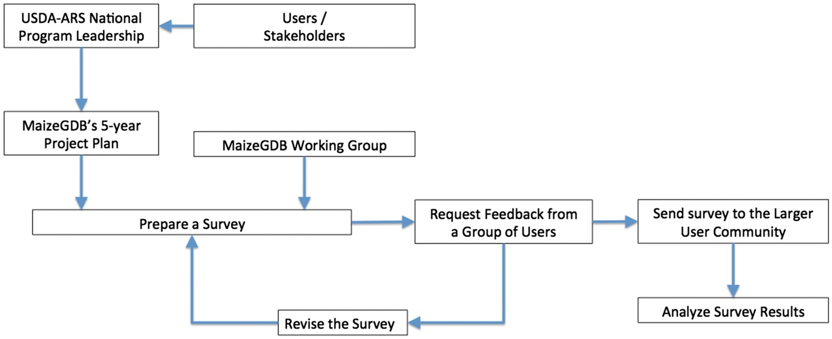
Figure 1. Flowchart showing the survey preparation workflow at MaizeGDB.
Notes:
Figure 1. Flowchart showing the survey preparation workflow at MaizeGDB.
Unless provided in the caption above, the following copyright applies to the content of this slide: Published by Oxford University Press 2017. This work is written by US Government employees and is in the public domain in the US.

Slide 2
Figure 2. Software release and enhancement cycle at MaizeGDB.
Notes:
Figure 2. Software release and enhancement cycle at MaizeGDB.
Unless provided in the caption above, the following copyright applies to the content of this slide: Published by Oxford University Press 2017. This work is written by US Government employees and is in the public domain in the US.

