Slide 1
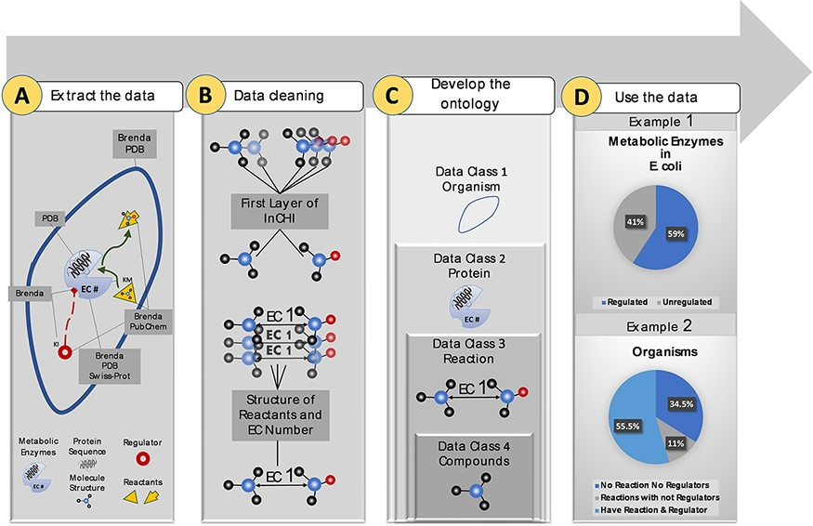
Figure 1. Visual abstract of the current study. Panel (A): Kinetic data scraped from BRENDA, PDB, PubChem and ...
Notes:
Figure 1. Visual abstract of the current study. Panel (A): Kinetic data scraped from BRENDA, PDB, PubChem and Swiss-Prot, each focused on separate sections of metabolism. Panel (B): Redundancy in compounds and reactions is filtered. Panel (C): Standard representation of multi-source data in hierarchical ontologies. Panel (D): The KinMod database enables extracting statistics of within- and cross-species relationships. (Example 1) 59% of enzymes in Escherichia coli have at least one known regulator, an example of the within-species relationship. (Example) 55.5% of organisms have at least one established reaction and regulator, an instance of the cross-species relationship.
Unless provided in the caption above, the following copyright applies to the content of this slide: © The Author(s) 2022. Published by Oxford University Press.This is an Open Access article distributed under the terms of the Creative Commons Attribution-NonCommercial License (https://creativecommons.org/licenses/by-nc/4.0/), which permits non-commercial re-use, distribution, and reproduction in any medium, provided the original work is properly cited. For commercial re-use, please contact journals.permissions@oup.com

