Slide 1
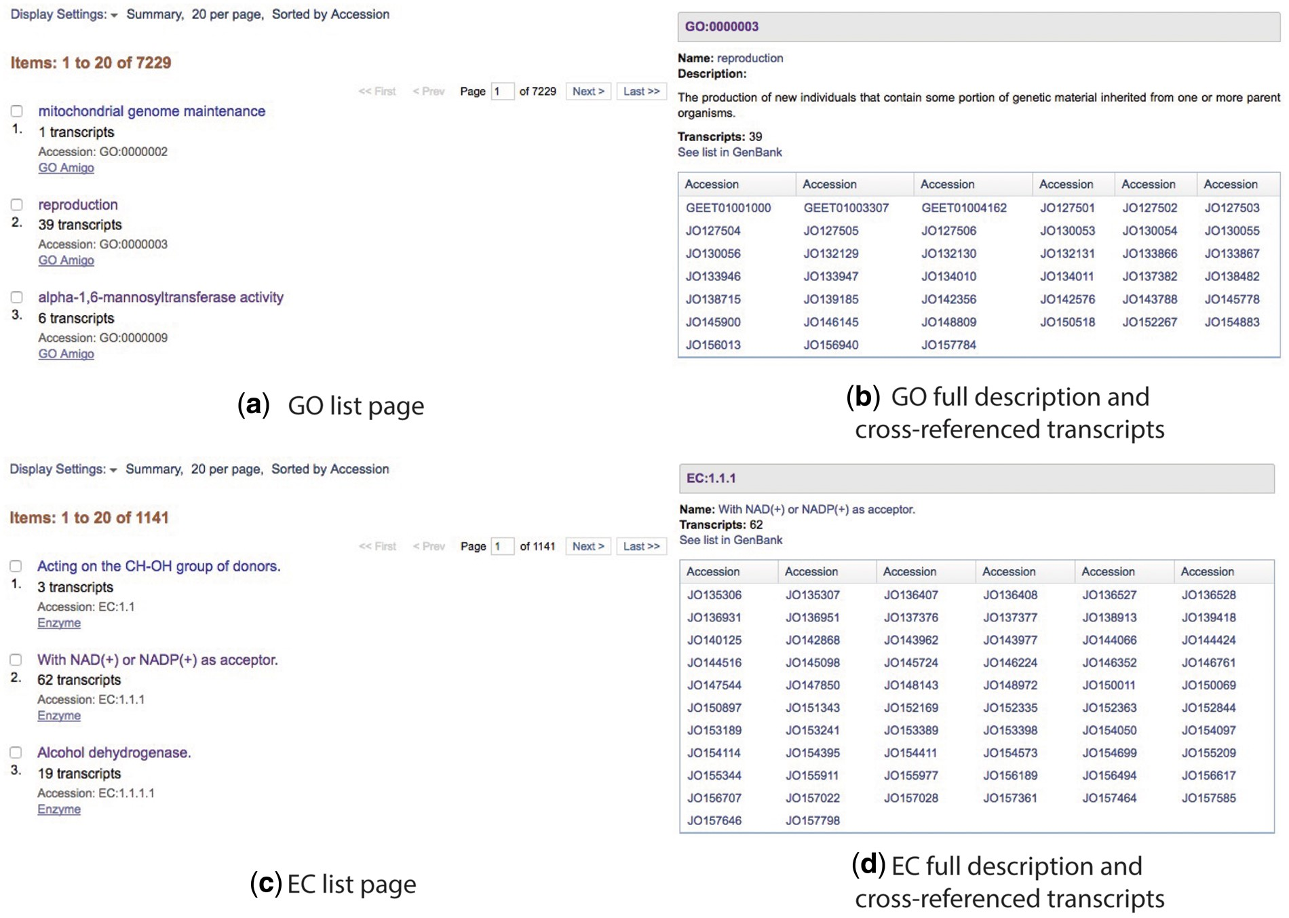
Figure 4. Cross-referenced Gene Ontology and Enzyme Commission lists (a and c) and full descriptions (b and d).
Notes:
Figure 4. Cross-referenced Gene Ontology and Enzyme Commission lists (a and c) and full descriptions (b and d).
Unless provided in the caption above, the following copyright applies to the content of this slide: Published by Oxford University Press 2017. This work is written by US Government employees and is in the public domain in the US.

