Slide 1
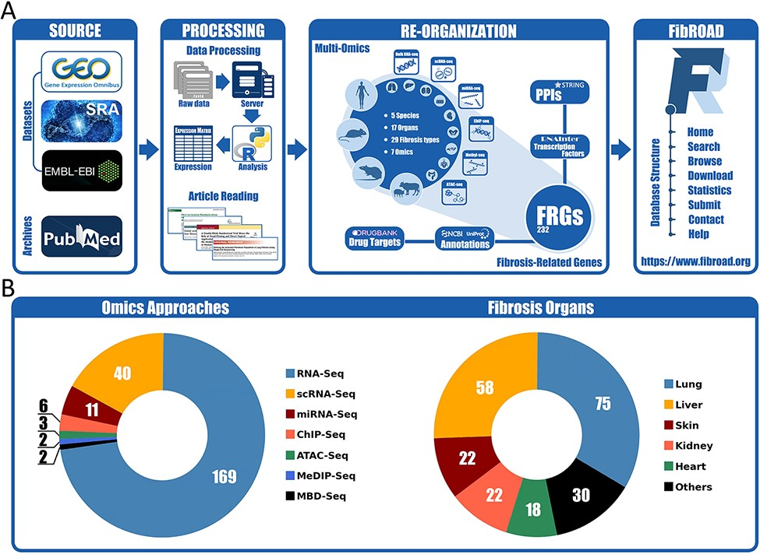
Figure 1. Workflow and statistics for the FibROAD database. (A) pipeline diagram depicting construction of the ...
Notes:
Figure 1. Workflow and statistics for the FibROAD database. (A) pipeline diagram depicting construction of the principal workflow of FibROAD. (B) Pie diagrams for the proportions of omic approaches (left) and organs (right) collected in FibROAD, with numbers indicating totals of projects.
Unless provided in the caption above, the following copyright applies to the content of this slide: © The Author(s) 2022. Published by Oxford University Press.This is an Open Access article distributed under the terms of the Creative Commons Attribution License (https://creativecommons.org/licenses/by/4.0/), which permits unrestricted reuse, distribution, and reproduction in any medium, provided the original work is properly cited.

Slide 2
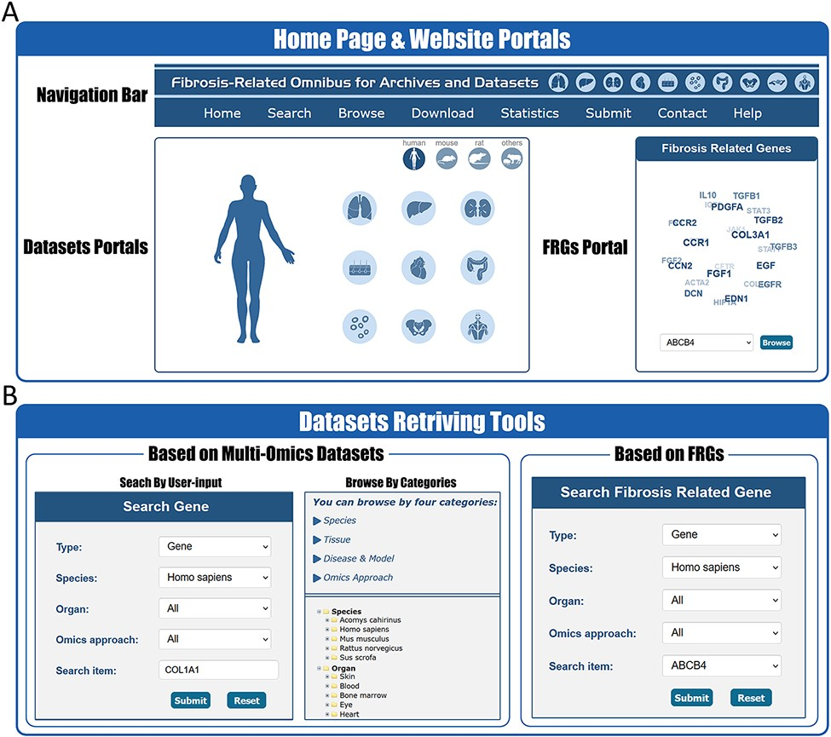
Figure 2. Website interface for FibROAD portals and dataset retrieving tools. (A) The home page of the FibROAD website ...
Notes:
Figure 2. Website interface for FibROAD portals and dataset retrieving tools. (A) The home page of the FibROAD website was equipped with a navigation bar at the top and portals to enter dataset browsers within specific categories (left), as well as portals to enter for the page containing fibrosis-related genes (right). (B) The FibROAD dataset retrieving tools (Search and Browse), which can be accessed through the navigation bar on the home page. Users can retrieve relative information with either self-defined keywords (left) or with pre-set FRGs (right).
Unless provided in the caption above, the following copyright applies to the content of this slide: © The Author(s) 2022. Published by Oxford University Press.This is an Open Access article distributed under the terms of the Creative Commons Attribution License (https://creativecommons.org/licenses/by/4.0/), which permits unrestricted reuse, distribution, and reproduction in any medium, provided the original work is properly cited.

Slide 3
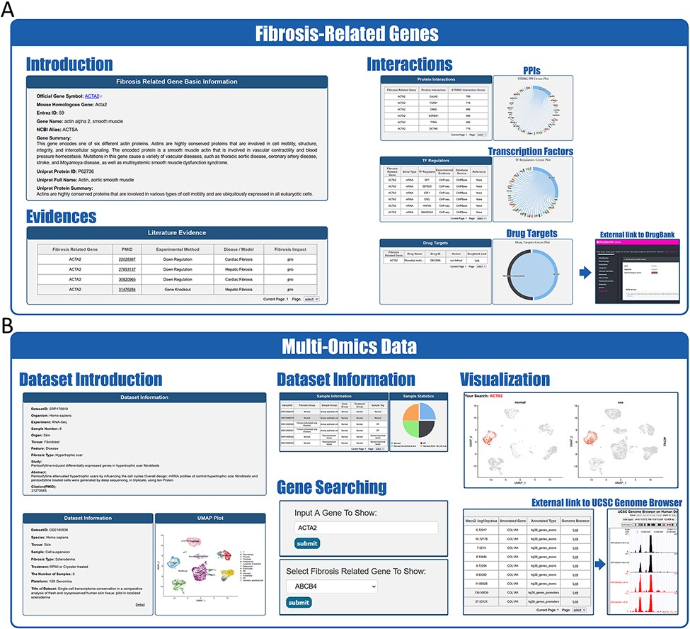
Figure 3. Website interface for FibROAD results and visualizations. (A) Result page for Fibrosis-Related Genes: gene ...
Notes:
Figure 3. Website interface for FibROAD results and visualizations. (A) Result page for Fibrosis-Related Genes: gene introduction collected from both NCBI-Gene and UniProt databases are displayed in the basic information column, followed by literature evidence for the gene (left). Protein-protein interactions (right upper), transcription factor regulators (right middle) and drug targets (right lower) with the FRG are collected from String, RNAinter and DrugBank databases, respectively. An external link to the DrugBank database record for each target drug is provided. (B) Result page for omic data: retrieved datasets of types (RNA-seq, miRNA-seq, scRNA-seq, ATAC-seq, ChIP-seq, Methyl-seq) are shown in a similar pattern, with dataset introduction at the top (left panel), followed by a detailed sample information table (middle upper panel). A search tool for a self-input gene or FRGs within the dataset is provided (middle lower panel) and, once an item is submitted, search results and visualizations will be displayed below (right panel). For ATAC-seq/ChIP-seq/Methyl-seq, an external link to the UCSC Genome Browser is provided for genome tracks observation.
Unless provided in the caption above, the following copyright applies to the content of this slide: © The Author(s) 2022. Published by Oxford University Press.This is an Open Access article distributed under the terms of the Creative Commons Attribution License (https://creativecommons.org/licenses/by/4.0/), which permits unrestricted reuse, distribution, and reproduction in any medium, provided the original work is properly cited.

Slide 4
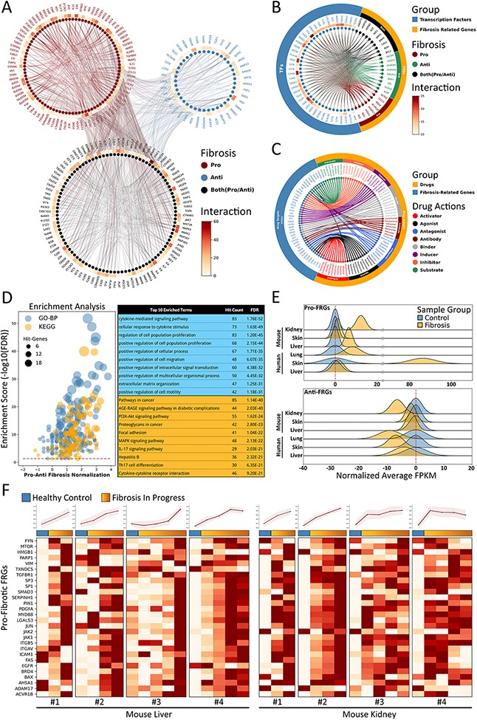
Figure 4. Fibrosis-Related Genes in FibROAD. (A) Circos plot for protein-protein interactions of all 232 FRGs as ...
Notes:
Figure 4. Fibrosis-Related Genes in FibROAD. (A) Circos plot for protein-protein interactions of all 232 FRGs as obtained from the String database. FRGs are divided into three groups (pro/anti/both shown in different colors) according to evidence contained within the literature. Interaction counts (edges number) for each FRG are presented with a circular heatmap around each circle. (B) Circos plot for several example transcription factors-FRGs regulations according to hTFtarget and RNAinter databases. Transcription factors are shown in orange whereas FRGs are divided into the three groups as described above and shown in steel blue. Regulation counts (edges number) for each transcription factor are shown with a surrounding circular heatmap. (C) Circos plot for several examples of drug targets according to the DrugBank database. Drugs are shown in orange whereas gene targets (FRGs) in steel blue. The eight different drug actions are presented using different colors. (D) Gene ontology (biological processes, steel blue) and KEGG (orange) enrichment analysis for FRGs (left panel). The pro/anti-fibrosis normalization (x-axis) was performed by calculating the z-score for pro- and anti-fibrosis FRGs within each term. The enrichment score (y-axis) was calculated with FDR from the hyper-geometry test. Red dashed line refers to the FDR threshold (0.05). The top 10 enriched terms of GO-BP (steel blue) and KEGG (orange) are shown in the right panel. (E) The average expressions (FPKM) of pro- (upper panel) and anti- (lower panel) FRGs in several datasets, with expressions of fibrotic groups (orange) normalized to that of control groups (steel blue). (F) Expressions (FPKM) of detected pro-fibrotic FRGs in datasets designed for fibrosis progression research. Results from healthy control groups are indicated in steel blue whereas fibrotic groups are displayed in orange gradients. Results of 4 independent datasets for mouse liver (left panel) and mouse kidney (right panel) are each illustrated in heatmaps, with normalized average expressions depicted in line plots at the top.
Unless provided in the caption above, the following copyright applies to the content of this slide: © The Author(s) 2022. Published by Oxford University Press.This is an Open Access article distributed under the terms of the Creative Commons Attribution License (https://creativecommons.org/licenses/by/4.0/), which permits unrestricted reuse, distribution, and reproduction in any medium, provided the original work is properly cited.

Slide 5
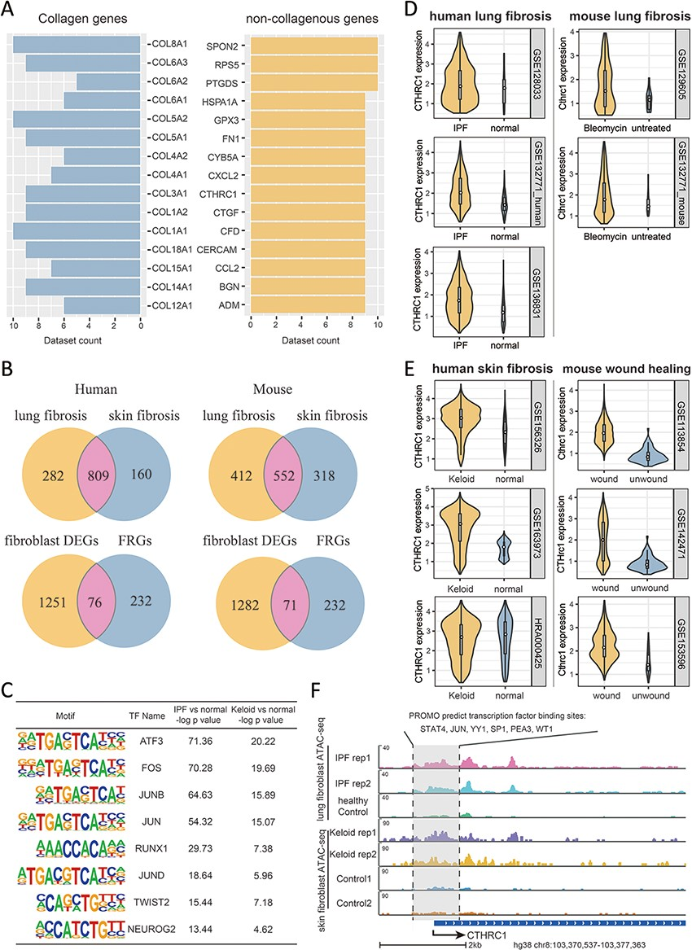
Figure 5. Multi-omics explorations with FibROAD indicate that CTHRC1 may be a potential candidate gene for skin ...
Notes:
Figure 5. Multi-omics explorations with FibROAD indicate that CTHRC1 may be a potential candidate gene for skin fibrosis. (A) Bar graphs showing the top 15 most extensively and differentially expressed collagenous and non-collagenous fibroblast genes in scRNAseq datasets as collected with FibROAD (filtered by Wilcoxon Rank Sum test with log fold-change cutoff of 0.5 and P < 0.05). (B) Venn plots showing intersections of differentially expressed genes (DEGs) between lung and skin fibroblasts, in humans and mouse respectively (upper 2 Venn plots), and the intersections between DEGs and FRGs in the two species (lower 2 Venn plots). (C) Transcription factor motif enrichment analysis of differential chromatin accessibility regions located in the promotor region of the 55 commonly differentially expressed FRGs with ATAC-seq fibroblast datasets. (D-E) Violin plots showing significant differences in CTHRC1 expressions within lung (D) and skin (E) fibroblasts between the fibrotic group and healthy controls, in humans (left panel) and mice (right panel). (F) Representative genome browser tracks comparing CTHRC1 ATAC-seq signals in fibroblasts between the fibrotic group and healthy controls.
Unless provided in the caption above, the following copyright applies to the content of this slide: © The Author(s) 2022. Published by Oxford University Press.This is an Open Access article distributed under the terms of the Creative Commons Attribution License (https://creativecommons.org/licenses/by/4.0/), which permits unrestricted reuse, distribution, and reproduction in any medium, provided the original work is properly cited.

