Slide 1
Figure 1. A screenshot of the revision history for record INSDC AC034192.5 ...
Notes:
Figure 1. A screenshot of the revision history for record INSDC AC034192.5 (http://www.ncbi.nlm.gov/nuccore/AC034192.5?report=girevhist). Note the differences between normal updates (changes on a record itself) and merged records (duplicates). For instance, the record was updated from version 3 to 4, which is a normal update. A different record INSDC AC087090.1 is merged in during Apr 2002. This is a case of duplication confirmed by ENA staff. We only collected duplicates, not normal updates.
Unless provided in the caption above, the following copyright applies to the content of this slide: © The Author(s) 2017. Published by Oxford University Press.This is an Open Access article distributed under the terms of the Creative Commons Attribution License (http://creativecommons.org/licenses/by/4.0/), which permits unrestricted reuse, distribution, and reproduction in any medium, provided the original work is properly cited.

Slide 2
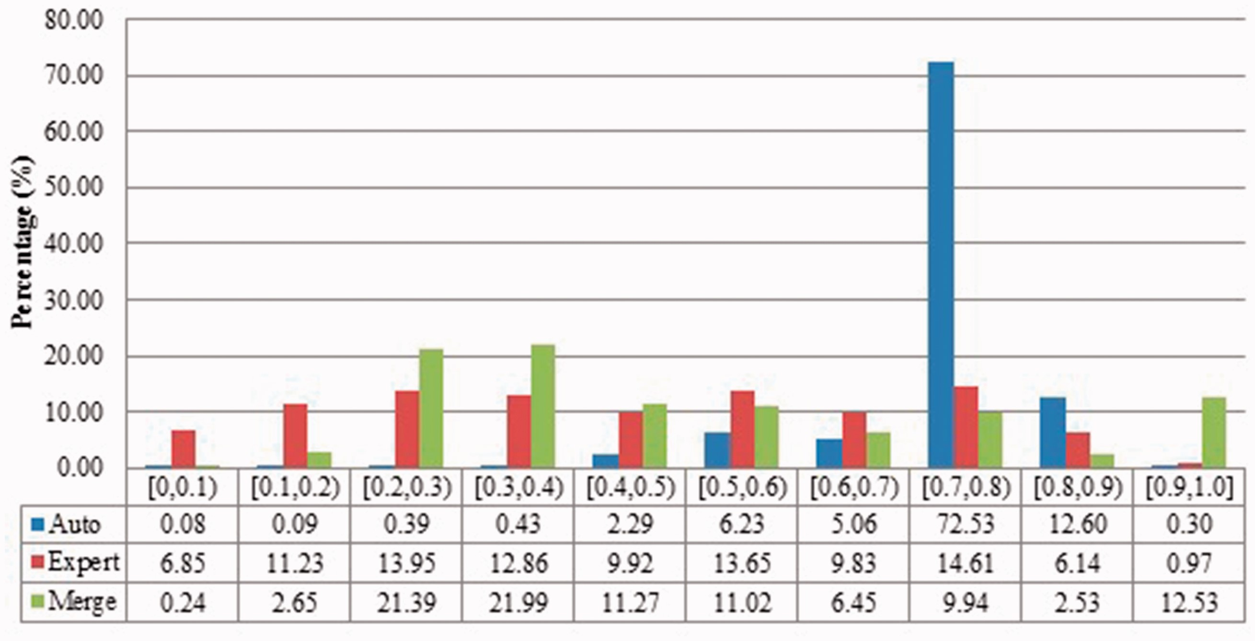
Figure 2 Description similarities of duplicates from Xenopus laevis in three benchmarks: Auto for auto curation based; ...
Notes:
Figure 2 Description similarities of duplicates from Xenopus laevis in three benchmarks: Auto for auto curation based; Expert for expert curation; and Merge for merge-based collection. X-axis defines the similarity range. For instance, [0.5, 0.6) means greater than or equal to 0.5 and <0.6. Y-axis defines the proportion for each similarity range.
Unless provided in the caption above, the following copyright applies to the content of this slide: © The Author(s) 2017. Published by Oxford University Press.This is an Open Access article distributed under the terms of the Creative Commons Attribution License (http://creativecommons.org/licenses/by/4.0/), which permits unrestricted reuse, distribution, and reproduction in any medium, provided the original work is properly cited.

Slide 3
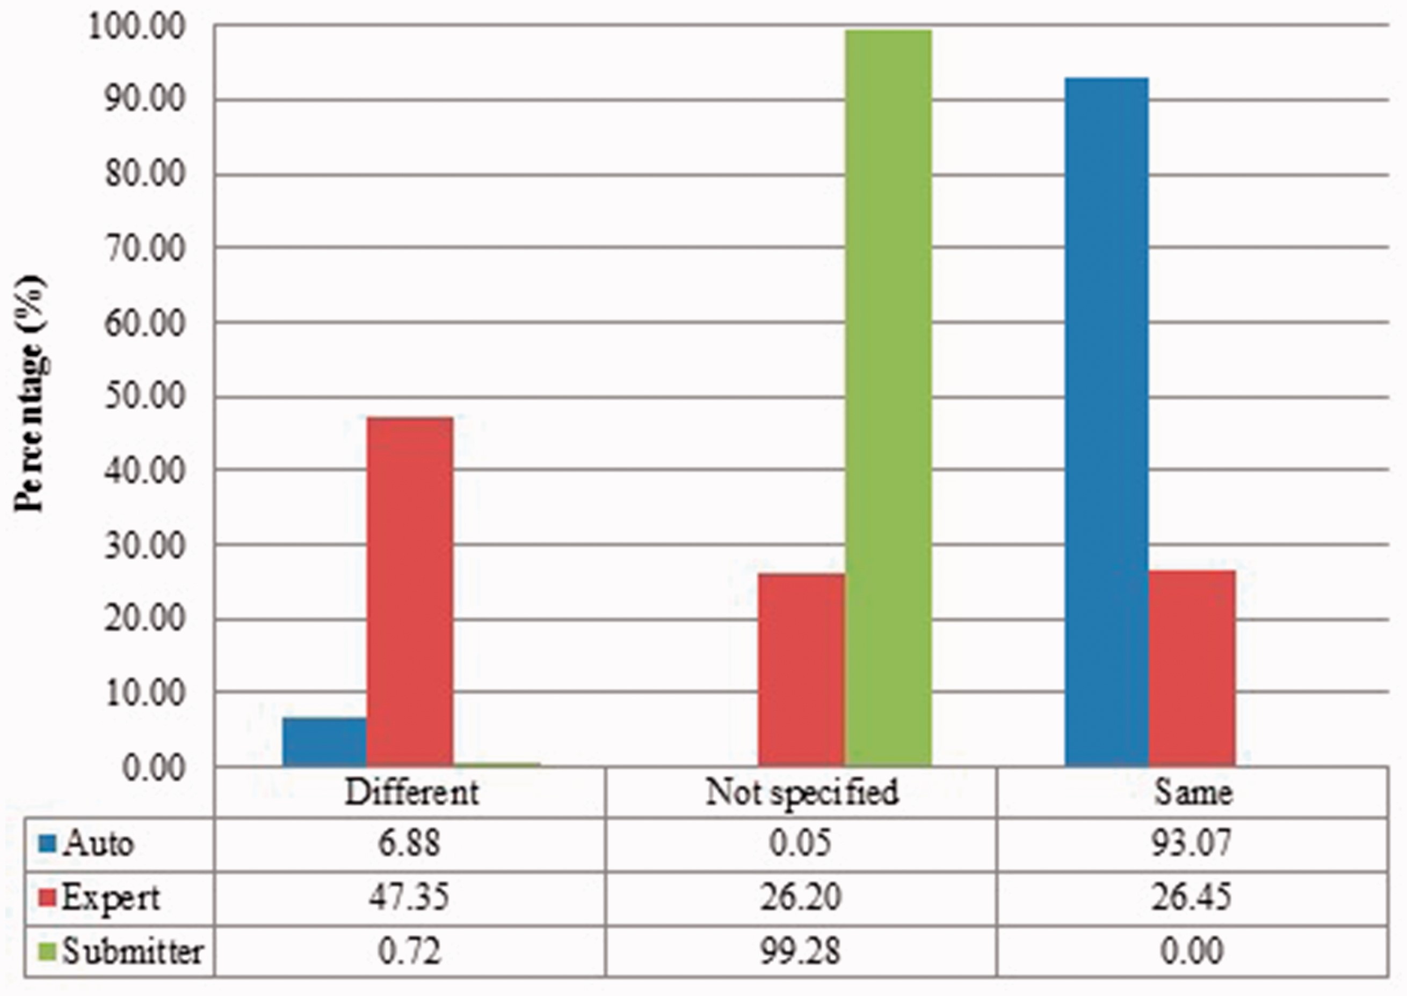
Figure 3. Submitter similarities of duplicates from Xenopus laevis in three benchmarks. Different: the submitters of ...
Notes:
Figure 3. Submitter similarities of duplicates from Xenopus laevis in three benchmarks. Different: the submitters of records are completely Different; Same: the pair at least shares with at least one submitter; Not specified: no submitter details are specified in REFERENCE field in records by standard. The rest is the same as above.
Unless provided in the caption above, the following copyright applies to the content of this slide: © The Author(s) 2017. Published by Oxford University Press.This is an Open Access article distributed under the terms of the Creative Commons Attribution License (http://creativecommons.org/licenses/by/4.0/), which permits unrestricted reuse, distribution, and reproduction in any medium, provided the original work is properly cited.

Slide 4
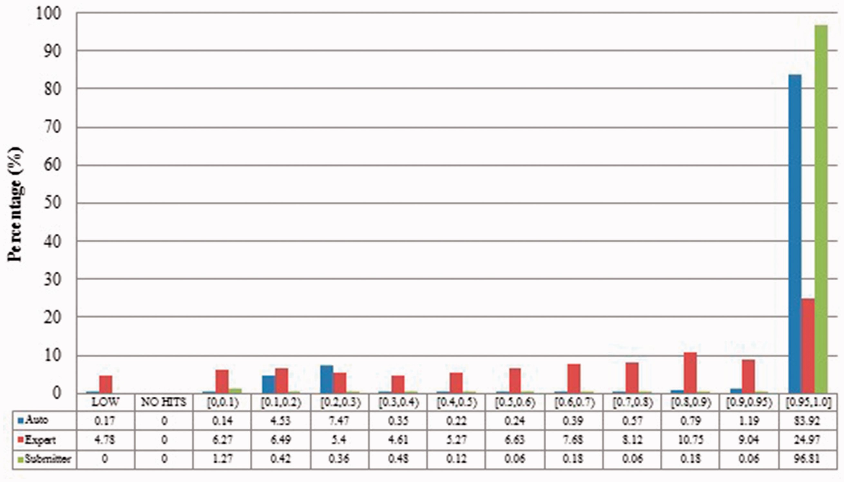
Figure 4. Alignment proportion of duplicates from Xenopus laevis. LOW refers to similarity that is greater than the ...
Notes:
Figure 4. Alignment proportion of duplicates from Xenopus laevis. LOW refers to similarity that is greater than the threshold or NO HITS based on BLAST output. Recall that we chose the parameters to produce reliable BLAST output.
Unless provided in the caption above, the following copyright applies to the content of this slide: © The Author(s) 2017. Published by Oxford University Press.This is an Open Access article distributed under the terms of the Creative Commons Attribution License (http://creativecommons.org/licenses/by/4.0/), which permits unrestricted reuse, distribution, and reproduction in any medium, provided the original work is properly cited.

Slide 5
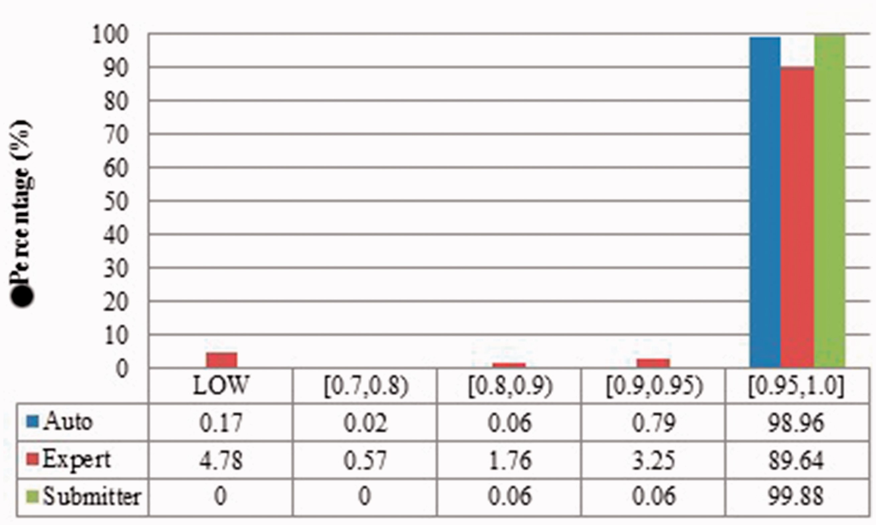
Figure 5 Local sequence identity of duplicates from Xenopus laevis in three benchmarks. The rest is the same as ...
Notes:
Figure 5 Local sequence identity of duplicates from Xenopus laevis in three benchmarks. The rest is the same as above.
Unless provided in the caption above, the following copyright applies to the content of this slide: © The Author(s) 2017. Published by Oxford University Press.This is an Open Access article distributed under the terms of the Creative Commons Attribution License (http://creativecommons.org/licenses/by/4.0/), which permits unrestricted reuse, distribution, and reproduction in any medium, provided the original work is properly cited.

Slide 6
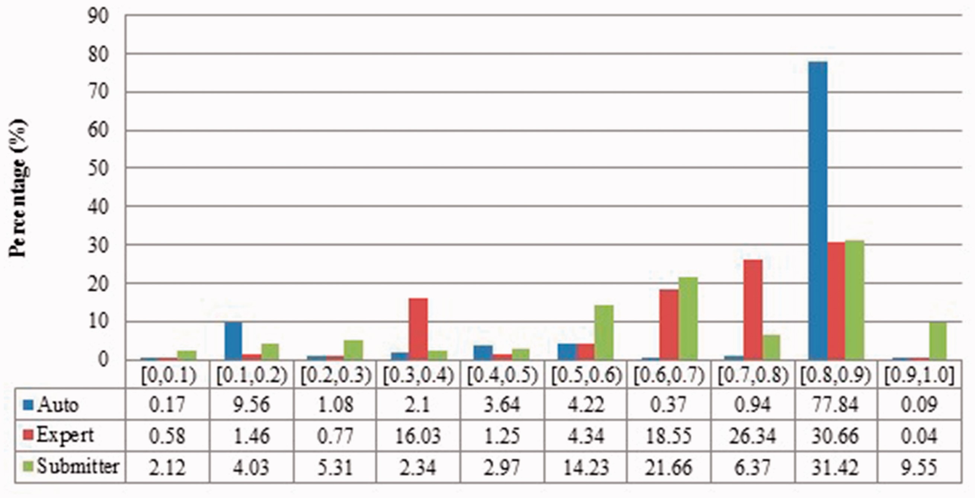
Figure 6 Description similarity of duplicates from Zea mays in three benchmarks.
Notes:
Figure 6 Description similarity of duplicates from Zea mays in three benchmarks.
Unless provided in the caption above, the following copyright applies to the content of this slide: © The Author(s) 2017. Published by Oxford University Press.This is an Open Access article distributed under the terms of the Creative Commons Attribution License (http://creativecommons.org/licenses/by/4.0/), which permits unrestricted reuse, distribution, and reproduction in any medium, provided the original work is properly cited.

Slide 7
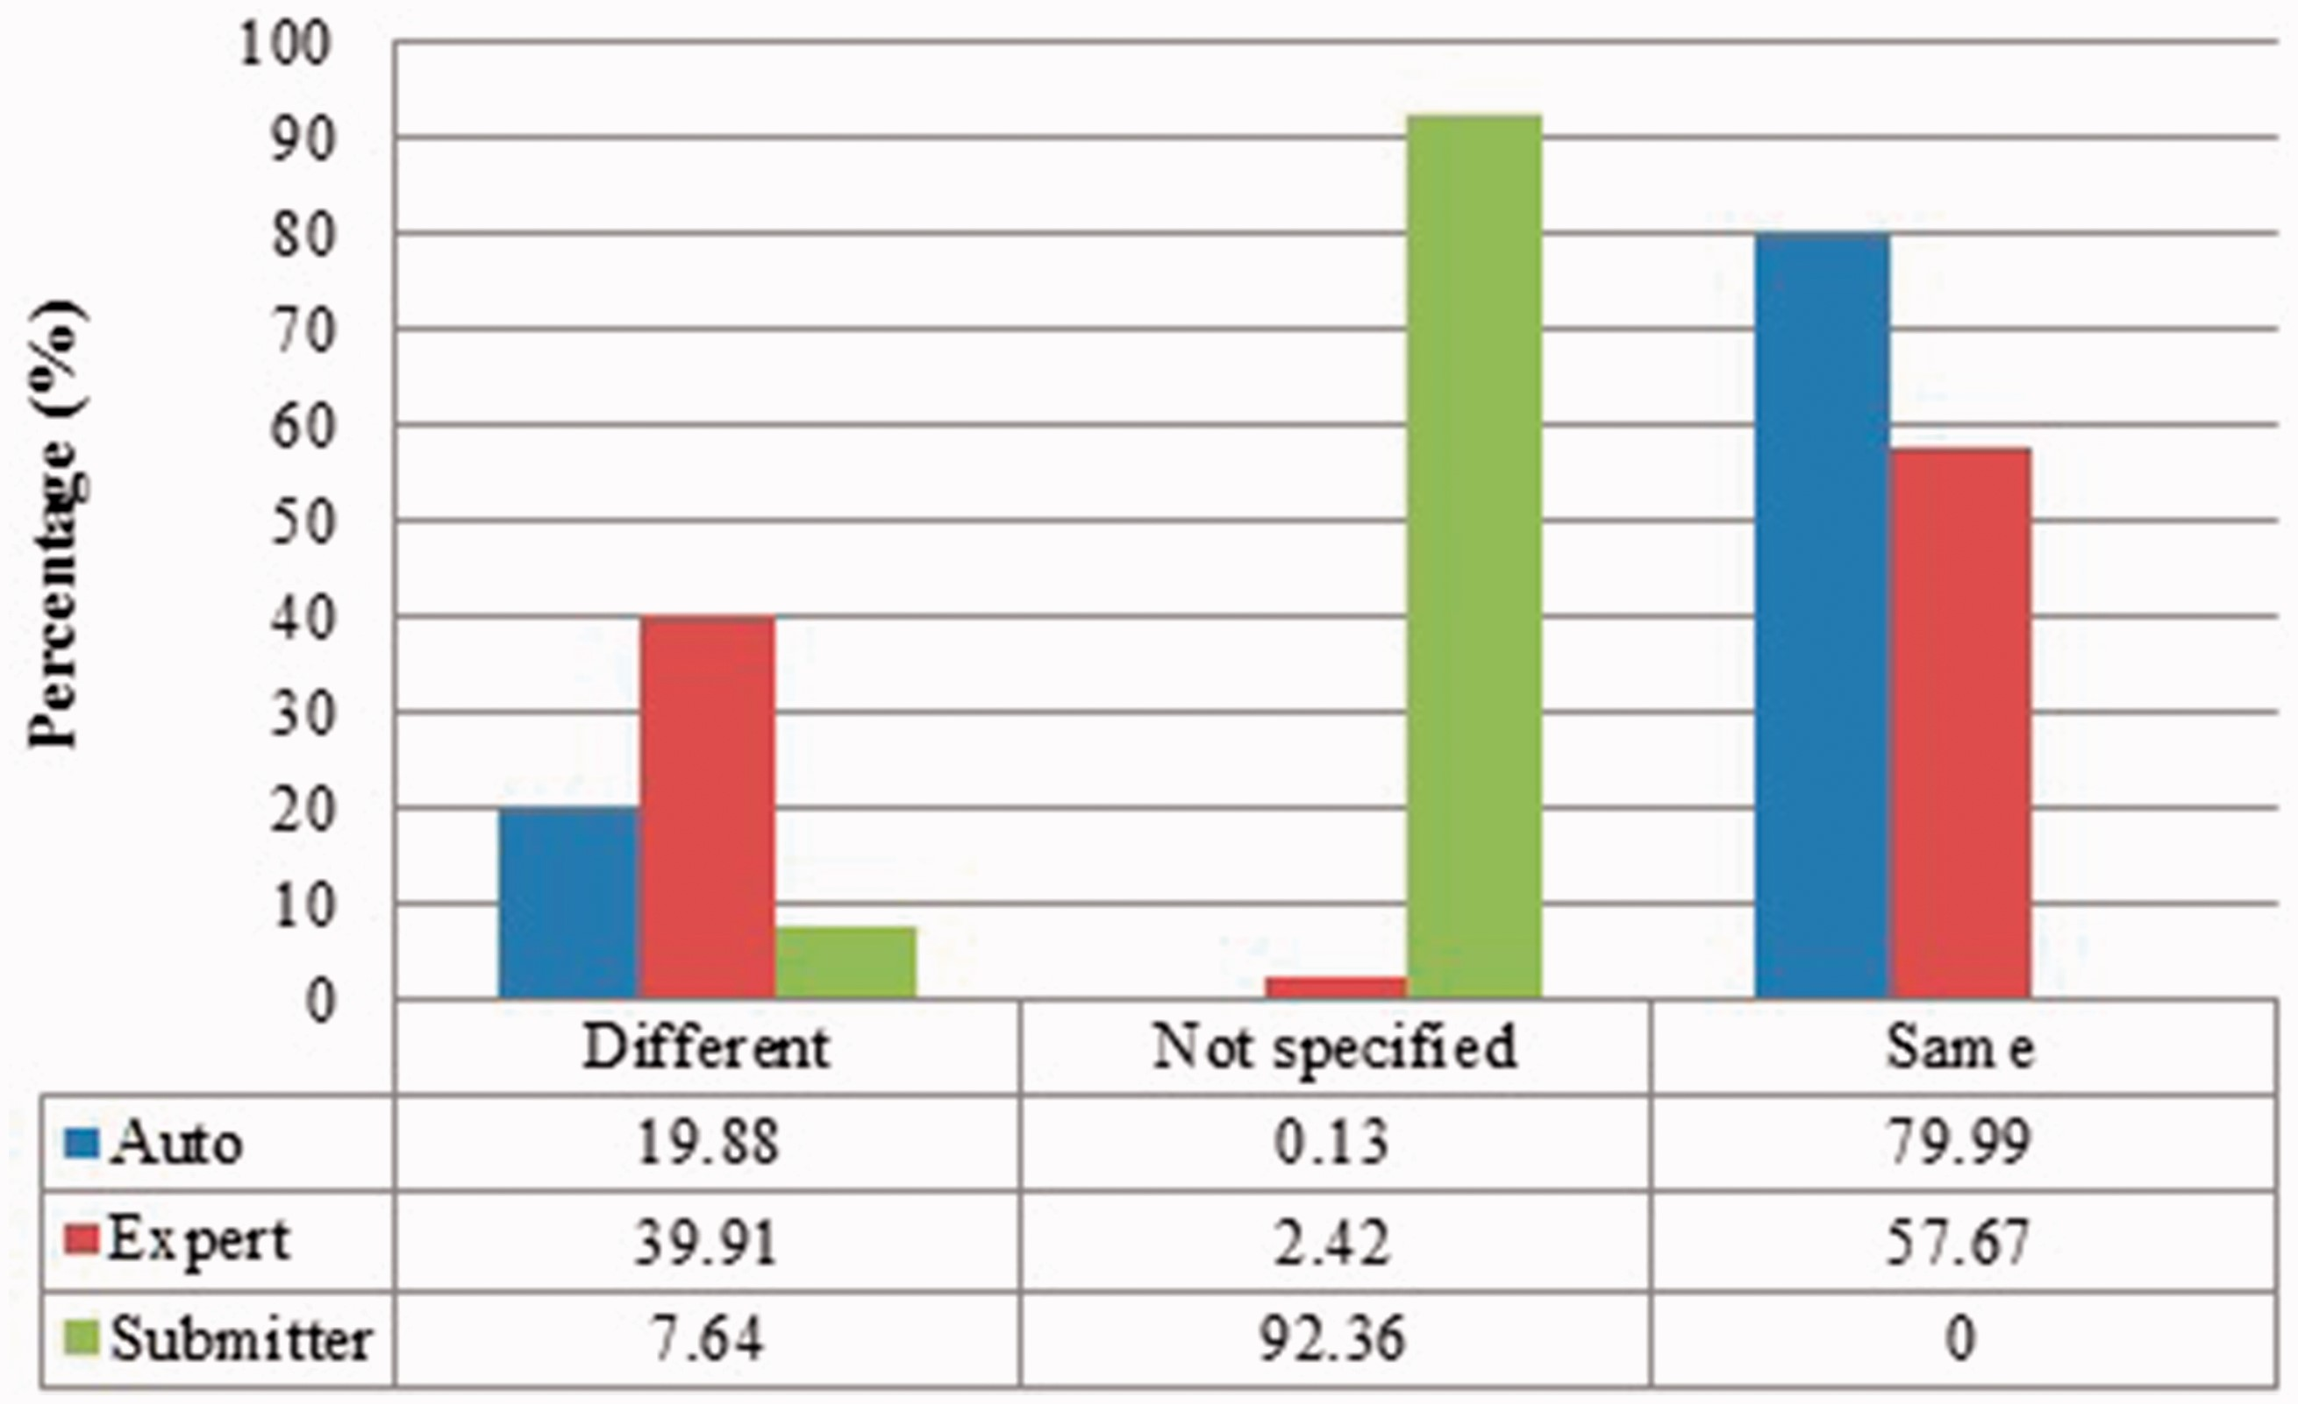
Figure 7 Submitter similarity of duplicates from Zea mays in three benchmarks.
Notes:
Figure 7 Submitter similarity of duplicates from Zea mays in three benchmarks.
Unless provided in the caption above, the following copyright applies to the content of this slide: © The Author(s) 2017. Published by Oxford University Press.This is an Open Access article distributed under the terms of the Creative Commons Attribution License (http://creativecommons.org/licenses/by/4.0/), which permits unrestricted reuse, distribution, and reproduction in any medium, provided the original work is properly cited.

Slide 8
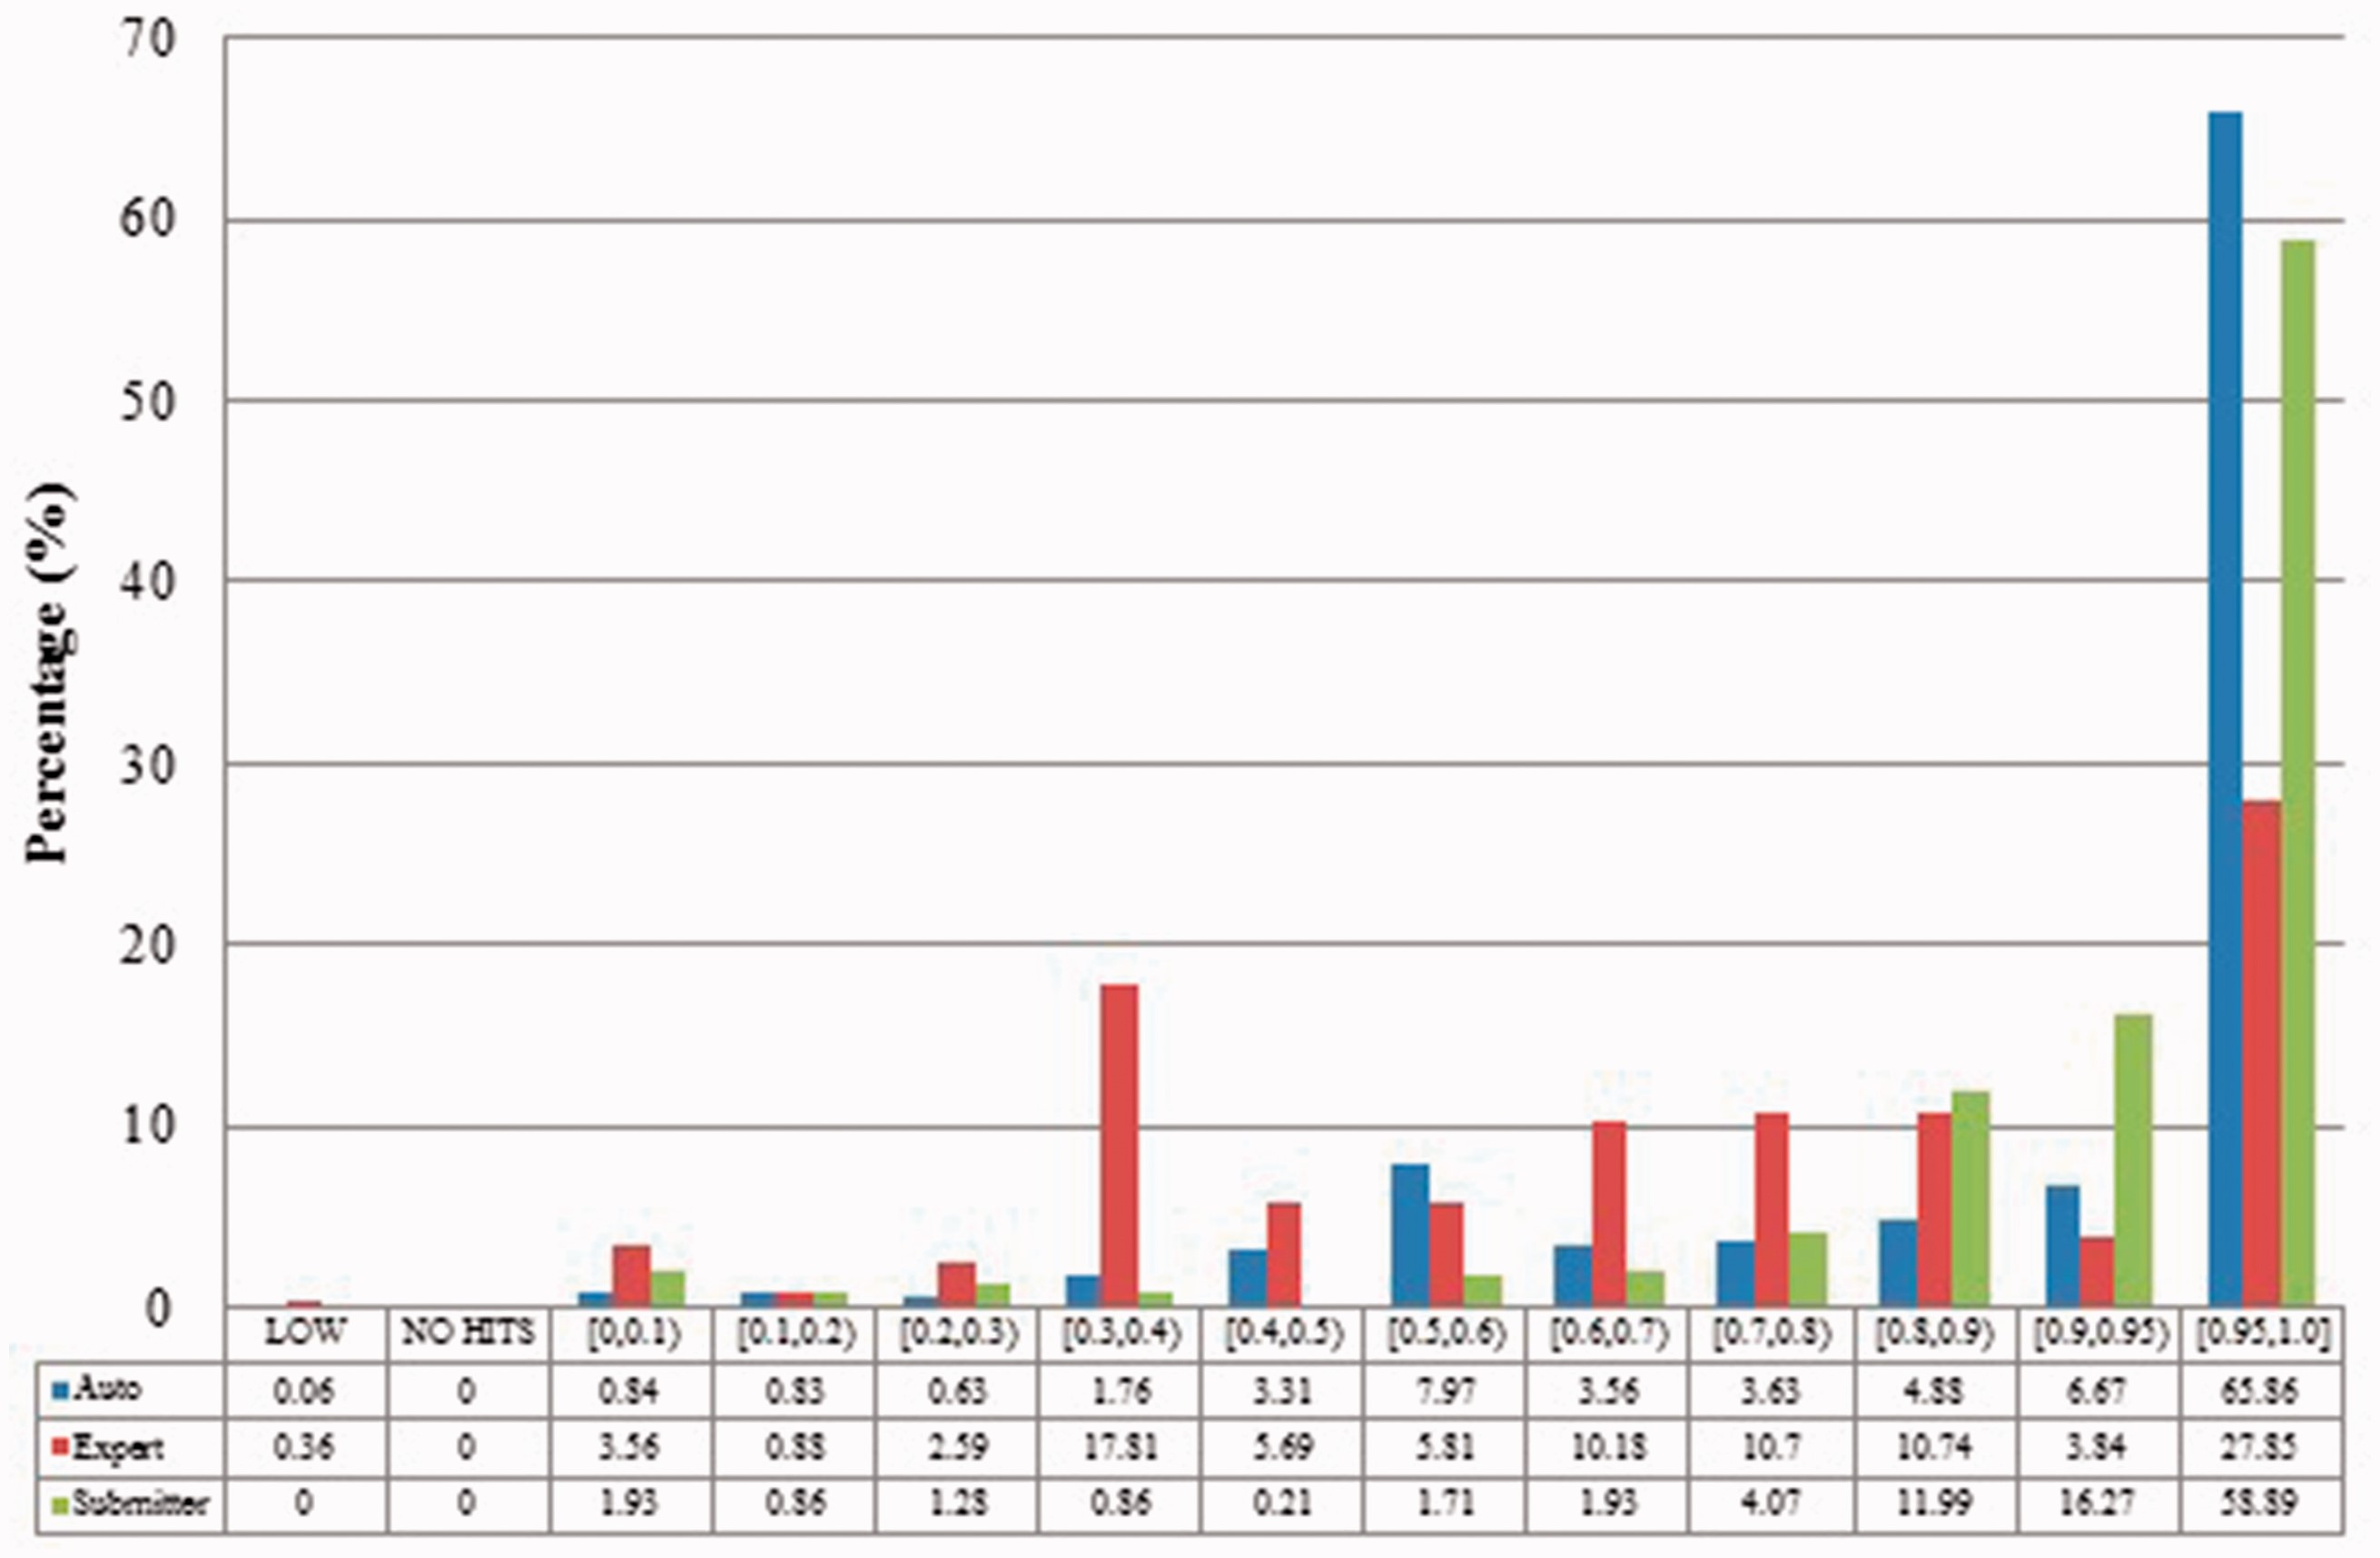
Figure 8 Alignment proportion of duplicates from Zea mays in three benchmarks.
Notes:
Figure 8 Alignment proportion of duplicates from Zea mays in three benchmarks.
Unless provided in the caption above, the following copyright applies to the content of this slide: © The Author(s) 2017. Published by Oxford University Press.This is an Open Access article distributed under the terms of the Creative Commons Attribution License (http://creativecommons.org/licenses/by/4.0/), which permits unrestricted reuse, distribution, and reproduction in any medium, provided the original work is properly cited.

Slide 9
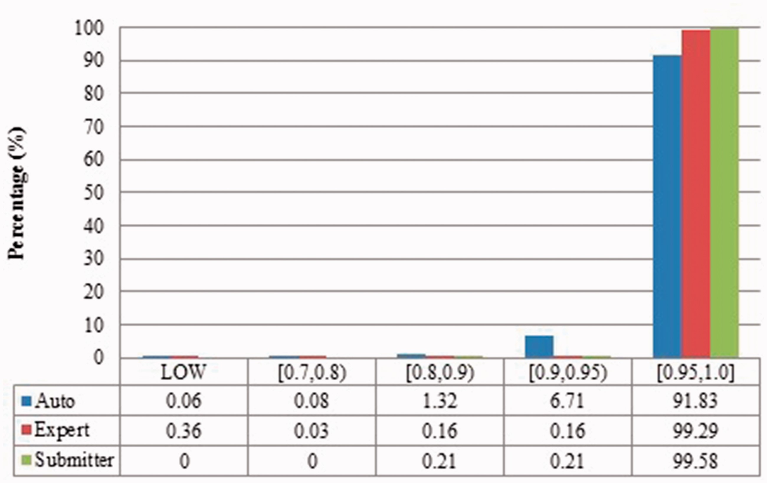
Figure 9 Local sequence identity of duplicates from Zea mays in three benchmarks.
Notes:
Figure 9 Local sequence identity of duplicates from Zea mays in three benchmarks.
Unless provided in the caption above, the following copyright applies to the content of this slide: © The Author(s) 2017. Published by Oxford University Press.This is an Open Access article distributed under the terms of the Creative Commons Attribution License (http://creativecommons.org/licenses/by/4.0/), which permits unrestricted reuse, distribution, and reproduction in any medium, provided the original work is properly cited.

