Slide 1
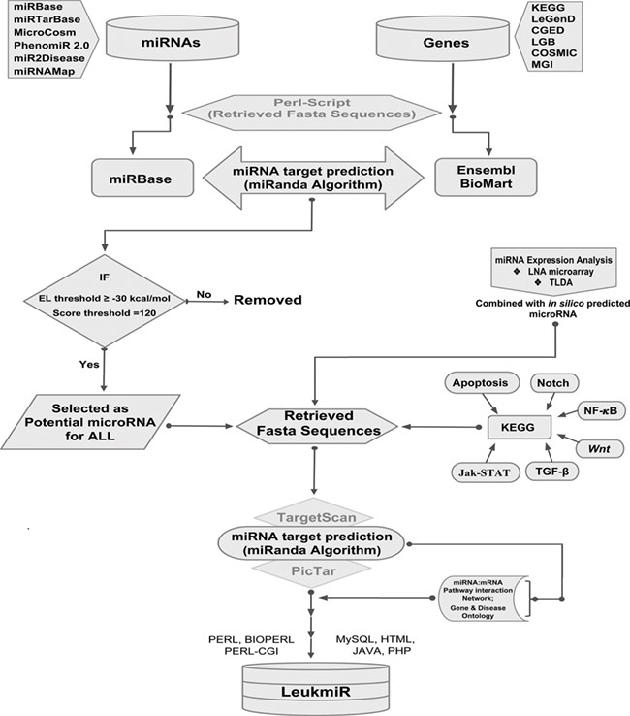
Figure 1 Schematic representation of database structure and construction. The work flow represents the mining of ...
Notes:
Figure 1 Schematic representation of database structure and construction. The work flow represents the mining of miRNAs and their target genes using Perl script and further incorporation into the database using mysql, perl-cgi, java, php and html.
Unless provided in the caption above, the following copyright applies to the content of this slide: © The Author(s) 2020. Published by Oxford University Press.This is an Open Access article distributed under the terms of the Creative Commons Attribution License (http://creativecommons.org/licenses/by/4.0/), which permits unrestricted reuse, distribution, and reproduction in any medium, provided the original work is properly cited.

