Slide 1
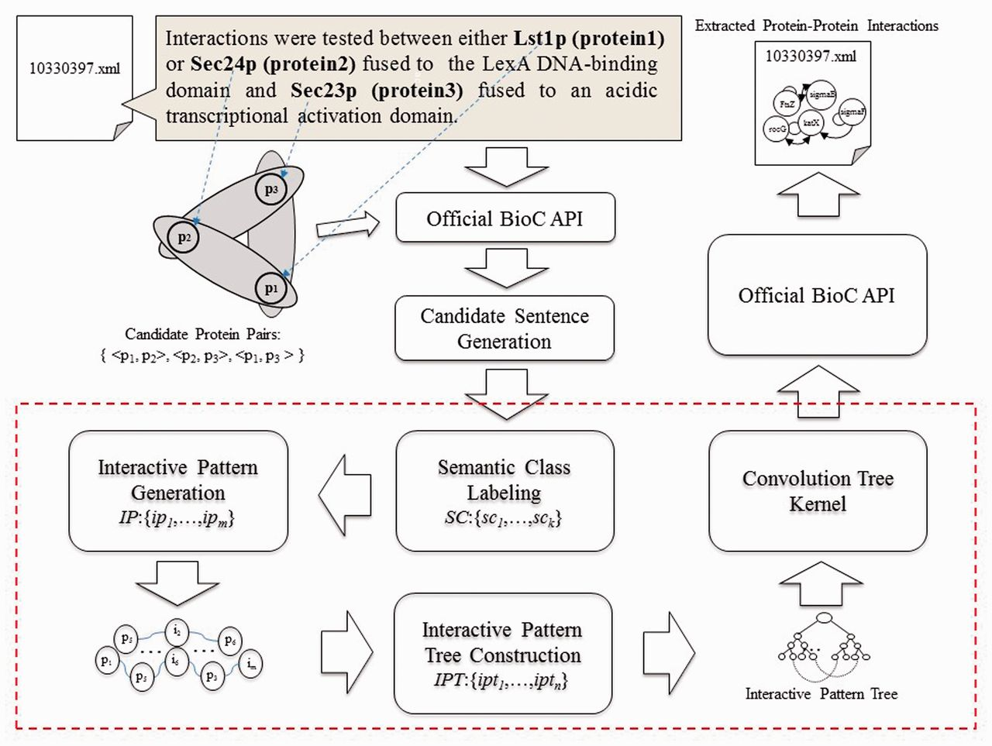
Figure 1. Overview of the PPI extraction method.
Notes:
Figure 1. Overview of the PPI extraction method.
Unless provided in the caption above, the following copyright applies to the content of this slide: © The Author(s) 2016. Published by Oxford University Press.This is an Open Access article distributed under the terms of the Creative Commons Attribution License (http://creativecommons.org/licenses/by/4.0/), which permits unrestricted reuse, distribution, and reproduction in any medium, provided the original work is properly cited.

Slide 2
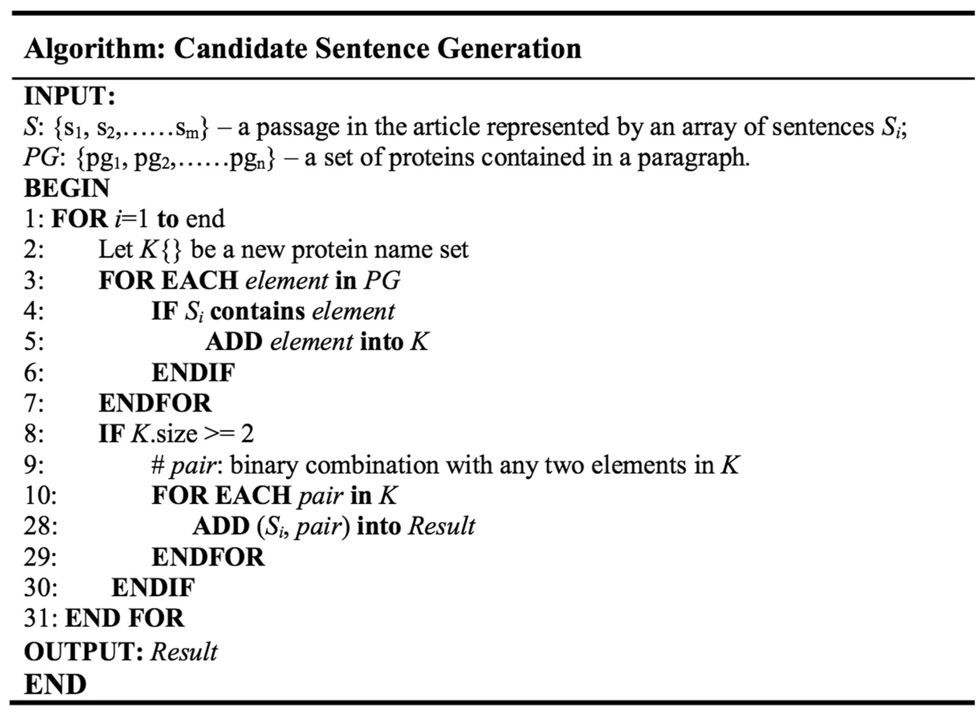
Figure 2. Candidate sentence generation algorithm.
Notes:
Figure 2. Candidate sentence generation algorithm.
Unless provided in the caption above, the following copyright applies to the content of this slide: © The Author(s) 2016. Published by Oxford University Press.This is an Open Access article distributed under the terms of the Creative Commons Attribution License (http://creativecommons.org/licenses/by/4.0/), which permits unrestricted reuse, distribution, and reproduction in any medium, provided the original work is properly cited.

Slide 3
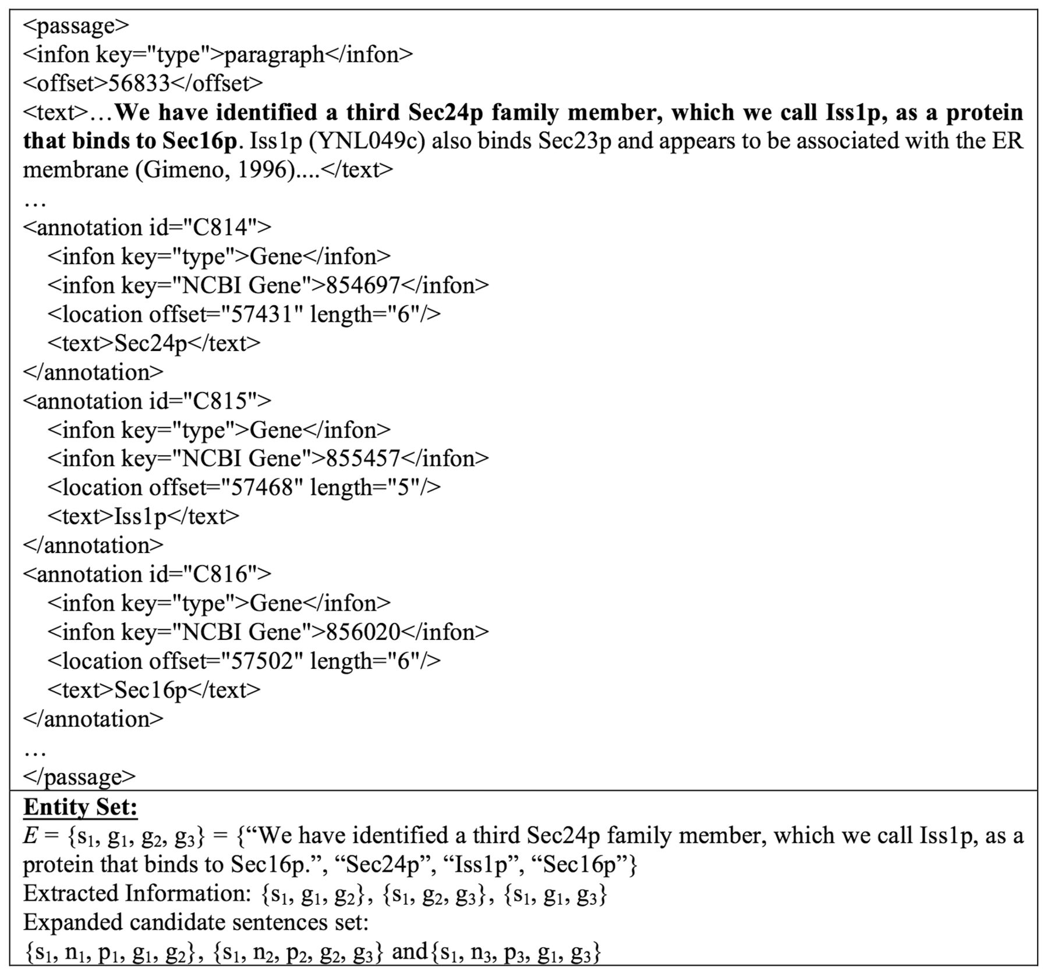
Figure 3. An example of expanded candidate sentence extraction.
Notes:
Figure 3. An example of expanded candidate sentence extraction.
Unless provided in the caption above, the following copyright applies to the content of this slide: © The Author(s) 2016. Published by Oxford University Press.This is an Open Access article distributed under the terms of the Creative Commons Attribution License (http://creativecommons.org/licenses/by/4.0/), which permits unrestricted reuse, distribution, and reproduction in any medium, provided the original work is properly cited.

Slide 4
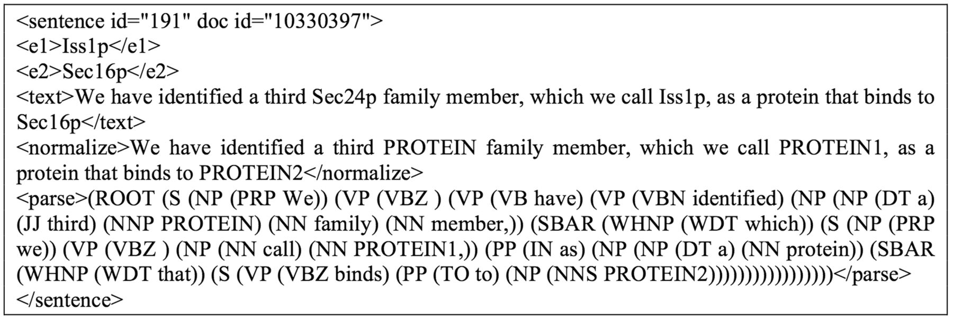
Figure 4. An example of the expanded candidate sentence {s1, n2, p2, g2, g3}.
Notes:
Figure 4. An example of the expanded candidate sentence {s1, n2, p2, g2, g3}.
Unless provided in the caption above, the following copyright applies to the content of this slide: © The Author(s) 2016. Published by Oxford University Press.This is an Open Access article distributed under the terms of the Creative Commons Attribution License (http://creativecommons.org/licenses/by/4.0/), which permits unrestricted reuse, distribution, and reproduction in any medium, provided the original work is properly cited.

Slide 5
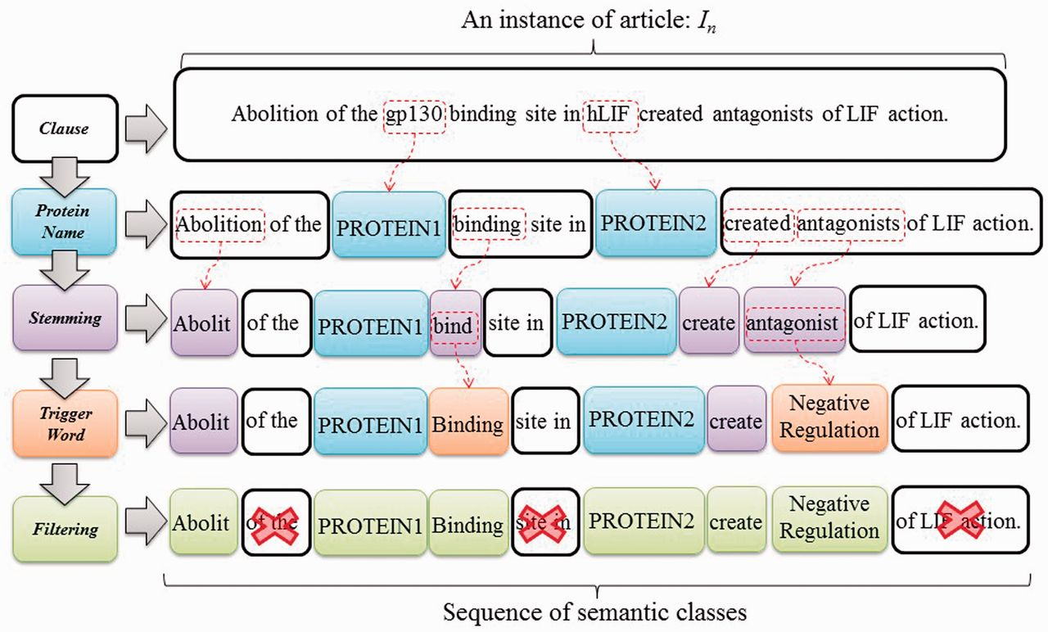
Figure 5. SCL process.
Notes:
Figure 5. SCL process.
Unless provided in the caption above, the following copyright applies to the content of this slide: © The Author(s) 2016. Published by Oxford University Press.This is an Open Access article distributed under the terms of the Creative Commons Attribution License (http://creativecommons.org/licenses/by/4.0/), which permits unrestricted reuse, distribution, and reproduction in any medium, provided the original work is properly cited.

Slide 6
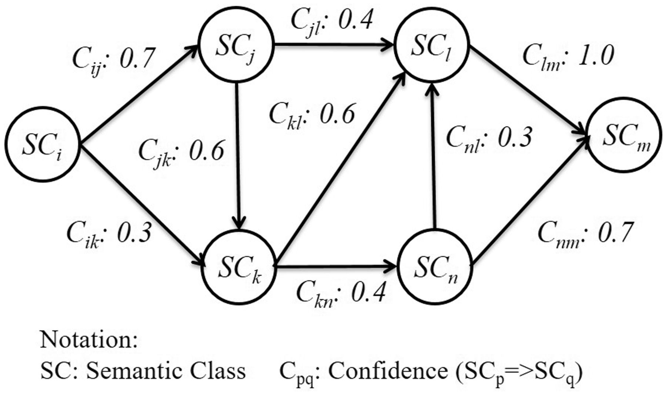
Figure 6. An interactive graph for pattern generation.
Notes:
Figure 6. An interactive graph for pattern generation.
Unless provided in the caption above, the following copyright applies to the content of this slide: © The Author(s) 2016. Published by Oxford University Press.This is an Open Access article distributed under the terms of the Creative Commons Attribution License (http://creativecommons.org/licenses/by/4.0/), which permits unrestricted reuse, distribution, and reproduction in any medium, provided the original work is properly cited.

Slide 7
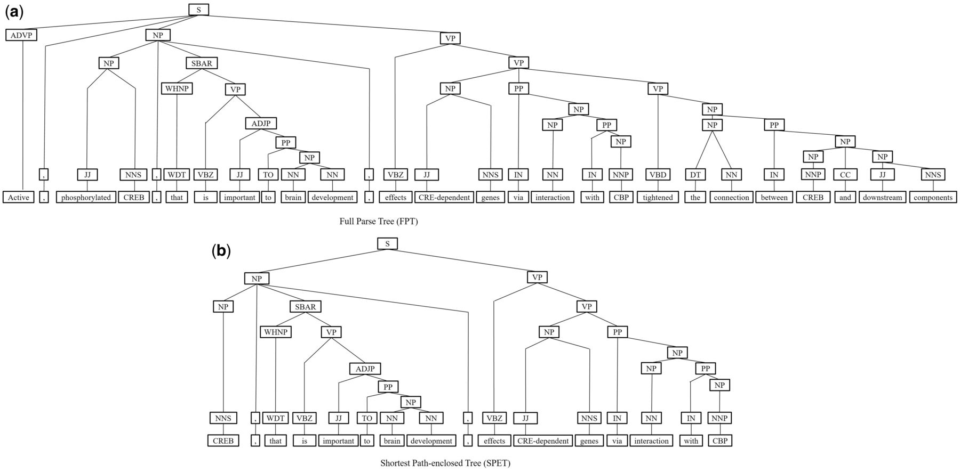
Figure 7. The FPT and SPET of the example sentence (a)FPT (b) SPET.
Notes:
Figure 7. The FPT and SPET of the example sentence (a)FPT (b) SPET.
Unless provided in the caption above, the following copyright applies to the content of this slide: © The Author(s) 2016. Published by Oxford University Press.This is an Open Access article distributed under the terms of the Creative Commons Attribution License (http://creativecommons.org/licenses/by/4.0/), which permits unrestricted reuse, distribution, and reproduction in any medium, provided the original work is properly cited.

Slide 8
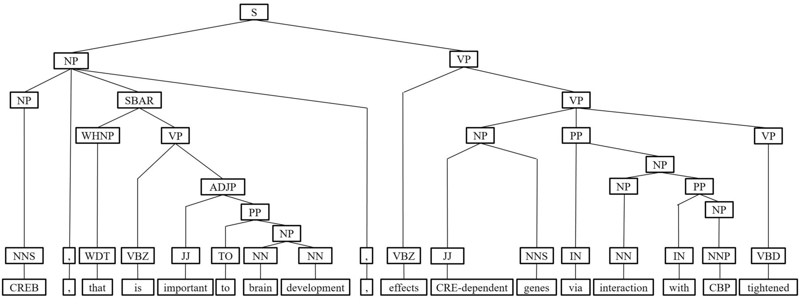
Figure 8. The branching operation of IPT of the example sentence.
Notes:
Figure 8. The branching operation of IPT of the example sentence.
Unless provided in the caption above, the following copyright applies to the content of this slide: © The Author(s) 2016. Published by Oxford University Press.This is an Open Access article distributed under the terms of the Creative Commons Attribution License (http://creativecommons.org/licenses/by/4.0/), which permits unrestricted reuse, distribution, and reproduction in any medium, provided the original work is properly cited.

Slide 9
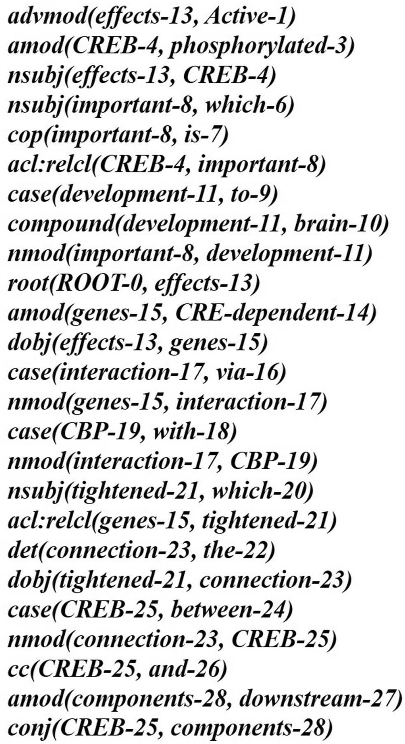
Figure 9. The typed dependencies representation of the example sentence.
Notes:
Figure 9. The typed dependencies representation of the example sentence.
Unless provided in the caption above, the following copyright applies to the content of this slide: © The Author(s) 2016. Published by Oxford University Press.This is an Open Access article distributed under the terms of the Creative Commons Attribution License (http://creativecommons.org/licenses/by/4.0/), which permits unrestricted reuse, distribution, and reproduction in any medium, provided the original work is properly cited.

Slide 10
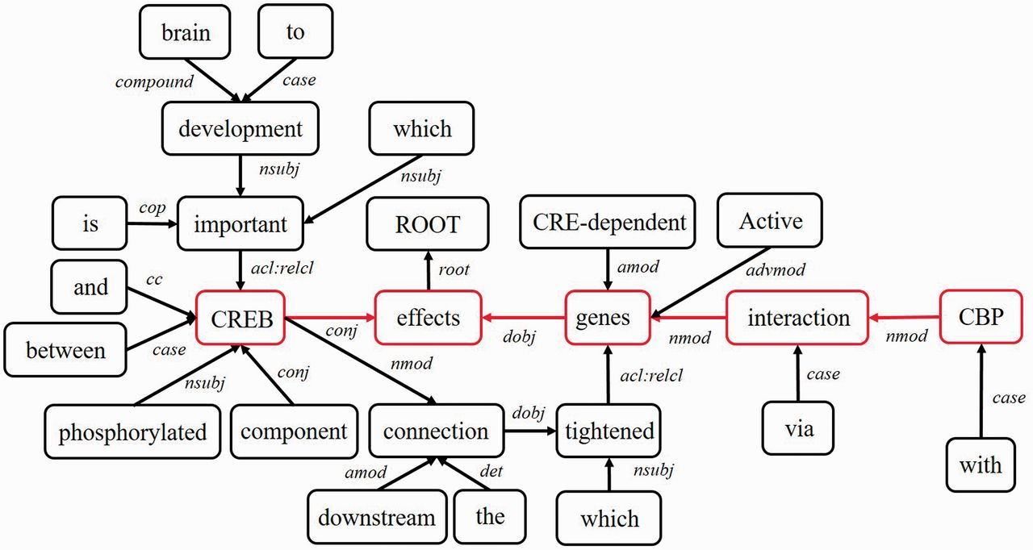
Figure 10. The dependency graph of the example sentence.
Notes:
Figure 10. The dependency graph of the example sentence.
Unless provided in the caption above, the following copyright applies to the content of this slide: © The Author(s) 2016. Published by Oxford University Press.This is an Open Access article distributed under the terms of the Creative Commons Attribution License (http://creativecommons.org/licenses/by/4.0/), which permits unrestricted reuse, distribution, and reproduction in any medium, provided the original work is properly cited.

Slide 11
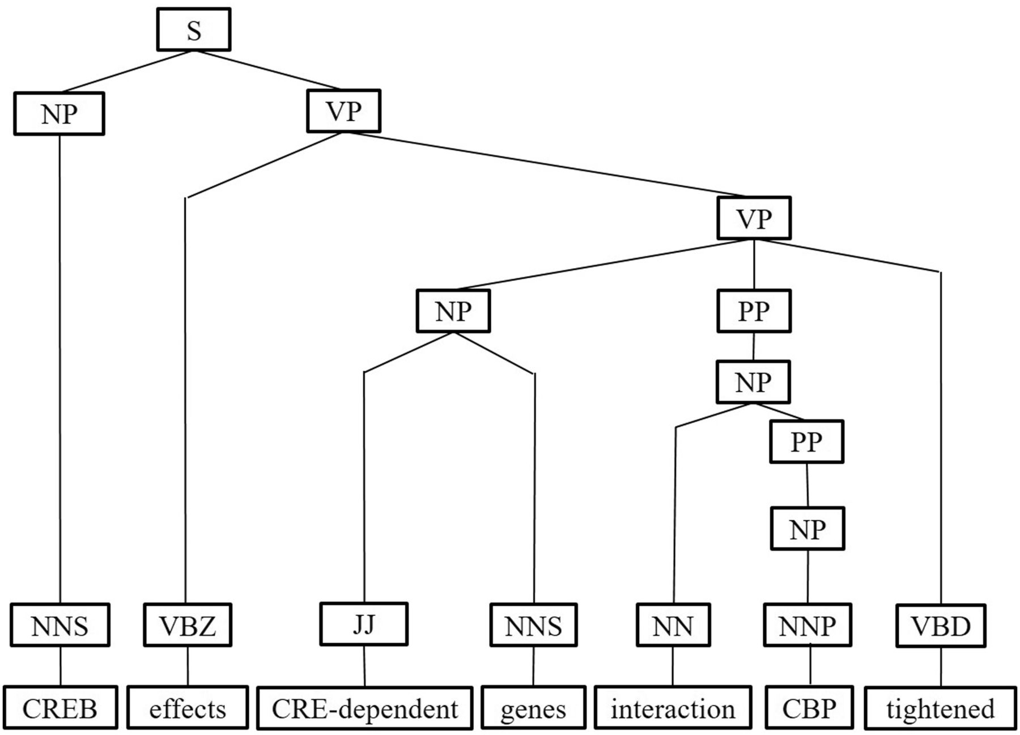
Figure 11. The pruning operation of IPT of the example sentence.
Notes:
Figure 11. The pruning operation of IPT of the example sentence.
Unless provided in the caption above, the following copyright applies to the content of this slide: © The Author(s) 2016. Published by Oxford University Press.This is an Open Access article distributed under the terms of the Creative Commons Attribution License (http://creativecommons.org/licenses/by/4.0/), which permits unrestricted reuse, distribution, and reproduction in any medium, provided the original work is properly cited.

Slide 12
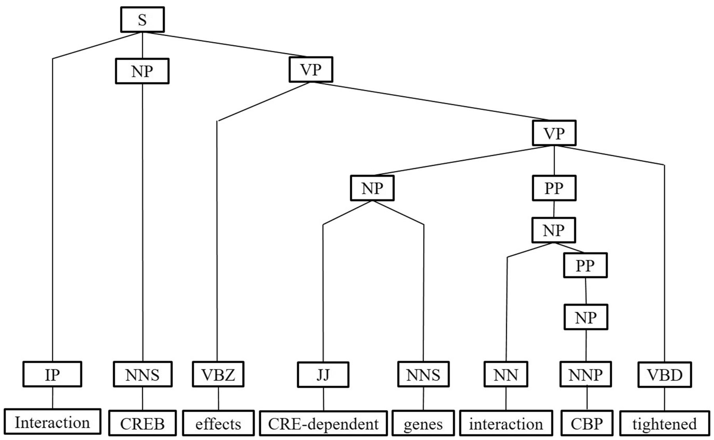
Figure 12. The ornamenting operation of IPT of the example sentence.
Notes:
Figure 12. The ornamenting operation of IPT of the example sentence.
Unless provided in the caption above, the following copyright applies to the content of this slide: © The Author(s) 2016. Published by Oxford University Press.This is an Open Access article distributed under the terms of the Creative Commons Attribution License (http://creativecommons.org/licenses/by/4.0/), which permits unrestricted reuse, distribution, and reproduction in any medium, provided the original work is properly cited.

