Slide 1
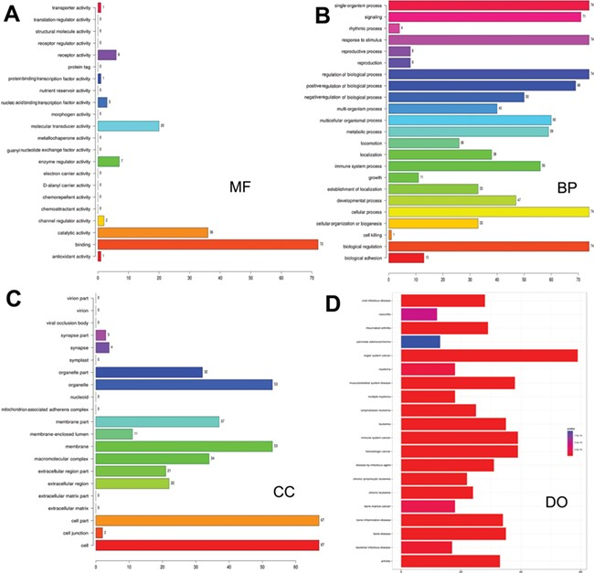
Figure 3 Gene ontology and disease ontology of miRNA targets in various signaling pathways. The gene ontology of ...
Notes:
Figure 3 Gene ontology and disease ontology of miRNA targets in various signaling pathways. The gene ontology of targets represented in terms of their associated (A) molecular function (MF), (B) biological process (BP), (C) cellular component (CC) and (D) disease ontology of target genes.
Unless provided in the caption above, the following copyright applies to the content of this slide: © The Author(s) 2020. Published by Oxford University Press.This is an Open Access article distributed under the terms of the Creative Commons Attribution License (http://creativecommons.org/licenses/by/4.0/), which permits unrestricted reuse, distribution, and reproduction in any medium, provided the original work is properly cited.

