Slide 1
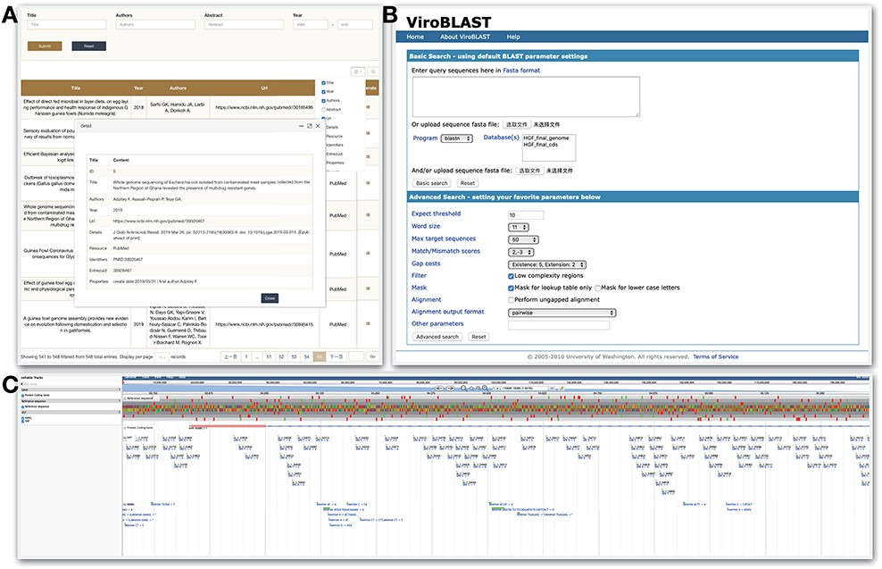
Figure 5. Tools module. HGFDB provides three tools, which are (A) Publication that allows to search related papers by ...
Notes:
Figure 5. Tools module. HGFDB provides three tools, which are (A) Publication that allows to search related papers by keywords, (B) BLAST that compares users’ nucleotide or protein sequence with our assembly and annotation results and (C) JBrowse that provides the view of genomic features of HGF assembly.
Unless provided in the caption above, the following copyright applies to the content of this slide: © The Author(s) 2021. Published by Oxford University Press.This is an Open Access article distributed under the terms of the Creative Commons Attribution License (http://creativecommons.org/licenses/by/4.0/), which permits unrestricted reuse, distribution, and reproduction in any medium, provided the original work is properly cited.

