Slide 1
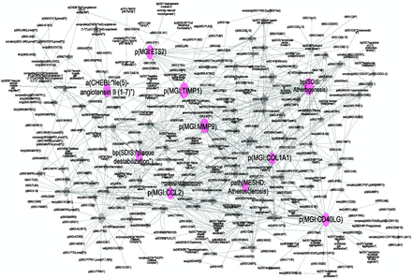
Figure 3. Atherosclerosis plaque destabilization network showing the degree of distribution of nodes. Biological ...
Notes:
Figure 3. Atherosclerosis plaque destabilization network showing the degree of distribution of nodes. Biological Entities or Nodes. Pink circles indicate the 10 most connected nodes (from 41° to 28°) defined as hubs. From left to right, the hub nodes are Ile2-angiotensin II ( 1-7 ), plaque destabilization, ETS2, CCL2, TIMP1, MMP9, atherosclerosis, COL1A1, atherogenesis and CD40LG. Relationships or edges. Gray lines with arrows indicate positive causal relationships; fine dotted lines with Ts indicate negative causal relationships; gray sine waves indicate correlative relationships; and fine dotted lines indicate non-causal relationship.
Unless provided in the caption above, the following copyright applies to the content of this slide: © The Author(s) 2015. Published by Oxford University Press.This is an Open Access article distributed under the terms of the Creative Commons Attribution License (http://creativecommons.org/licenses/by/4.0/), which permits unrestricted reuse, distribution, and reproduction in any medium, provided the original work is properly cited.

