Slide 1
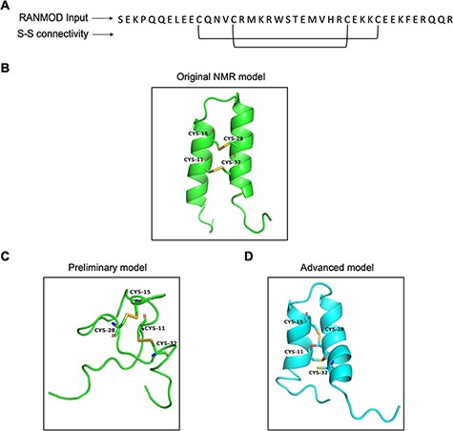
Figure 8. Model generated using RANMOD program for test case of buckwheat trypsin inhibitor BWI-2c. (A) The input ...
Notes:
Figure 8. Model generated using RANMOD program for test case of buckwheat trypsin inhibitor BWI-2c. (A) The input sequence of BWI-2c (PDB ID: 2LQX). and disulphide connectivity information. (B) The native NMR model (the first model of the ensemble) with the disulphide connectivity highlighted. (C) Cartoon representation of the generated model using no secondary structural clues (preliminary modelling). (D) Cartoon representation of the generated model using secondary structure information (advanced modelling). Green and cyan cartoon corresponds to conformation of native template and modelled structures, respectively.
Unless provided in the caption above, the following copyright applies to the content of this slide: © The Author(s) 2022. Published by Oxford University Press.This is an Open Access article distributed under the terms of the Creative Commons Attribution License (https://creativecommons.org/licenses/by/4.0/), which permits unrestricted reuse, distribution, and reproduction in any medium, provided the original work is properly cited.

