Slide 1
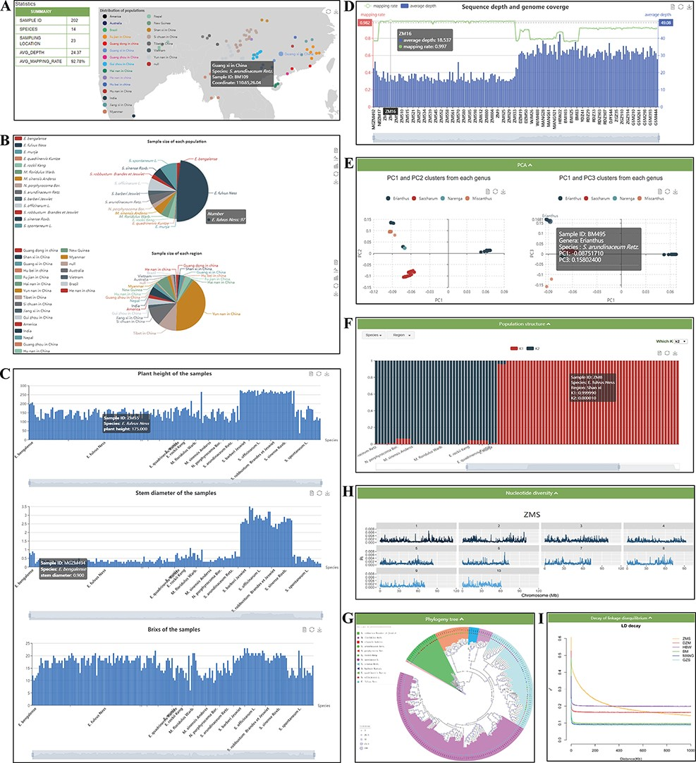
Figure 4. ‘Re-sequence’ module. The ‘Re-sequence’ module has subpages: ‘Statistics’ (A–D) and ‘Analysis’ pages (E–I). ...
Notes:
Figure 4. ‘Re-sequence’ module. The ‘Re-sequence’ module has subpages: ‘Statistics’ (A–D) and ‘Analysis’ pages (E–I). (A) Geographic distribution of 202 individuals. (B) Sample size of each species and region. (C) Statistics of plant height, stem diameter and brix for each sample. (D) Resequencing quality statistics. (E) PCA clusters from 202 individuals. (F) Bar plot of admixture analysis for all samples with K from 2 to 10. (G) Phylogenetic tree. (H) Nucleotide diversity statistics. (I) Decay of LD.
Unless provided in the caption above, the following copyright applies to the content of this slide: © The Author(s) 2022. Published by Oxford University Press.This is an Open Access article distributed under the terms of the Creative Commons Attribution-NonCommercial License (https://creativecommons.org/licenses/by-nc/4.0/), which permits non-commercial re-use, distribution, and reproduction in any medium, provided the original work is properly cited. For commercial re-use, please contact journals.permissions@oup.com

