Slide 1
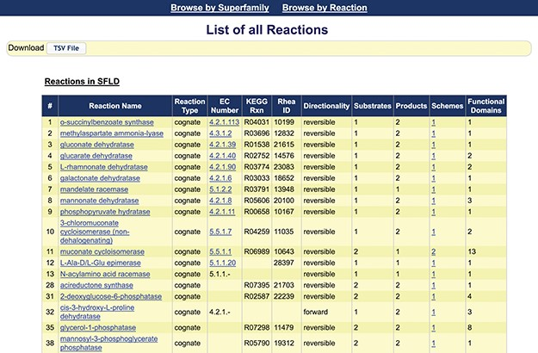
Figure 3 Screenshot of the first 18 reactions listed in the SFLD. The information available from this web page ...
Notes:
Figure 3 Screenshot of the first 18 reactions listed in the SFLD. The information available from this web page includes the assigned name of each reaction, reaction type, links to the EC number and identifiers for relevant outside resources, directionality (forward, backward and reversible) and counts of the number of substrates, products, reaction schemes and functional domains assigned by curators. (The complete reaction list includes some reactions curated using MEERCat but for which the associated protein-centric data is not curated in the public SFLD archive.) The left-most column represents the number of the unique SFLD reaction identifiers for each reaction in the downloadable TSV file of all the reactions available in the SFLD Archive.
Unless provided in the caption above, the following copyright applies to the content of this slide: © The Author(s) 2020. Published by Oxford University Press.This is an Open Access article distributed under the terms of the Creative Commons Attribution License (http://creativecommons.org/licenses/by/4.0/), which permits unrestricted reuse, distribution, and reproduction in any medium, provided the original work is properly cited.

