Slide 1
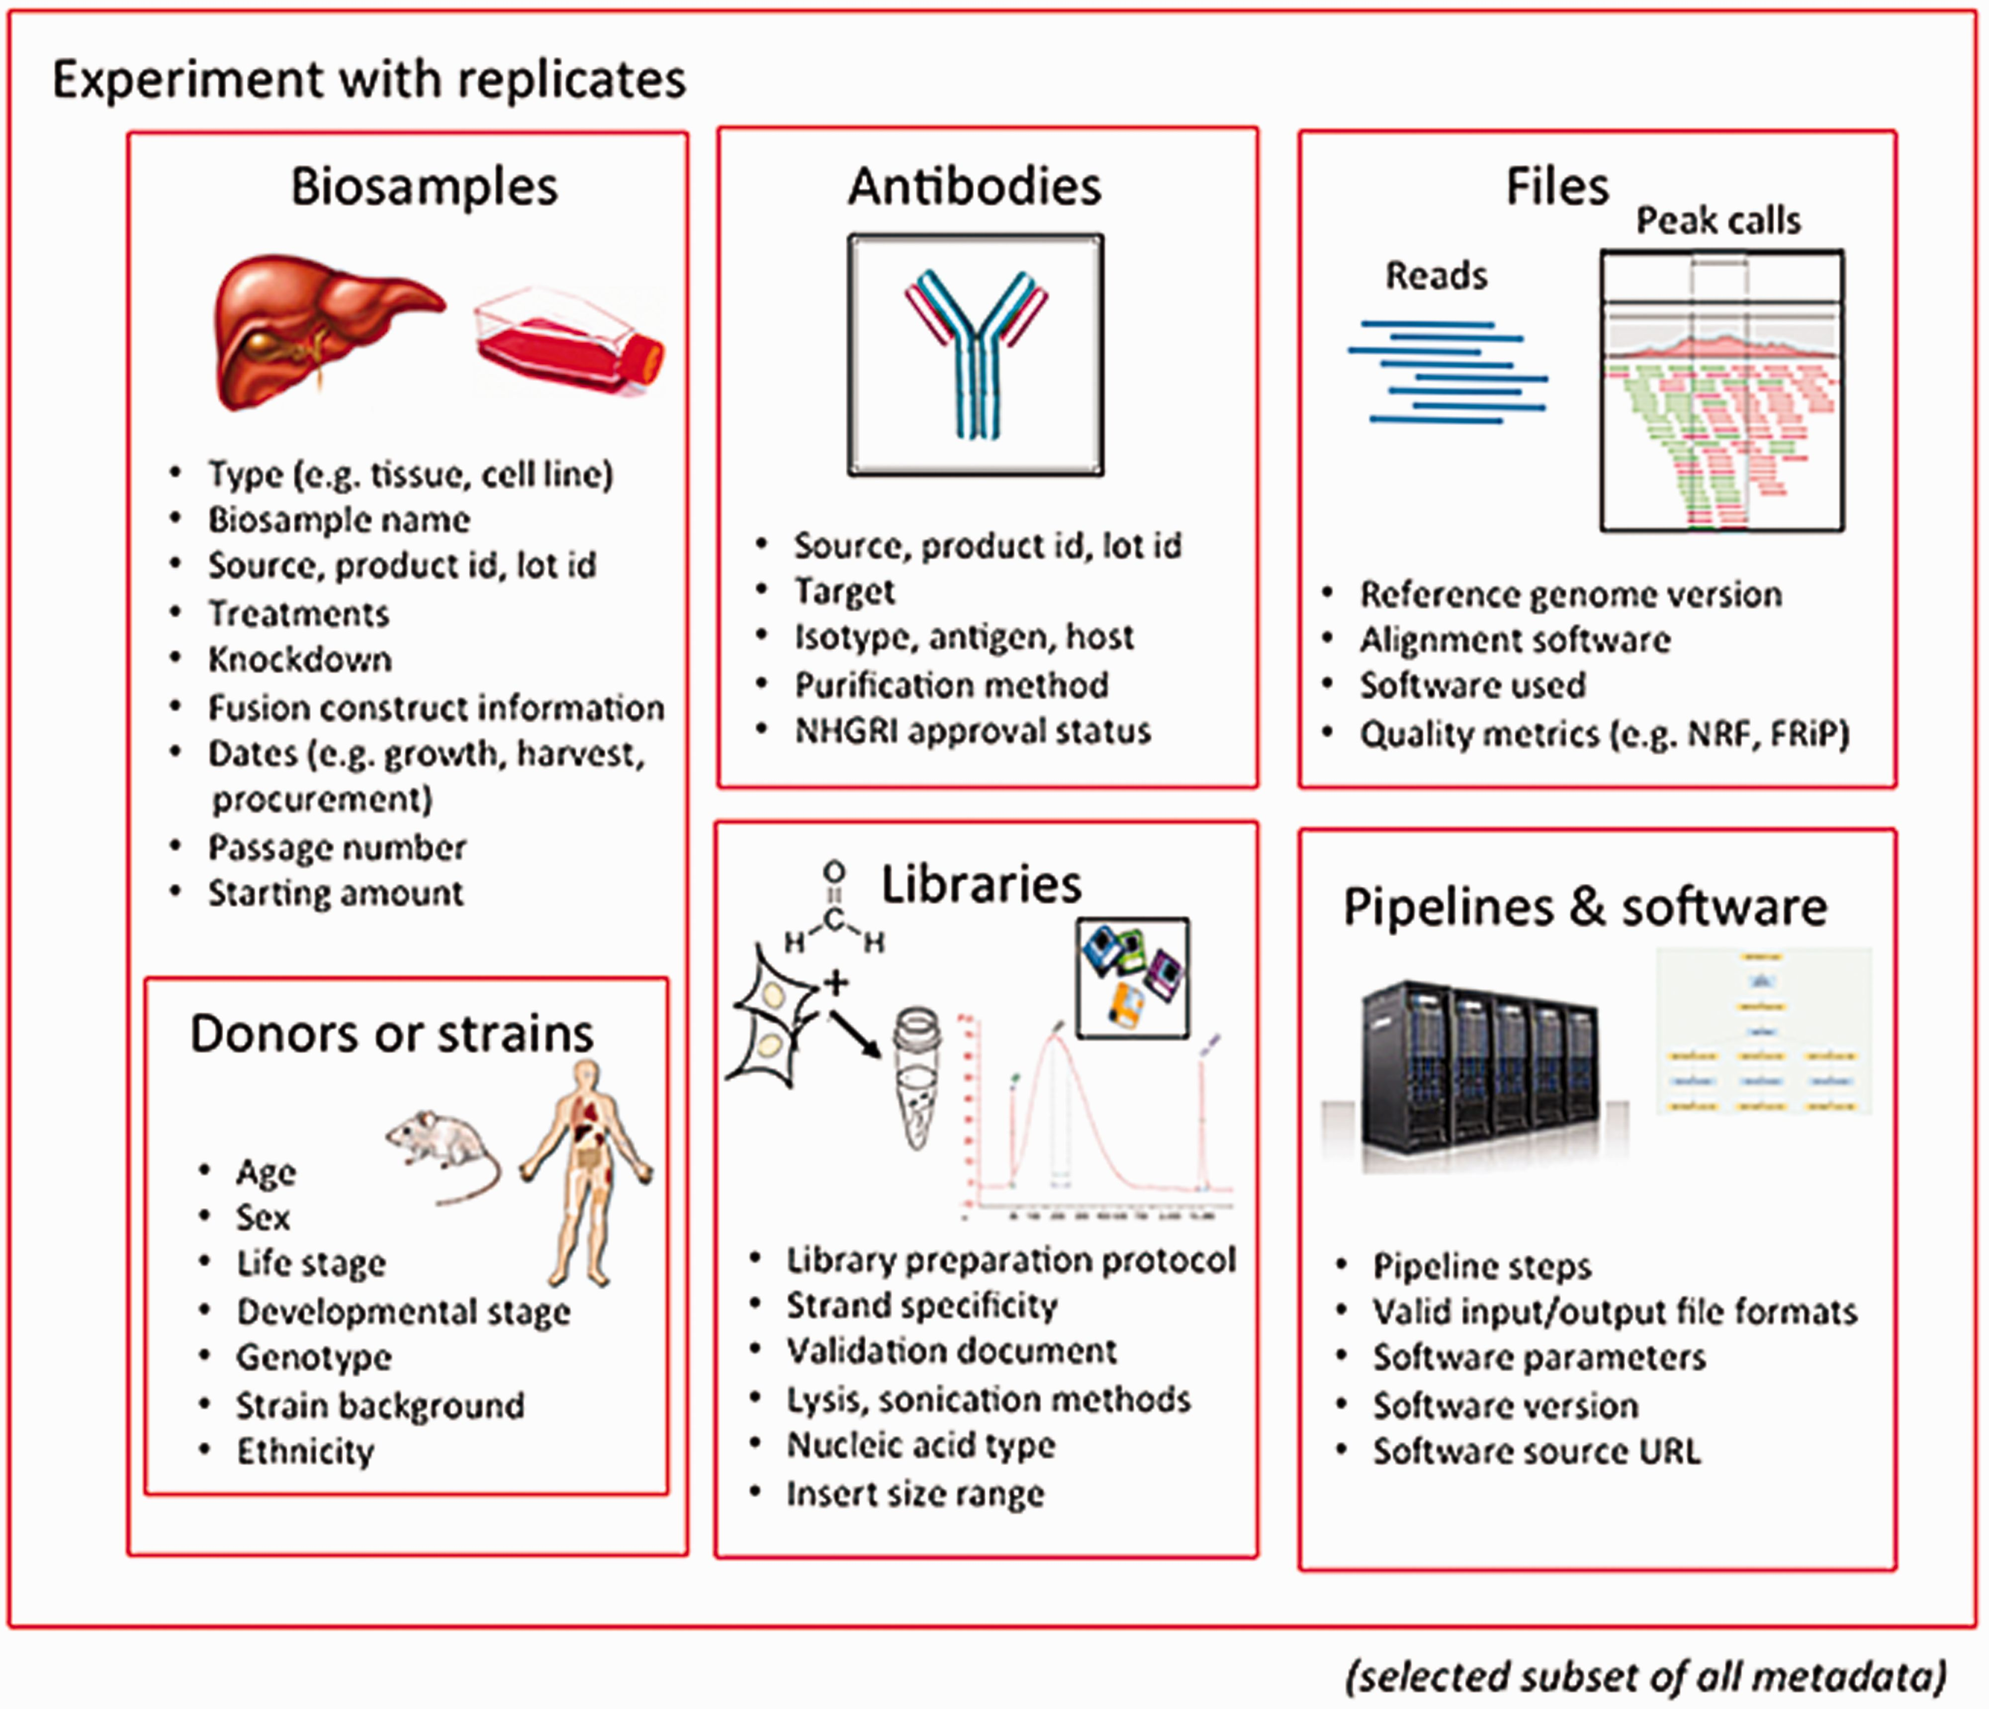
Figure 1 Major categories of metadata. The metadata captured for ENCODE can be grouped into the following major ...
Notes:
Figure 1 Major categories of metadata. The metadata captured for ENCODE can be grouped into the following major areas: biosamples and donors/strains (formerly ‘cell types’), libraries, antibodies, data files and pipelines and software. These categories are then grouped into an experiment with replicates. Only a subset of metadata is listed in the figure to provide an overview of the breadth and depth of metadata collected for an assay. The full set of metadata can be viewed at https://github.com/ENCODE-DCC/encoded/tree/master/src/encoded/schemas .
Unless provided in the caption above, the following copyright applies to the content of this slide: © The Author(s) 2016. Published by Oxford University Press. This is an Open Access article distributed under the terms of the Creative Commons Attribution License ( http://creativecommons.org/licenses/by/4.0/ ), which permits unrestricted reuse, distribution, and reproduction in any medium, provided the original work is properly cited.

