Slide 1
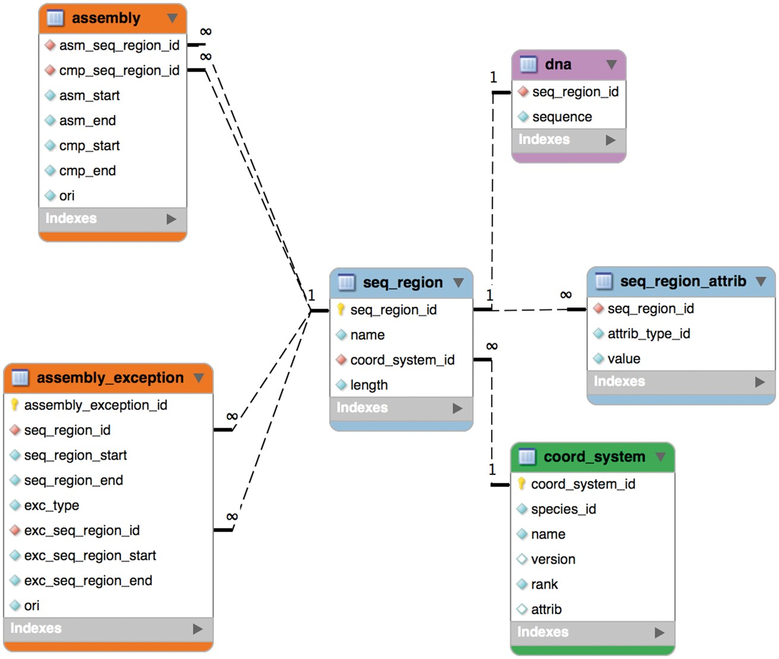
Figure 1. The core assembly schema.
Notes:
Figure 1. The core assembly schema.
Unless provided in the caption above, the following copyright applies to the content of this slide: © The Author(s) 2017. Published by Oxford University Press.This is an Open Access article distributed under the terms of the Creative Commons Attribution License (http://creativecommons.org/licenses/by/4.0/), which permits unrestricted reuse, distribution, and reproduction in any medium, provided the original work is properly cited.

Slide 2
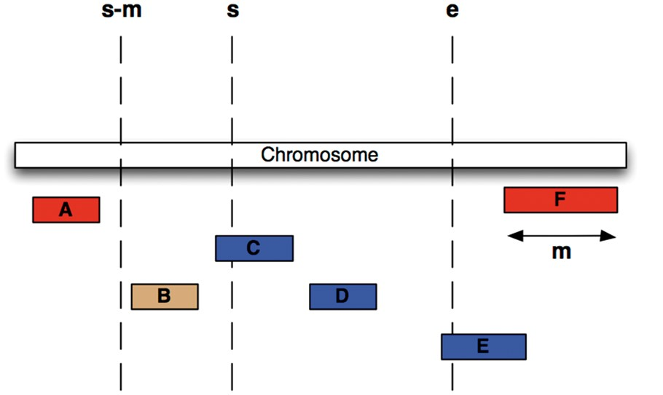
Figure 3. Efficient Searching of genomic features To find all features between coordinates s and e (i.e. C, D and E) in ...
Notes:
Figure 3. Efficient Searching of genomic features To find all features between coordinates s and e (i.e. C, D and E) in the situation were the maximum length of a feature for this coordinate system is m (i.e. the length of feature F), we extract all features whose start lies between s – m and e, then exclude B, since it ends before s.
Unless provided in the caption above, the following copyright applies to the content of this slide: © The Author(s) 2017. Published by Oxford University Press.This is an Open Access article distributed under the terms of the Creative Commons Attribution License (http://creativecommons.org/licenses/by/4.0/), which permits unrestricted reuse, distribution, and reproduction in any medium, provided the original work is properly cited.

Slide 3
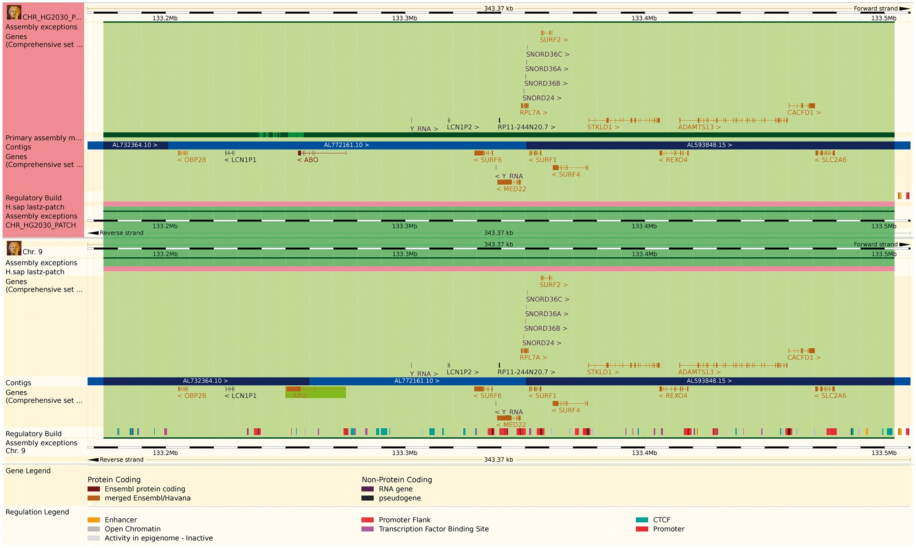
Figure 2. The Ensembl web browser can display the differences between a patch region and its equivalent in the primary ...
Notes:
Figure 2. The Ensembl web browser can display the differences between a patch region and its equivalent in the primary assembly. Genes that are present in both regions are identified as alt_alleles. (http://e87.ensembl.org/Homo_sapiens/Location/Multi?db=core;g=ENSG00000175164;r=CHR_HG2030_PATCH:133174055-133504218;r1=9:133173980-133504143:1;s1=Homo_sapiens–9).
Unless provided in the caption above, the following copyright applies to the content of this slide: © The Author(s) 2017. Published by Oxford University Press.This is an Open Access article distributed under the terms of the Creative Commons Attribution License (http://creativecommons.org/licenses/by/4.0/), which permits unrestricted reuse, distribution, and reproduction in any medium, provided the original work is properly cited.

Slide 4
Figure 4. This ID History Map for the SCARN4 gene ...
Notes:
Figure 4. This ID History Map for the SCARN4 gene (http://e87.ensembl.org/Homo_sapiens/Gene/Idhistory?g=ENSG00000281516) aligns Ensembl release numbers, genomic assembly versions, and version numbers of that gene across multiple Ensembl IDs. The different updates in the version ID are represented as a chain of small nodes, connected by lines. The colour of the line reflects how well consecutive versions match, for recent releases. If a score was not calculated (typically in older releases), the line is grey.
Unless provided in the caption above, the following copyright applies to the content of this slide: © The Author(s) 2017. Published by Oxford University Press.This is an Open Access article distributed under the terms of the Creative Commons Attribution License (http://creativecommons.org/licenses/by/4.0/), which permits unrestricted reuse, distribution, and reproduction in any medium, provided the original work is properly cited.

Slide 5
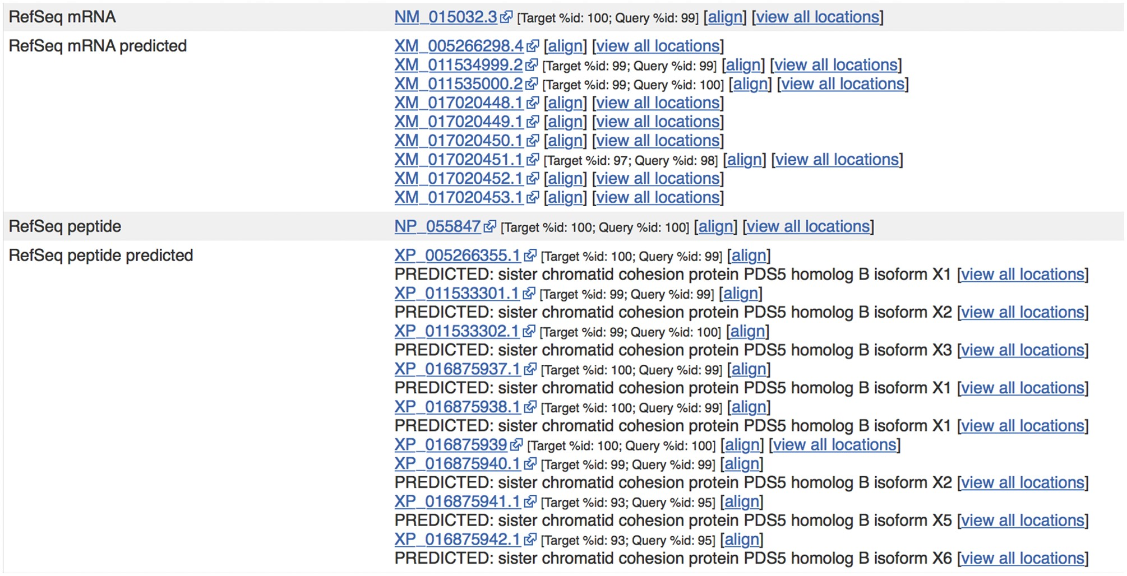
Figure 5. Sequences from external sources are aligned against Ensembl features. For ENST00000315596.14 ...
Notes:
Figure 5. Sequences from external sources are aligned against Ensembl features. For ENST00000315596.14 (http://e87.ensembl.org/Homo_sapiens/Transcript/Similarity?db=core;g=ENSG00000083642;r=13:1-50000000;t=ENST00000315596), a number of predicted RefSeq peptide sequences have been aligned with small mismatches. The curated RefSeq peptide NP_055847 aligns perfectly but the corresponding mRNA sequence, NM_015032.3, does not, indicating that there is a difference in the UTR sequence of this transcript.
Unless provided in the caption above, the following copyright applies to the content of this slide: © The Author(s) 2017. Published by Oxford University Press.This is an Open Access article distributed under the terms of the Creative Commons Attribution License (http://creativecommons.org/licenses/by/4.0/), which permits unrestricted reuse, distribution, and reproduction in any medium, provided the original work is properly cited.

