Slide 1
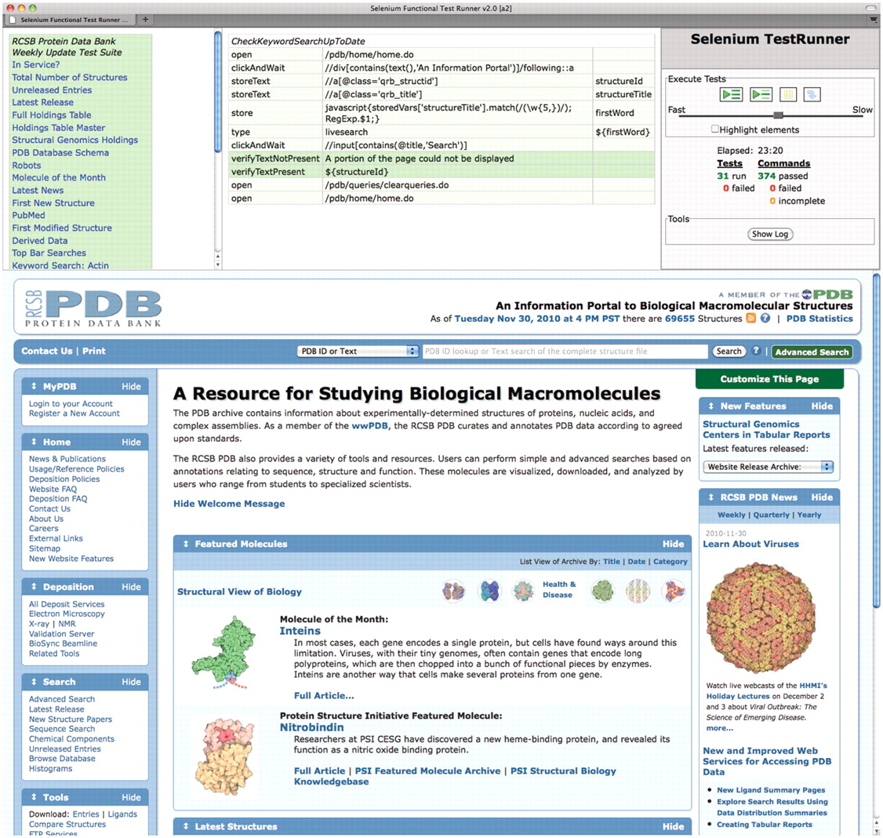
Figure 3. Screenshot of fully executed Selenium IDE test suite in a Firefox browser. We have developed an extensive ...
Notes:
Figure 3. Screenshot of fully executed Selenium IDE test suite in a Firefox browser. We have developed an extensive suite of testing scripts with several goals such as checking key elements of the user interface, verifying the integrity of the weekly update, and comparing results between multiple servers. The top-left panel shows the list of test scripts. The top-middle panel shows as an example the script for verifying that keyword searches are up to date. It selects the first entry ID from the weekly release, extracts a keyword from its title, and then performs a search for this keyword and asserts that the search results include the given entry ID. The top-right panel contains the controls for executing tests and shows the test results. The bottom panel is a regular browser window that shows the web pages being loaded by the scripts.
Unless provided in the caption above, the following copyright applies to the content of this slide: © The Author(s) 2011. Published by Oxford University Press.This is Open Access article distributed under the terms of the Creative Commons Attribution Non-Commercial License (http://creativecommons.org/licenses/by-nc/2.5), which permits unrestricted non-commercial use, distribution, and reproduction in any medium, provided the original work is properly cited.

