Slide 1
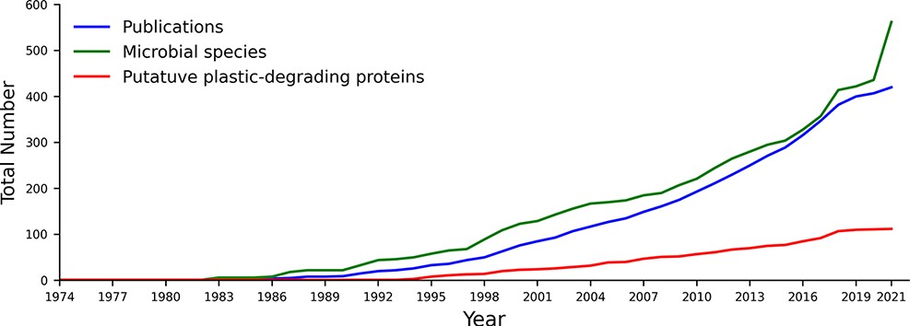
Figure 1. The cumulative number of publications, microbial species and proteins reported to degrade plastics between ...
Notes:
Figure 1. The cumulative number of publications, microbial species and proteins reported to degrade plastics between 1974 and August 2021. All included data fit our criteria for putative plastics degradation, as outlined in the methods.
Unless provided in the caption above, the following copyright applies to the content of this slide: © The Author(s) 2022. Published by Oxford University Press.This is an Open Access article distributed under the terms of the Creative Commons Attribution License (https://creativecommons.org/licenses/by/4.0/), which permits unrestricted reuse, distribution, and reproduction in any medium, provided the original work is properly cited.

