Slide 1
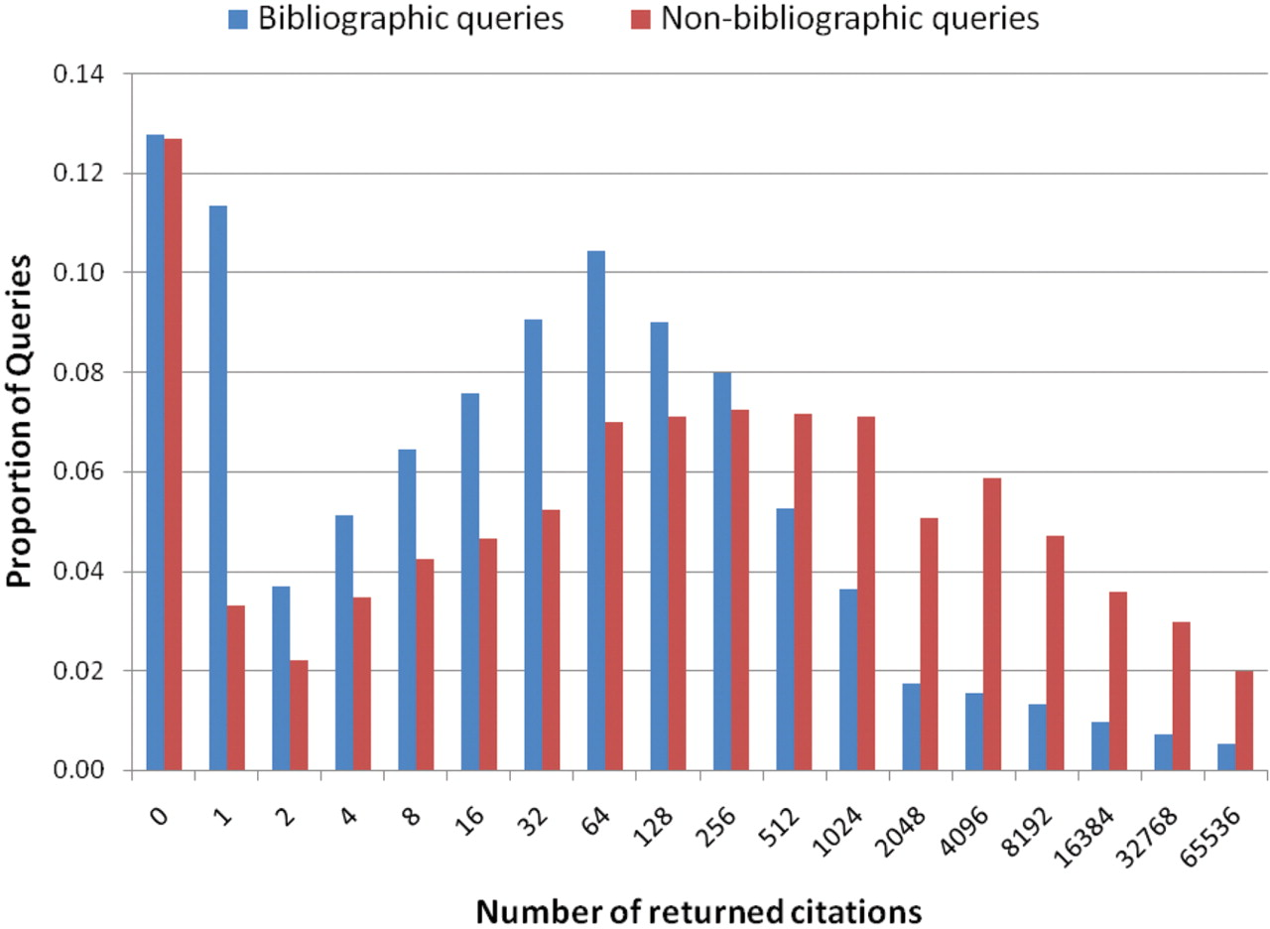
Figure 6. Distribution of bibliographic queries (author name, journal name, title and other citation information) and ...
Notes:
Figure 6. Distribution of bibliographic queries (author name, journal name, title and other citation information) and non-bibliographic queries (disorder, gene/protein, research or medical procedure, device, body part, cell, tissue or living being) according to their result set size.
Unless provided in the caption above, the following copyright applies to the content of this slide: © The Author(s) 2009. Published by Oxford University Press.This is Open Access article distributed under the terms of the Creative Commons Attribution Non-Commercial License (http://creativecommons.org/licenses/by-nc/2.5/uk/) which permits unrestricted non-commercial use, distribution, and reproduction in any medium, provided the original work is properly cited.

