Slide 1
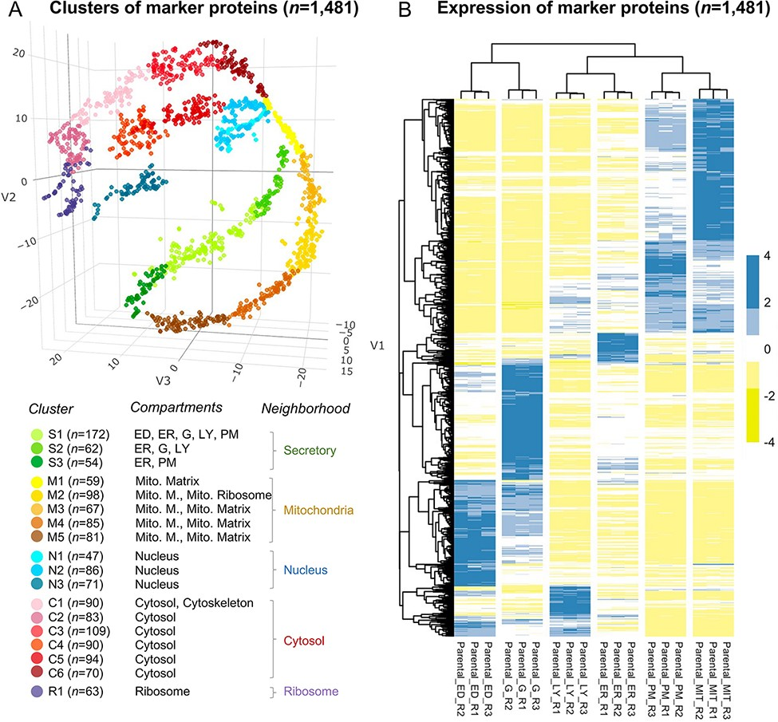
Figure 2. The annotation of the selected 1481 marker proteins. (A) A three-dimensional visualization for 18 clusters of ...
Notes:
Figure 2. The annotation of the selected 1481 marker proteins. (A) A three-dimensional visualization for 18 clusters of marker proteins. Different colors represent clusters or neighborhoods. The number of marker proteins classified in each cluster was shown in brackets. Annotation for the subcellular compartments/organelles and their corresponding neighborhoods was present. ED, endosome; ER, endoplasmic reticulum, G, golgi apparatus; LY, lysosome; PM, plasma membrane; Mito, mitochondria; Mito. M., mitochondria membrane. (B) Differential expression of the selected marker proteins in organelles. R, replicate.
Unless provided in the caption above, the following copyright applies to the content of this slide: © The Author(s) 2022. Published by Oxford University Press.This is an Open Access article distributed under the terms of the Creative Commons Attribution License (https://creativecommons.org/licenses/by/4.0/), which permits unrestricted reuse, distribution, and reproduction in any medium, provided the original work is properly cited.

