Slide 1
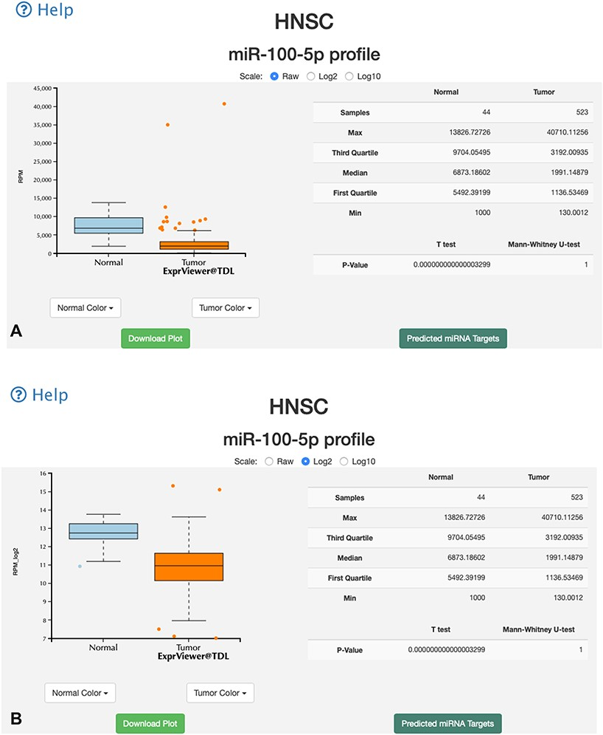
Figure 3 Overall-overview miRNA expression interface of miR-TV. (A) A new box plot graph window opens when the user ...
Notes:
Figure 3 Overall-overview miRNA expression interface of miR-TV. (A) A new box plot graph window opens when the user clicks on a specific cancer type for interrogation. The default expression scale is RPM values. (B) Users can change the y-axis scale to a Log2 or Log10 scale by using the scale buttons at the top. (C) To obtain a better illustration of all patient samples, users can click on the box-shaped regions in either of the Normal or Cancer groups and the box plots will instantly transform into scatter plots. Double clicking the scatter plot smoothly reverts the scatter plot back to a box plot. Each dot represents one patient sample, and moving the mouse over each dot reveals TCGA sample ID, clinical information and miRNA expression value. (D) Two color change buttons are available below the graph plot area. Users can change the Normal group or Cancer group colors according to their preference.
Unless provided in the caption above, the following copyright applies to the content of this slide: © The Author(s) 2020. Published by Oxford University Press. All rights reserved. For Permissions, please email: journals.permissions@oup.comThis is an Open Access article distributed under the terms of the Creative Commons Attribution License (http://creativecommons.org/licenses/by/4.0/), which permits unrestricted reuse, distribution, and reproduction in any medium, provided the original work is properly cited.

